Slide 1
(SIGGRAPH 2010) Street Slide: Browsing Street Level Imagery
Johannes Kopf Billy Chen Richard Szeliski Michael Cohen
Microsoft Research Microsoft Microsoft Research Microsoft Research

Slide 2
Outline
Introduction
Related Work
As-Perspective-as-Possible
Hyper-Perspective
User Study
Future Work

Slide 3
Introduction
Constructing the Street Slide application is to provide a seamless means to explore the details of individual bubbles while also being able to navigate efficiently and intuitively along the streets.

Slide 4
Introduction
the imagery is captured by a 10 camera panoramic rig mounted on top of a car
multi-perspective panoramas
interpolation between multi-perspective and single perspective panoramas
intuitive user interface including annotations for adding information and navigation affordances

Slide 5
Related Work
Taking online maps down to street level
[Vincent 2007]
Photographing long scenes with multi-viewpoint panoramas [Szeliski 2006] (Fast Fourier Transforms to efficiently perform)
Image-based interactive exploration of real-world environments [Uyttendaele et al. 2004]

Slide 6
Transitions between Bubbles and Street Slide
starting from within a bubble
zoom out and approach a field of view of 90°
zooming out beyond 90° triggers a cross fade from the wider projection of the bubble to the multi-perspective panorama

Slide 7
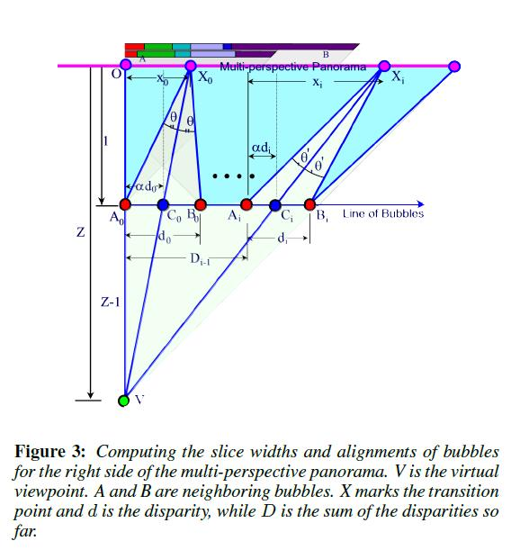
An As-Perspective-as-Possible Panorama Algorithm
V - the location of the simulated viewpoint
Z - some distance from the origin
- vertical columns
capture original images at
d - The alignment distance (horizontal disparity) between bubbles A and B

Slide 8
An As-Perspective-as-Possible Panorama Algorithm
1. initialize x = 1, i.e. select the full extent of bubble A.
2. find d that aligns bubbles A and B at X.
3. determine α such that is bisected.
4. given d and α, based on similar triangles and , reset
5. repeat steps 2-4 until x converges.

Slide 9
An As-Perspective-as-Possible Panorama Algorithm
In practice, initialize α = 0.5
reset α = and repeat for 10 iterations
accumulated offsets are summed into d

Slide 10
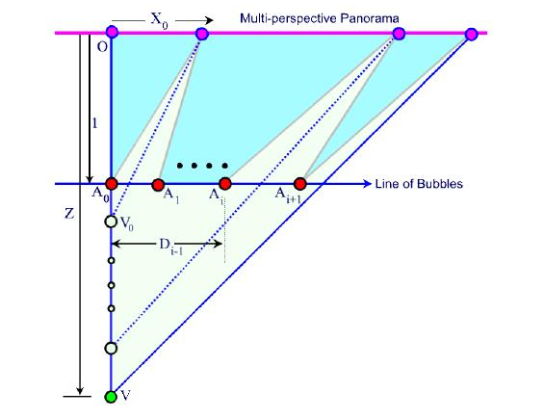
A Hyper-Perspective Panorama
a second closely hyper-perspective - accentuates the center of the panorama
The value of 0.35 was selected to create a minimum field of view of the central slice of 40°

Slide 11
A Hyper-Perspective Panorama
first compute the alignment for the first pair of images (at ) and set
take the distance along the “Line of Bubbles”, which is
stretch it to cover the remaining pixels along the top row, which is

Slide 12
Discussion of the Alternative Constructions
First, looking down a crossing street is better captured by a wider view from near the intersection rather than from a long distance.
Second, the hyper-perspective tends to hide alignment artifacts better , i.e. when there are multiple depths in a local region, which is especially the case at intersections.

Slide 13
Image Alignment
precompute the disparity between each pair of neighboring bubbles at 11 different vertical columns
each alignment is performed offline using a simple SSD (sum of squared differences) minimization
align a 64 by 128 pixel rectangle lying just above the midline and just inside the column to be aligned

Slide 14
Rendering the Multi-Perspective Panorama
alignment errors due to non-planar scenes are mitigated by rendering the slices with alpha blended feathering of the slice boundaries
trim off the top 3% and bottom 15% of the slice height to create the final multi-perspective panorama

Slide 15
Annotations
ratio of the street slide leaves unused screen real estate above and below the multi-perspective panorama
street names lie directly above the strip with building numbers
icons containing store names and/or logos below the strip

Slide 16
User Study
Google Street View VS. Street Slide
- Seattle’s downtown
- A 5 minute introduction about
GSV - jump to discrete locations
SSL - hyper-perspective construction
- 20 subjects
all heavy computer users
ranging in age from 25 to 55
all but one were male

Slide 17
User Study
each subject was then tested 8 times
four times with each interface, either 4 GSV’s followed by 4 SSL’s, or vice-versa.
the subject was given one of 8 images of a building front to find as a goal
placed goals at approximately 25, 50, 100, and 200 meters from the starting positions in randomized order within each

Slide 18
Study Results
Familiarity:
-four familiar with downtown
Seattle
-six familiar with GSV
Ease of Finding the Goal:
-18 of the 20 subjects
found it easy or very easy
with SSL
Timings:
-100m : GSV=2.5*SSL
-200m : GSV=3*SSL

Slide 19
Future Work
currently have processed about 2400 panoramas covering about 4 kilometers on 6 streets with 8 intersections
integrating our viewer into a larger database containing millions of bubbles of street level imagery

Slide 20
Future Work
supplied annotations can be imagined such as allowing users to add comments tied to specific locations while browsing in Street Slide
to new modalities for remotely exploring the full richness of visual imagery from around the world

