Slide 1
Using Structural Information for Identifying Similar Chinese Characters
HLT’ 08
Chao-Lin Liu
Jen-Hsiang Lin
Department of Computer Science
National Chengchi University
Notes:
政大
應用結構信息識別類似中文字
HLT : Human Language Technologies

Slide 2
Abstract
Introduction
Overview
It is possible for us to employ image-based methods to identify visually similar characters, the resulting computational costs can be very high.
In this paper propose methods for identifying visually similar Chinese characters by adopting and extending the basic concepts of a proven Chinese input method—Cangjie(倉頡).
Conclusions
1 / 12
Notes:
中文字在讀音或內部結構上具有相似性，但如果直接用基於影像的方法，代價會相當高
他們提出的方法，打算採納倉頡作為基礎

Slide 3
Introduction
Overview
There are Chinese characters that are pronounced or written alike.
Pronounced
In Chinese, the sentence “今天上午我們來試場買菜” contains an incorrect word.
We should replace “試場” (a place for taking examinations) with “市場” (a market).
Written
The sentence “我構買一部計算機” also contains an error, we need to replace “構買” with “購買”.
“構買” is considered an incorrect word, but can be confused with “購買” because the first characters in these words look similar.
Conclusions
2 / 12
Notes:
在中文中，時常會打錯字
上面是拼音相似，底部是字型的相似

Slide 4
Identifying Similar
Introduction
Overview
Examples of Similar Chinese Characters0
Conclusions
3 / 12
Notes:
三種容易讓人搞混的中文字
第一部分:
差別在於多一點少一點
第二部分:
每個字都有部分相同，且讀音不一定同
第三部分:
讀音和字形相似，這種最容易被使用者搞混

Slide 5
Introduction
Overview
It is intriguing to resort to image processing methods to find such structurally similar words, but the computational costs can be very high.
The Ministry of Education in Taiwan suggests that about 5000 characters are needed for ordinary usage. In this case, there are about 25 million pairs.
Conclusions
4 / 12
Notes:
我們可以用圖形處理的方法，但是對於22000個中文字來說，處理會相當耗時，必須處理到約4.9億次
在台灣教育部提供的5000常用字，需要處理2500萬次
所以需要適當的移動位置，來尋找共同的部分來使的圖像處理的方式更有效率

Slide 6
Introduction
Overview
The shared components in these groups are radicals of the characters, so we can find the characters of the same group in the same section in a Chinese dictionary.
e.g., “頸”and “勁”
Conclusions
5 / 12
Notes:
我們可以發現有些字的部分是相同的
像頸跟勁做邊是一樣的

Slide 7
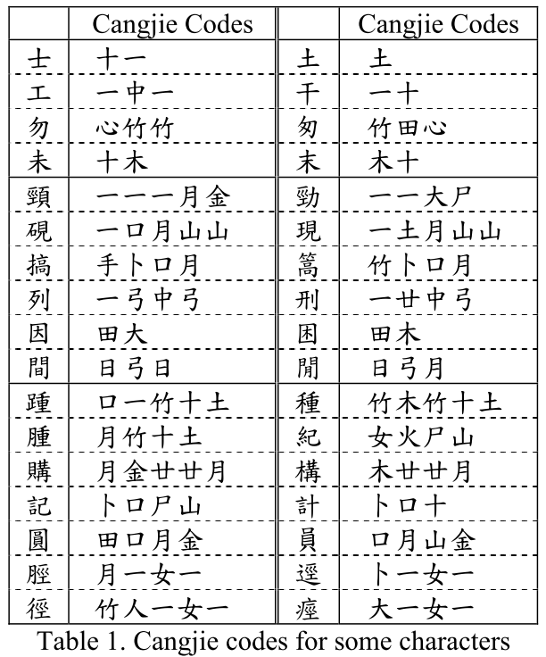
Introduction
Overview
Encoding the Chinese Characters (Cangjie)
Conclusi0ns
6 / 12
Notes:
中文字編碼
中文字的倉頡編碼
倉頡是利用中文24個字符的基本要素，並使用一套規則分解中文字

Slide 8
Introduction
Overview
Every Chinese character is decomposed into an ordered sequence of elements.
Drawbacks
Cangjie codes do not appear to be as helpful for identifying the similarities between characters that differ subtly at the stroke level, e.g., “士土工干
The Cangjie codes for characters that contain multiple components were intentionally simplified to allow users to input Chinese characters more efficiently.
Conclusions
7 / 12
Notes:
每個中文字都可被分解為倉頡序列，這些元素都是這個字的重要組成部分。
1.倉頡法不適合用在只有些微差別的字上面 EX: 士土工干
2.倉頡碼是已經被簡化處理過，方便使用者輸入，所以最長不超過5個符號來代表一個字
簡化導致字符與實際看起來相差甚遠

Slide 9
Engineering the Original Cangjie Codes
Introduction
Overview
Some characters can be decomposed vertically
“盅”can be split into two smaller components, “中” and “皿”
Some characters can be decomposed horizontally
“現” is consisted of “王” and “見”
Some have enclosing components
“人” is enclosed in “囗” in “囚”.
Conclusions
8 / 12
Notes:
關於中文圖形的結構可以拆解
例如:
(垂直)盅 --> 中皿
(水平)現 --> 王見
(封閉)囚 --> 人口
因此可以考慮，分解位置、共享組件數量來確定字的相似程度

Slide 10
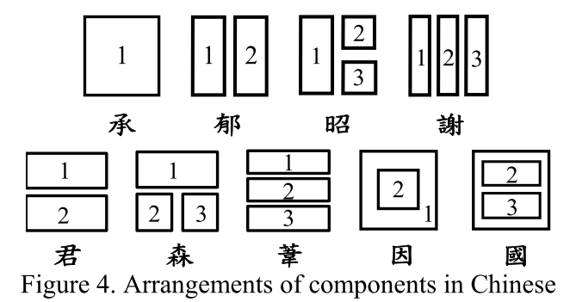
Introduction
Overview
A box in a layout indicates a component in a character, and there can be at most three components in a character.
Conclusions
9 / 12
Notes:
一個框框代表一個字的組件，一個字最多可以用3個框框

Slide 11
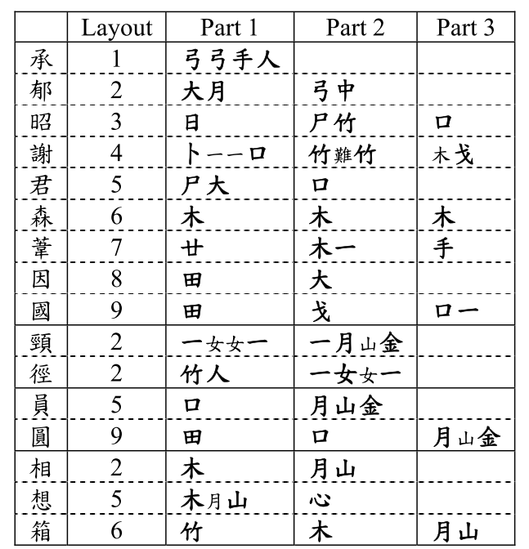
Introduction
Overview
Conclusions
10 / 12
Notes:
他們回復了原本的倉頡，使他們做出來的table2比簡化的table1還要更能比較出相似的文字，

Slide 12
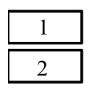
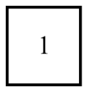
Drawbacks of Using the Cangjie Codes
Introduction
Overview
Cangjie codes for some characters, particular those simple ones, were not assigned without ambiguous principles.
“分”
“兑”
Conclusions
11 / 12
Notes:
有一些特殊的字，它的定義不明確，這種很難利用倉頡來做相似度比對，
例如分、兑 看起來分割類型應該是一樣的
分是上下切割，是layout5的屬性，
兑是整體沒有切割，是屬於layout1的屬性

Slide 13
Introduction
Overview
In this paper adopt the Cangjie alphabet to encode Chinese characters, but choose not to simplify the code sequences, and annotate the characters with the layout information of their components.
The resulting method is not perfect, but allows us to find visually similar characters more efficient than employing the image-based methods.
Conclusions
12 / 12
Notes:
他們採用倉頡但是不是用簡化過後的倉頡，然後用他們定義的Layout去註解每一個字
雖然他們提出的方法不是非常完美，但是比起直接用圖像資訊來說，能更有效率地找出相似字

Slide 14
LSH-Based Large Scale Chinese Calligraphic Character Recognition
JCDL’13
Yuan Lin
Jiangqin Wu
Pengcheng Gao
Yang Xia
Tianjiao Mao
College of Computer Science
Zhejiang University Hangzhou
Notes:
浙江大学
基於LSH的大型中文書法辨識

Slide 15
Abstract
Introduction
Overview
Nowadays more and more calligraphic works are digitized, preserved and exhibited in digital libraries.
But, for common users sometimes recognizing some of the calligraphic characters is somewhat difficult.
EXPERIMENTS
1)風
2)有
3)類
4)長
1 / 9
Notes:
現在越來越多的書法作品數位化，方便保存和展出的在數位圖書館。
但對於一般人來說，有些字很難辨認，如圖一

Slide 16
Introduction
Overview
This paper used commercial software Hanvon(漢王) to recognize 100 binary character images randomly selected from the Internet, only seven of these characters were correctly recognized.
EXPERIMENTS
2 / 9
Notes:
但是傳統OCR對於書法沒辦法很好的識別
他們用漢王(OCR)辨識100個，只有7個可以認出來

Slide 17
Introduction
Overview
OCR technology is not suitable for Chinese calligraphic recognition.
This is mainly due to：
1)Complexity
Different writing styles exist in Chinese calligraphy
2)Deformation
Strokes are not regular in calligraphic characters(connected with each other or broken).
3)Degradation
Calligraphic works tend to be degraded by natural changes
EXPERIMENTS
3 / 9
Notes:
所以一般OCR不適合用來作書法字辨識
1)Complexity(複雜)
在中國存在著不同的寫作風格書法，如篆書，隸書，楷書，行書和草書，有些還會互相混雜，此外作者也會用不同的寫作風格寫同一個字
2)Deformation(變形)
筆劃是不正規的書法字，在某些筆劃彼此連接和一些被破壞。
3)Degradation(簡化)
毛筆字往往會自然的化簡一些筆畫

Slide 18
CHINESE CALLIGRAPHIC CHARACTER RECOGNITION
Introduction
Overview
Binaryzation: Binarize all the calligraphic character images
$C_{i}$( i = 1~m) in CCD into binary image $B_{i}$ ( i = 1~m)
Representation:
Extract $B_{i}$’ s GIST feature represented as a point $p_{i}$ in ${\text{ℝ}}^{d}$
d is dimension of GIST feature vector
Storage :
Storage: Store each $p_{i}$( i = 1~m) in the bucket
EXPERIMENTS
CCD : Calligraphic Character Dictionary
4 / 9
Notes:
1)圖片二質化(Bi)
2)處理 : 取得Bi的特徵紀錄為Pi
3)保存 : 把pi放到 Hash 裡面，在 3.3 與 4.1有詳細
GIST 是一種局部特徵萃取的方法

Slide 19
Calligraphic Character Image Representation
Introduction
Overview
Before the computation need to normalize the character images to the same size.(60x60)
In this paper use 8 orientations and 3 scales and output magnitude of each filter is averaged over 9 non-overlapping windows arranged on a 3x3 grid.
So the final character image representation is a 3 x 8 x 9 = 216 dimensional vector, which can be seen as a point p in ${\text{ℝ}}^{d}$ (d = 216)
EXPERIMENTS
GIST descriptors
5 / 9
Notes:
書法字影像的表示法
在開始前都先等化為60X60像素，它們說這樣就夠表達這個字了，不需要圖像的細節
在本篇利用8個方向與三種尺度，然後將輸出放在3*3的網格中
所以會用3*8*9=216個維度代表一個字

Slide 20
Similarity Searching
Introduction
Overview
EXPERIMENTS
q : query point
$p_{i}$ : $B_{i}$’ s GIST feature represented
d : dimensional (216)
6 / 9
Notes:
q : 查詢點
d : 特徵維度 j = 1~d
Pi : 所有二質化圖片特徵紀錄為Pi

Slide 21
Recognition
Introduction
Overview
Only take the first fifteen similar character images as the candidate character images if the number of similarities is beyond this. ($C_{1}\sim C_{15}$)
EXPERIMENTS
7 / 9
Notes:
計算權重
Wi 是權重
i 是排第幾順位

Slide 22
Introduction
Overview
Suppose there are X annotated characters $A_{1}\sim A_{X}$for the N(15) candidate character images. And $n_{i}$ images $C_{i_{1}}$~ $C_{i_{ni}}$are the calligraphic character images whose annotated character is $A_{i}$.
EXPERIMENTS
The probability that $C_{q}^{′}s$ meaning is $A_{i}$ is
8 / 9
Notes:
假設有x個註解文字${ A}_{1}\sim A_{X}$ for的N（ 15 ）的候選字符圖像。 $n_{i}$ 圖像${ C}_{i_{1}}$~ $C_{i_{ni}}$ 的書法字圖像是在註釋字符𝐴_𝑖 。
(有ni張圖是在講同一個字)
以(離)字舉例:
有10個候選字，他有A(離、雖)，>X=2
但是有
A(離)有8個->ni
A(雖)有2個->ni

Slide 23
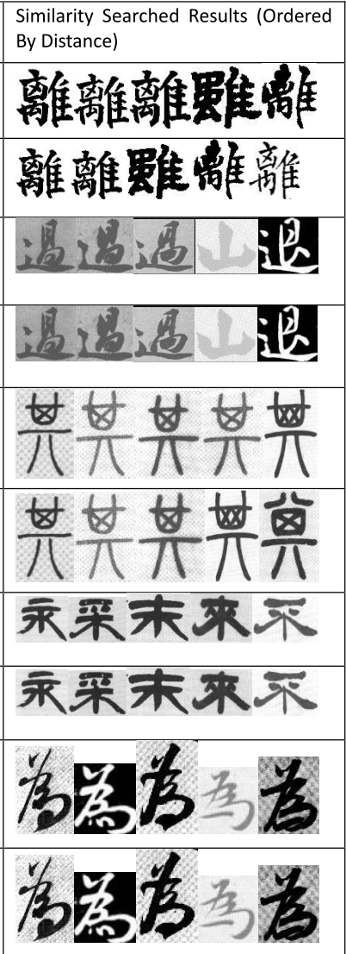
Introduction
Overview
EXPERIMENTS
9 / 9

Slide 24
Spell Checking for Chinese
LREC’12
Shaohua Yang
Hai Zhao
Xiaolin Wang
Bao-liang Lu
Department of Computer Science and Engineering
Shanghai Jiao Tong University
Notes:
Language Resources and Evaluation Conference
拼寫檢查中國

Slide 25
Abstract
Introduction
Overview
In this paper, a concise algorithm based on minimized-path segmentation is proposed to reduce the cost and suit the needs of current Chinese input systems.
Typically, the 2,500 most widely characters can cover 97.97% of text, while 3,500 can cover 99.48% of text.
EXPERIMENTS
1 / 10
Notes:
在本文中，提出了一種基於最短路徑分割的一個簡潔算法來降低成本，適應目前的中文輸入系統的需求。
通常情況下， 2500最廣泛的字符可以覆蓋文字的97.97 ％，而3500可以覆蓋文字的99.48 ％ 。

Slide 26
Introduction
Overview
Spelling errors can be roughly put into two main categories.
1) non-word spelling error, in which the input word’s form is deﬁnitely incorrect and cannot be found in any dictionary.
using ‘fcrm’ rather than ‘farm’
2) real-word spelling error, in which the input word’s form can be found in the dictionary but is incorrectly used.
using ‘come form’ not‘come from’
EXPERIMENTS
2 / 10
Notes:
中文錯誤大致上分為兩種
1) non-word spelling error
這種事明確的錯誤，無法在任何的字典中找到
2) real-word spelling error
是一個詞，但是用法不對

Slide 27
Chinese Input System and Spelling Errors
Introduction
Overview
Reports of empirical studies shows that spelling errors in Chinese text mostly depend on the way Chinese is typed into the computer, not on how well users have mastered this language.
EXPERIMENTS
3 / 10
Notes:
中文的錯誤通常是因為輸入法的關係，而不是對中文的掌握不足。
中國常用的輸入法是利用羅馬拼音，這個通知有很多相同拼音的字，很容易選錯

Slide 28
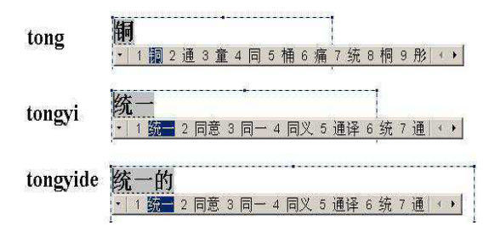
Introduction
Overview
Researchers observed that the uncertainty with which a Pinyin sequence is translated into a hanzi sequence may be greatly reduced if longer Pinyin sequences are input, thus more and more modern pronunciation-based CIS make use of this fact and handle longer and longer Pinyin sequences.
EXPERIMENTS
4 / 10
Notes:
研究者觀察到如果拼音越長越可以增加確定性，所以輸入長的拼音可以極大的減少輸入錯誤
如果輸入 tong : 會有符合的九個結果
Tongyi :會有五個
Tongyide : 只有一個結果

Slide 29
Approach using Minimized-Path Segmentation
Introduction
Overview
This is a Viterbi-style algorithm to search for the best segmentation for a given text T
EXPERIMENTS
$W_{i}$ : legal word
5 / 10
Notes:
最短路徑法
Wi 是合法的字
S* 是文章T的最佳分割
n 是分割路徑的長度

Slide 30
Introduction
Overview
The algorithm ﬁrst takes the output of a minimized-path word segmentation which aims to minimize the number of words based on a dictionary.
Then used some similar word replacement from the given word list so that the path length can be reduced.
EXPERIMENTS
6 / 10
Notes:
該算法首先需要輸出的最小路徑分詞，目的是盡量減少基於字典的單詞數。
然後找一些相似的字做替換，減少路徑的長度，如果路徑有確實簡短，表示該句中有誤用的字

Slide 31
Approach using Statistical Criteria
Introduction
Overview
Need large text sample T to calculate the logarithmic probabilities and a confusion set to get candidate errors.
Build the confusion set by utilizing the Pinyin
If the Pinyin is the same for two hanzi characters, they are in the same confusion set.
EXPERIMENTS
7 / 10
Notes:
使用統計標準的方法
使用這種方法需要大量的文件去計算對數機率，此外他們還要一組混亂的集合來取得錯誤候選
他們利用拼音建立混亂集合，
如果兩個字詞但是拼音一樣，那就會在同一個混亂集合內

Slide 32
Language Model(LM)
Introduction
Overview
If a character incorrectly occurs, then it should signiﬁcantly change bigram probabilities (which can be estimated well by a language model) in which it is involved.
EXPERIMENTS
8 / 10
Notes:
因為如果出現錯誤的字，那他的bi-gram 機率就會有顯著的變化
舉例來說有字串”我是誰”，用 bi-gram切割，那會出現”我是”、”是誰”，當用一個錯誤的”視”取代”是”，那”我視”和”視誰”頻率就會下降。

Slide 33
Introduction
Overview
Mutual information of two characters is deﬁned as
EXPERIMENTS
MI indicates how possible two characters are collocated together.
if both MI($h_{−1}$ , $h_{1}$) − MI($h_{−1}$ , h) > β and MI($h_{2}$ , $h_{+1}$) − MI(h ,$h_{+1}$) > β for hanzi sequence $h_{−1} h h_{+1}$in which $h_{1}$ and $h_{2}$ are the values to get the largest mutual information’s value, then we say h may be a spelling error candidate.
$h_{1}$ and $h_{2}$ are h’s candidates
9 / 10
Notes:
用兩個字的交互資訊
L1L2是代表
h(-1)h和hh(+1)這兩組的可能性
h1和h2是h這個字的候選字，放進去後取出一個最大的可能性
如果L1'-L1 > 閥值，且L2'-L2 > 閥值
那h 這個字就是一個錯字
如果兩個都大於β 那麼我們說h可以是一個拼寫錯誤。

Slide 34
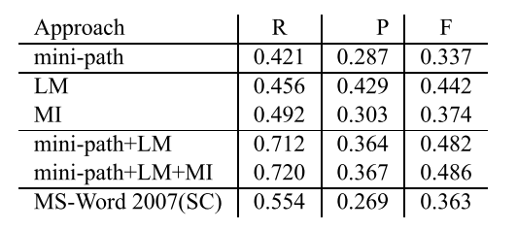
Introduction
Overview
EXPERIMENTS
F-score = 2RP/(R + P )
The recall R is the ratio of the correctly identified spelling errors of the checker’s output to all spelling errors in the gold-standard.
The precision P refers to the ratio of the correctly identified spelling errors of the checker’s output to all identified errors of the checker’s output.
10 / 10
Notes:
R : 是所有拼寫錯誤和檢測出有錯誤的字的比率
P : 精度是指檢測錯誤率

Slide 35
Introduction to CKIP Chinese Spelling Check System for SIGHAN Bakeoff 2013 Evaluation
SIGHAN’ 13
Yu-Ming Hsieh
Ming-Hong Bai
Keh-Jiann Chen
Institute of Information Science, Academia Sinica Taiwan
Department of Computer Science, National Tsing-Hua University, Taiwan
Notes:
Special Interest Group 漢
中研院
清華大學

Slide 36
Abstract
Introduction
Overview
In this paper developed two error detection systems with different dictionaries.
CKIP-WS
adopted the CKIP word segmentation system which based on CKIP dictionary as its core detection procedure
G1-WS
used Google 1T uni-gram data to extract pairs of potential error word and correction candidates as dictionary
EXPERIMENTS
1 / 10
Notes:
他們為了做錯字檢測，做了兩套系統
第一套
CKIP-WS,是利用CKIP的中文分詞系統
第二套
G1-WS,是利用Google 1T uni-gram
來提取對潛在的錯誤字和糾正候選人字典。

Slide 37
Introduction
Overview
Most Chinese character detection systems are built based on confusion sets and a language model.
Some new systems also incorporate NLP technologies for Chinese character error detection in recent years
EXPERIMENTS
2 / 10
Notes:
大多數的中文檢測，是基於混亂集(容易搞混的一些詞庫集)和語言模型
近年來一些新的系統通常會結合一些自然語言處理的技術

Slide 38
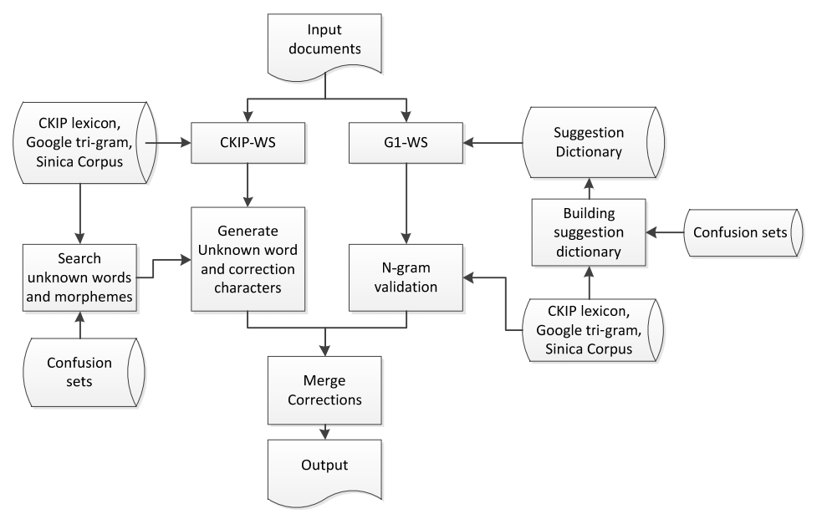
Introduction
Overview
Flowchart of the system
EXPERIMENTS
3 / 10
Notes:
lexicon 辭典
morpheme 詞態
generate 產生
validation 驗證
merge 合併

Slide 39
Unknown word detection
Introduction
Overview
Word segmentation to find possible error candidates
不怕措折地奮鬥 → 不() 怕() 措(?) 折(?) 地() 奮鬥()
Focus on the morphemes marked with (?) only and provide possible replacement words by checking confusion sets and CKIP dictionary.
EXPERIMENTS
4 / 10
Notes:
系統架構
發現未知的字
第一步驟需要將字做分割找出可能的錯字
EX : 不怕措折地奮鬥
“不() 怕() 措(?) 折(?) 地() 奮鬥()”
那些?的地方就是未知單詞，然後把焦點放在?的地方，利用混亂字集和CKIP辭典去做檢測

Slide 40
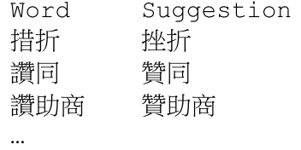
Building suggestion dictionary
Introduction
Overview
In this paper use this uni-gram data, and the confusion set to search for similar word pairs and ranks the pair of words by their frequencies.
The word of low frequency is considered as error candidate and the high frequency similar word is considered as correction suggestion.
EXPERIMENTS
5 / 10
Notes:
建立建議辭典
它們在做G1-WS的時候，第一步需要先建立潛在的錯字建議辭典
他們用google 1T uni-gram 來找出相似的詞對，與將其作頻率的排序，用頻率高的取代頻率低的

Slide 41
Introduction
Overview
However, the extracted naive suggestion dictionary may have a lot of noises.
Two method to confirm
Use word segmentation in Sinica Corpus
Count all words and suggestions
If the frequency ratio of freq(word)/freq(suggestion) > 0.1, then ignore this suggestion.
EXPERIMENTS
6 / 10
Notes:
但是這種建議很粗淺，會有很多的雜訊
所以他們需要做進階的篩選
1)首先他們用分詞語料庫
2)然後他們將所有的字與建議的字作加總，如果freq(word)/freq(suggestion) > 0.1，那他們忽略建議字

Slide 42
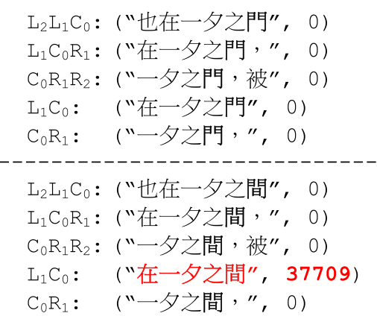
Validation and correction by n-gram model
Introduction
Overview
Based on the marked error spots, we set a window to count the frequency of these strings which contain potential errors, and select the suggestion candidates with the highest string frequency as the answer.
EXPERIMENTS
5 / 10
Notes:
用n-gram 做校正與驗證
基於錯誤的標記他們計算了這些字的包含潛在錯誤的頻率，他們選擇了詞頻最高的做替換
c : “也在一夕之門”
L : left
R : right

Slide 43
Conclusions
Introduction
Overview
Recall problems:
Some correct characters are not in the confusion sets
Dispute on the gold standard.
["糊塗"、"胡塗"]
The word pairs as (再,在),(得,的) cannot be distinguished in system
No information on the related words
(“圈差” ,“圈叉”)
(“二連罷”,“二連霸”)
EXPERIMENTS
8 / 9
Notes:
討論
最終結果還是有一些問題
recall problems:
1)一些要矯正的字，但是不再混亂集中
2)一些有爭議的"糊塗"、"胡塗"
[禁]不起、[經]不起
3)有一些不能區分的字對 (再,在),(得,的)
4)一些相關的詞，但是對應的沒有資訊
(“圈差” “圈叉”)
(“二連罷”“二連霸”)

Slide 44
Introduction
Overview
Precision problem :
There are a lot of irrelevant characters in the confusion sets. There should be a way to filter out some of the irrelevant characters.
A better n-gram language model needs to be developed.
EXPERIMENTS
8 / 9
Notes:
精度問題
他們注重在混亂集和n-gram語言模型
1)有很多不相關的字符在混亂集之中。需要找出一些方法過濾掉這些不相干的字
2)需要開發一個更好的n-gram語言模型

Slide 45
Text Segmentation for Chinese Spell Checking
JOURNAL OF THE AMERICAN SOCIETY FOR INFORMATION SCIENCE’ 1999
Kin Hong Lee
Mau Kit Michael Ng
Department of Computer Science and Engineering
Notes:
JOURNAL OF THE AMERICAN SOCIETY FOR INFORMATION SCIENCE.

Slide 46
Abstract
Introduction
Overview
Chinese text has no natural delimiters such as spaces between words, which are meaningful sequences of characters.
Every Chinese character input must be a valid ideograph, but the sequence of Chinese characters may not make sense.
(EX : “時間“ is mistyped as ”時閒” , 時and閒are correct characters , although
the character sequence is not a correct word.)
EXPERIMENTS
1 / 8
Notes:
中文不像英文有空白分割
且每個中文字都有他的意義，但如果放在句子中意思又可能不太一樣
時間打錯為時閒，但時、閒兩個字都有他的意思，但如果把兩個字放在一起那他就是錯字

Slide 47
Introduction
Overview
In Chinese spell checking, it cannot be assumed that texts are free of errors.
There are four main kinds of errors.
Misuses of characters due to same or similar sounds
(按步就班 → 按部就班)
Misuses of characters due to similar shapes
(茶,荼)
Misuses of characters due to similar meanings
(名『符』其實，名『副』其實)
Typing errors related to Chinese input methods.
EXPERIMENTS
2 / 8
Notes:
在中國拼寫檢查，它不能被假定文本有沒有錯誤。
細部切割可以分為4種錯誤
1.相同拼音
2.相似字形
3.因為相似的辭意而字符的誤用
4.輸入法所造成的錯誤

Slide 48
The Segmentation Process and System Interaction Model
Introduction
Overview
When a piece of text is to be handled, it is ﬁrst divided into sentences.
Punctuation marks are used as delimiters to separate sentences.
Some of the sentences may contain symbols, alphabetic symbols, and numerals. These types of characters are skipped without checking, and are used as unnatural delimiters to further divide sentences into phrases.
To reduce false alarms, occurrences of the ﬁrst 200 most frequently used single-character words such as 的(of), 一(one), 是(is), 不(not), 有(have), 在(in), 個(unit, quantity) should not be considered as suspected errors.
EXPERIMENTS
3 / 8
Notes:
分割過程和系統的互動模型
第一步是先將句字做切割
標點符號做分段
有些句子包含符號，字母符號和數字。
這些類型的字符被跳過而不檢查，並作為異常的符號，可以進一步劃分成句短語。
為了減少誤報，他們將最多使用的200個常用字剔除

Slide 49
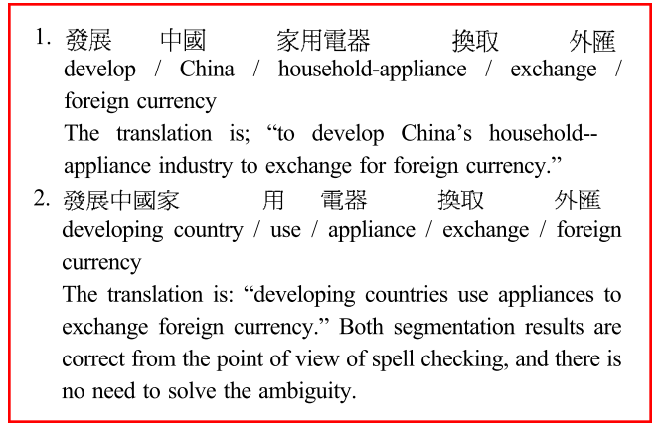
Introduction
Overview
Unlike text analysis for translation or semantic analysis, sometimes it is not necessary for a spelling checker to ﬁnd a unique segmentation solution.
EXPERIMENTS
4 / 8
Notes:
錯字校正不像文字翻譯或語意，有時候不需要為了拼字檢查而做獨特的細分解決方案

Slide 50
Segmentation Method
Introduction
Overview
“誰都不知道他的確實用途”
EXPERIMENTS
This may be deduced from so-called word formation power, in which the word formation power of the character is higher than that of the character 的, and so it is more likely that the character sequence 確實 is a word.
5 / 8
Notes:
根據字典做斷詞法
字符構成的詞有比較高的權重，所以分割出來會是 的"確實"而不是"的確"實

Slide 51
Heuristic for Finding the Best Segmentation
Introduction
Overview
Theoretically, any sequence of Chinese characters can form a word, if unknown words are also considered.
EXPERIMENTS
6 / 8
Notes:
啟發式的尋找最佳的分割
從理論上說，中國字符的任何序列都能形成一個單詞，如果不知道的話，也算。
對一個短詞來說，如果詞的最大限制長度為M，那將會有M種可能
EX: 天鵝湖是 ,m = 3
>天鵝湖
>天鵝
>天

Slide 52
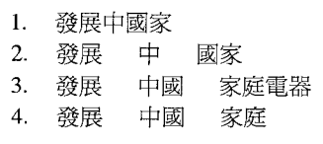
Maximum Number of Combinations in Each Iteration
Introduction
Overview
The length of all the words are ${Max}_{W}$ or less, and P is the ﬁrst character considered in the current iteration.
EX : “發展中國家庭電器換取外匯”
The corresponding words in the dictionary are
“發展中國家”、“發展”、 “中國”、 “國家”、 “家庭電器” 、 “家庭”
、 “電器” 、 “換取”、 “外匯”
${Max}_{W}$ = 5
That is, if a word of six or more characters is encountered, the word will be chosen as the result of that iteration.
EXPERIMENTS
7 / 8
Notes:
最大跌代組合
所有的話的長度〖𝑀𝑎𝑥〗 _𝑊 or 少，而P是在當前迭代認為網絡第一個字符。
也就是說，如果遇到的六個或更多個字符的單詞，該單詞將被選擇作為該次迭代的結果。

Slide 53
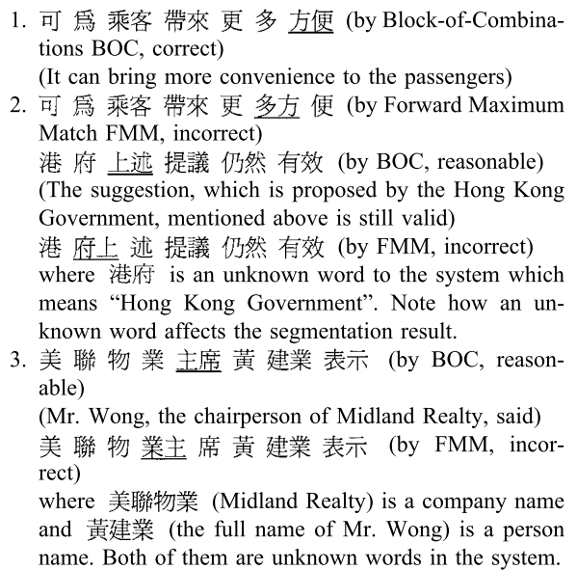
Conclusions
Introduction
Overview
In this paper used a total of 100 ambiguities.
Among the 100 ambiguities, 68 of them can be solved correctly by both methods, and 5 of them cannot be solved correctly by both methods.
EXPERIMENTS
8 / 8
Notes:
結果
精確性
它們使用100個有歧異的句子
68個用兩種方法可以正確做出矯正
5種兩個都不行

