Slide 1
A Filter Based Post-OCR
Accuracy Boost System
Eugene Borovikov
Ilya Zavorin
Mark Turner
CACI International Inc, Lanham
HDP’04, November 12, 2004, Washington, DC, USA.
Notes:
基於後處理的OCR準確度提升系統
Hardcopy Document Processing

Slide 2
OUTLINE
INTRODUCTION
APPROACH
HMM BASED POST-OCR FILTER
ACCURACY EVALUATION
EXPERIMENTS

Slide 3
INTRODUCTION
In this paper focus on a Hidden Markov Model (HMM) based accuracy booster modeling OCR engine noise generation.
Improving OCR accuracy is a persisting problem because no OCR engine is perfect, and even for the best of them accuracy varies depending on the variety of factors that is simply impossible to account for in a single OCR engine.
Notes:
本文專注於馬可夫模型（ HMM），建模讓精度提升。
沒有OCR是完美無缺的，所以使用多種類OCR來決定出最終結果
因此利用後期OCR校正，例如拼寫檢查，詞典，字典等
精度提高有助於做檢索和翻譯

Slide 4
INTRODUCTION(cont.)
character/word confusion matrices
character/word image transformation energy matrices
character/word n-gram frequencies
character shapes
dictionaries and lexicons
high-level context
language syntax
Notes:
這篇研究是為了建立一個後處理機制來提升正確性，所以透過結合不同的OCR來提高校正的正確率
•字符/字分類矩陣(http://www.zhizhihu.com/html/y2011/3126.html)
•字符/字圖像變換的能量矩陣(紋理)
•字符/字的n-gram頻率
•字符形狀
•字典和詞典
•高層次內文(表達的意思)
•語法

Slide 5
P = TP / ( TP + FP)
R = TP / ( TP + FN)
P : Precision
R : Recall
5
Notes:
P:正確率
R:miss掉多少
只有正確率並沒有辦法知道整體miss掉多少加上Recall可以讓大家更清楚整體有多少沒有辨識到
prediction (直)預測
橫的是真實狀態

Slide 6
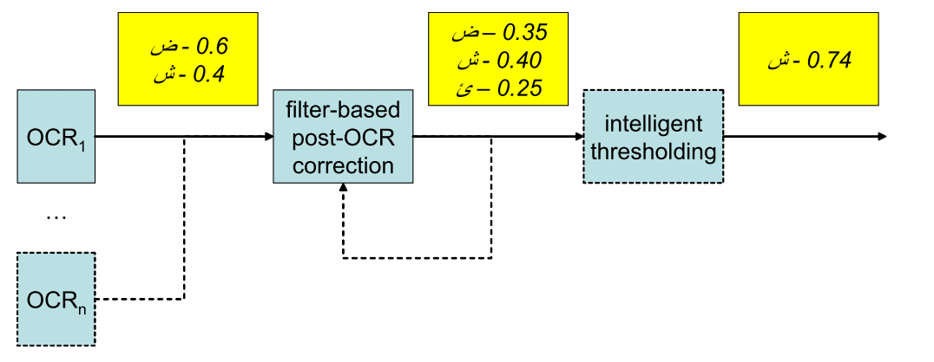
INTRODUCTION(cont.)
Notes:
根據多種OCR結果得到的分數，做選擇的到最後結果
顯示了後期的OCR糾錯系統的總體設計並給出了
實例的數據流量（可能是幾個） OCR輸出的候選，經後的OCR校正濾鏡的網絡去（重複） ，最後經過一番智能閾值處理需要具有一個最有可能的候選人。

Slide 7
INTRODUCTION(cont.)
In this paper focus on an HMM(Hidden Markov Models) based post-OCR correction ﬁlter that uses a dictionary trained HMM for correcting OCR errors and has three correction modes: aggressive, moderate, and conservative.
In the conservative mode it attempts to correct only low conﬁdence or unrecognized characters, improving character and word accuracy.
In the aggressive mode, the ﬁlter targets all words in the OCR output and corrects ones with low HMM scores, giving a chance to better post-OCR accuracy boost, but running the risk of accidentally lowering the accuracy
Notes:
在這篇利用辭典對HMM做訓練
3種校正方式
1主動:將所有字的分數列出來，並修正HMM分數低的字，但是可能造成精準度降低
(EX:沒有訓練好的HMM、不是正規的訓練集)
2中度
3保守:主要是為了那一些低可信度與不能辨識的文字可以濾掉
這個可以當作校正的基準線，但是不是最好的方法，因為可能原本就拼錯或有一些不同用法

Slide 8
APPROACH (GENERAL)
GENERAL
Most traditional OCR correction methods rely primarily on spell checkers to correct so called “non-word errors”
Many researchers have experimented with various statistical language models (SLM) to perform both non-word and “real-word” error correction, the latter referring to words in OCR output that actually appear in the lexicon but do not match the corresponding ground truth words.
Most OCR correction methods that involve language models work on a word level.
Given a lexicon Λ = {$w_{1}$, . . . ,$w_{N}$} that contains all known words
OCR output word O = {$o_{1}$ . . . ,$o_{k}$}
ﬁnd the known word sequence
Notes:
方法
傳統
依靠拼寫檢查，糾正所謂的“非單詞錯誤”
另外有其他人嘗試了統計語言模型（ SLM），來同時執行”非單詞”和“實際單字”糾錯，實際單字指的是在OCR輸出的話，實際上出現的詞彙，但不符合實際情況(可用n-gram、詞性標記等方法)
多數的OCR校正
Λ是所有已知的詞
O是OCR輸出的字
兩個詞做距離比對
這種方法可以處理部分錯誤，但是大都只是字元處理的階段

Slide 9
APPROACH (PROPOSED)
PROPOSED
This approach is not purely character-based, but may include some word-level information.
When character 2-grams statistics are computed, the number of times a given 2-gram appears in a given word may be multiplied by the number of times this word appears in the corpus.
Notes:
他們提出的方法是利用上面的方法加入一些而外資訊做優化
不是純粹基於字元的，還包括一些字串的資訊
用這個詞出現在文章的次數處理。像是TFIDF的方法

Slide 10
APPROACH(cont.) (PROPOSED)
Advantages
First, it can be applied without modiﬁcations to languages
Second, it is implemented in the well-developed framework of Hidden Markov Models (HMMs)
Third, while incorporating some word-level information, the resulting models are signiﬁcantly smaller than those that would be generated by the typical word-level approach.
Notes:
優點
1.不會因為語言不同而要調整
(某些語言，詞的邊界不清晰使得OCR的校正比較困難)
2.他們利用HMM做框架
(可以利用標準化工具，訓練跟OCR輸出校正)
3.融入了一些句子的訊息，因次產出的模型會明顯比一般使用句子的小

Slide 11
HMM BASED POST-OCR FILTER (Modeling OCR error generation)
Modeling OCR error generation
In order to correct OCR errors, we create a probabilistic model of the process of error generation.
dictionary (or known) characters $A_{\text{Λ}}$= {$c_{1}$, . . . , $c_{N}$}
OCR (or observed) characters $A_{\text{Ω}}$ = {$o_{1}$, . . . , $o_{M}$}
Notes:
基於HMM的OCR後處理過濾器
為了校正OCR錯誤，我們創建錯誤的生成過程的概率模型。
OCR錯誤生成
已知、OCR

Slide 12
HMM BASED POST-OCR FILTER (Modeling OCR error generation)(cont.)
In the first layer, a word is generated as a sequence C = {$c_{1}$, . . . , $c_{L}$} of dictionary characters $c_{j}$∈ $A_{\text{Λ}}$ according to a language model represented via 2-gram and initial character statistics of elements of$A_{\text{Λ}}$.
In the second layer, a character sequence passes through a model of a given OCR engine which introduces some OCR noise and produces a sequence of observed characters O = {$o_{1}$, . . . , $o_{K}$} corresponding to the correct word C , and unless the OCR engine commits an error, ${ c}_{j}$= $o_{j}$, K = L .
Notes:
這個部分可分為兩層
第一層，根據語言模型，例如2-gram和起始字符統計去做統計($A_{\text{Λ}}$)，生成一個字串的序列C屬於$A_{\text{Λ}}$
第二層，通過給定的OCR，產生一部分的OCR雜訊與產生的OCR序列O，然後用O去對應到正確的C

Slide 13
HMM BASED POST-OCR FILTER (Modeling OCR error generation)(cont.)
Each HMM is completely characterized by a set of three parameters λ = (π, A, B), where A ∈ $R^{N∗N}$is a matrix of transitional probabilities between the states, B ∈ $R^{N∗M}$ is a matrix of emission probabilities for all symbols from each state and π ∈ $R^{N}$is a vector of initial probabilities.
Matrix A and vector π are created using normalized bi-gram and initial character statistics from a dictionary and/or a large corpus of ground truth text, while matrix B is computed from a normalized character confusion matrix for the given OCR engine applied to a large body of text
Notes:
HMM是由一組三個參數λ = （π，A，B）
A ∈ $R^{N∗N}$ 是狀態之間的轉換機率矩陣
B ∈ $R^{N∗M}$ 是所有狀態的輸出機率矩陣
π ∈ $R^{N}$ 是初始機率向量
在這篇
A和π，是從大量語庫中取出bi-gram和首字符數
B是從OCR辨識出來的字，做正規化文字混亂矩陣

Slide 14
HMM BASED POST-OCR FILTER (HMM-based ﬁlter modes)
HMM-based ﬁlters can work in three diﬀerent modes : conservative ,moderate ,aggressive.
In the conservative mode, the ﬁlter attempts to correct only weak characters.
In the moderate mode, each weak word
In the aggressive mode, the ﬁlter targets all words in the output .
Notes:
基於HMM的過濾模式
基於HMM的過濾器可以在三種不同的模式下工作： 積極的，適度和保守。
1.保守:主要是為了那一些低可信度與不能辨識的”字”可以濾掉
2.中度:處理那些低可信度的”詞”，如果一段話中有一些無法識別的字，可校正
3.主動:將所有字的分數列出來，並修正HMM分數低的字，但是可能造成精準度降低
(EX:沒有訓練好的HMM、不是正規的訓練集)

Slide 15
HMM BASED POST-OCR FILTER (HMM-based ﬁlter modes)
best correspondence
$$ρ ( O ) = {Q ( O )}^{\frac{1}{L}}$$
L = number of C
Q ( O ) is the likelihood value approximating P ( C ) P ( O|C )
Notes:
最符合公式
C : 2-gram和起始字符統計
P ( C ) P ( O|C )近似值

Slide 16
HMM BASED POST-OCR FILTER (HMM-based ﬁlter modes)(cont.)
Conservative
Each such character is replaced by those from $A_{\text{Λ}}$.
The path C needed to compute ρ($O_{n}$) is determined as the sequence of characters from $A_{\text{Λ}}$ that are individually most likely for the given $O_{n}$.
Notes:
保守:主要是為了那一些低可信度與不能辨識的”字”可以濾掉
可以用$A_{\text{Λ}}$來取代錯誤的”字”
用$A_{\text{Λ}}決定C的序列，並\text{帶入 }\text{ρ}\text{(}O_{n}\text{) }$來取出最有可能的$O_{n}$(用上一頁公式說明)

Slide 17
HMM BASED POST-OCR FILTER (HMM-based ﬁlter modes)(cont.)
Moderate
Given a sequence O , the Viterbi algorithm may be used to determine the sequence C that maximizes P (C)P(O|C), that yields the corresponding score ρ(O).
These top sequences are returned by the ﬁlter as spelling alternatives, provided their scores are above a threshold.
Notes:
中等:處理那些低可信度的”詞”，如果一段話中有一些無法識別的字，可校正
給定一個序列O，並用Viterbi算法確保序列C最大化，得到相應的分數ρ(O)
然後給第一個閥值，高於就留下當候選

Slide 18
HMM BASED POST-OCR FILTER (HMM-based ﬁlter modes)(cont.)
Aggressive
This score is computed the same way as for the candidate sequences $O_{n}$ in the conservative mode.
If the word has to be corrected, we determine the characters that have the most negative impact on the score and replace them the same way as in the conservative mode.
Notes:
主動式:將所有字的分數列出來，並修正HMM分數低的字，但是可能造成精準度降低
(EX:沒有訓練好的HMM、不是正規的訓練集)
在此計算分數的方式與保守模式相同
如果字已被校正的，我們確定那個字對分數有不利的影響，那我們就用跟保守模式相同的方式取代掉他。

Slide 19
ACCURACY EVALUATION
Performance of any OCR error correction ﬁlter may be evaluated using ground truth and some standard measures such as precision and recall.
M : number of recognized tokens
|Input| : number of input tokens
|output| : number of output tokens
Notes:
它們評估是用
準確度、recall
M : 識別標記數量
I : 輸入標記數量
O : 輸出標記數量

Slide 20
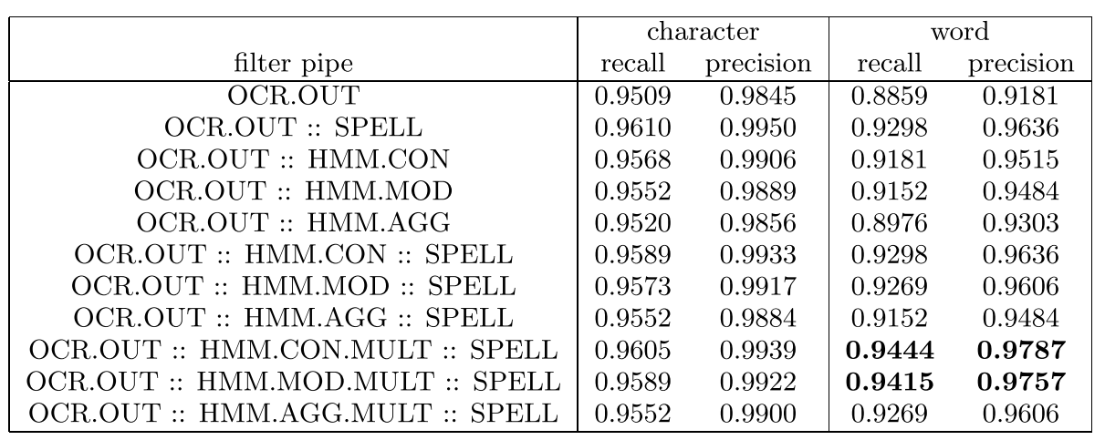
EXPERIMENTS
English
Notes:
OCR.OUT 是都沒處理直接輸出結果
SPELL 是微軟的Word拼寫檢查
HMM.CON ， HMM.MOD ， HMM.AGG 是基於HMM的濾波器的三種模式。(主、中、保)
MULT 是同上，但每個拼錯的單字都有多個候選方案
DSRCH 是基於Levenshtein 的字典查詢
在詞的部分有明顯較好結果

Slide 21
EXPERIMENTS
Arabic
Notes:
阿拉伯語
發現微軟的拼寫居然是最弱的

