Slide 1
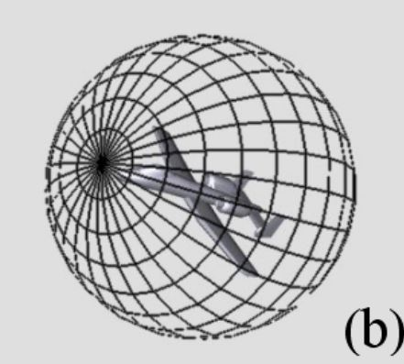
EUROGRAPHICS 2003
On Visual Similarity
Based 3D Model Retrieval
Ding-Yun Chen | Xiao-Pei Tian | Yu-Te Shen | Ming Ouhyoung
Department of Computer Science and Information Engineering,
National Taiwan University

Slide 2
Introduction
Most of method concentrate on the similarity of geometric distributions rather than directly searching for visually similar models.
This paper propose a method that matches 3D models using their visual similarities.
If two 3D models are similar, they also similar from all viewing angles.
Notes:
this paper is old, so it mean before this paper, a lot of method concentrate on the similarity of geometric distributions rather than directly searching for visually similar models.
the main idea is that if two 3D models are similar, they also similar from all viewing angles. 如圖，有兩個相似的模型，用一個球包住模型，然後球的每個面上放上camera去得到模型的每個視角的影像，再來一一比對相像的影像。
Extract features from the light fields rendered from cameras on a sphere.

Slide 3
Method
A LightField Descriptor for 3D models
  Translation and scaling are preprocessing to ensure that 3D model is entirely contained in rendered images.
  To reduce the retrieval time and size of feature, the light field cameras can be put on 20 vertices of a regular dodecahedron.
Notes:
Translation and scaling are preprocessing to ensure that 3D model is entirely contained in rendered images. The input 3D model is translated from the center of the model to the origin of world coordinate system. The axis is then scaled such that the maximum length is 1.
There are two 3D models, a pig and a cow, in Figure 3 (a), both rotated randomly.
First, 20 images are rendered from vertices of a dodecahedron for both the 3D model. As shown in Figure 3 (b),
we compare all the corresponding 2D images from the same viewing angles, such as, the order 1~5 between pig and cow model. Thus we get a similarity value under this rotation of camera system.
Then, we map the order 1~5 differently as in Figure 3 (d), and get another similarity value.
After repeating this process, we find a rotation of camera positions with the best similarity (cross-correlation being highest), as shown in Figure 3 (d). Therefore, the similarity between the two models is the summation of the similarities among all the corresponding images.

Slide 4

Method
To be robust against rotations among 3D models, a set of LightField Descriptors is applied to each 3D model.
(N * (N - 1) + 1) * 20 * 3 different rotations between the two models.
If set N = 10, the average maximum error of rotation angle between two 3D models in longitude and latitude is:
Notes:
If there are N LightField Descriptors, which are created from different camera system orientations for both 3D models, there are (N *(N -1)+1)*60 different rotations between the two models.
a regular dodecahedron, each of the 20 vertices is connected by 3 edges
If set N = 10, that is, the similarity between two 3D models is obtained from the best one of 5,460 different rotations. Therefore, the average maximum error of rotation angle between two 3D models is about 3.4 degree in longitude and latitude. That is:

Slide 5
Performance Evaluation
The test dataset with 1833 3D models from 3DCafe.
  They clustered into 47 classes including 549 3D models mainly for vehicle and household items, and all the other 1284 models are classified as “miscellaneous”.
Performance comparison
Notes:
The picture shows the comparison of the retrieval performance
Each curve plots the graph of "recall and precision“ averaged over all 549 classes models in the test database.
Obviously, their method performs better than the others.

Slide 6
Results
Notes:
http://3d.csie.ntu.edu.tw/~dynamic/cgi-bin/DatabaseII_v1.8/index_js.html

Slide 7
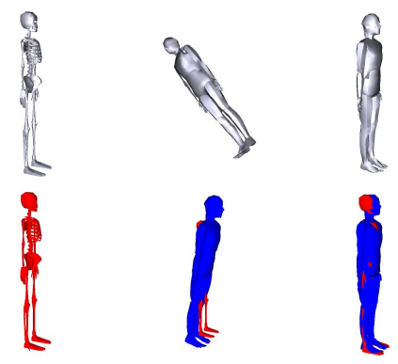
Shape Modeling International (SMI) 2008
A 3D Model Alignment and Retrieval System
Ding-Yun Chen | Ming Ouhyoung
Department of Computer Science and Information Engineering,
National Taiwan University

Slide 8
Introduction
This paper propose an algorithm for 3D model alignment, which gets the affine transformation between two 3D models.
The main idea of algorithm in rotation is to search the similarity of projected 2D shapes from each viewing angle between two models.

Slide 9
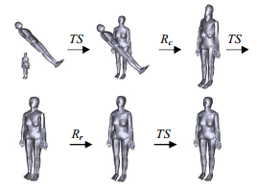
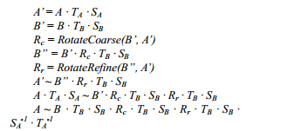
Method
3D model alignment
  TS denotes the translation and scaling
  Rc denote the coarser rotation alignment
  Rr denote the refined rotation alignment
Notes:
The order of 3D model alignment in their approach is following top picture, then explain by next picture.

Slide 10
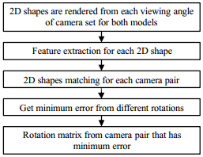
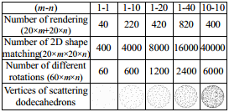
Method
3D model alignment in rotation
↑ Number of rendering and matching 2D shapes are calculated by mapping m to n different dodecahedrons. This paper set m=10 and n=10.
Notes:
First three step are same with previous paper.

Slide 11
Method
3D model alignment in rotation
ShapeDiff: difference between two 2D shape
i: different roation of the camera set, and j-th camera pair between the two models
coarser rotation alignment: using 10-10 camera sets, that is, searching the best one from 6000 different rotations.
refined rotation alignment: using iterative approach to close the best solution. They start from 10° and step half for each iterative until less than 1°.
Notes:
The rotation of a camera set, which has minimum error, also indicates the rotation between the two 3D models. The minimum error can also be used for judging the similarity of the two 3D models, and is defined as …
there is a difference between coarser and refined rotation alignment.
refined rotation alignment: In each iterative, we adjust rotation of one axis and fix that of another two axes in the order of X, Y and Z axis, respectively.

Slide 12
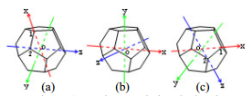
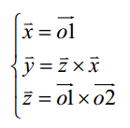
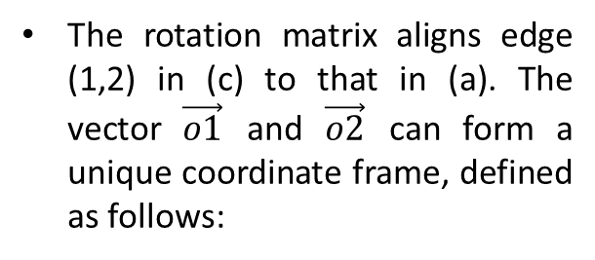
Method
3D model alignment in rotation
The rotation matrix is then applied to one model to another.
The rotation matrix aligns edge (1,2) in (c) to that in (a). The vector $\vec{o1}$ and $\vec{o2}$ can form a unique coordinate frame, defined as follows:
Notes:
The problem of solving the rotation matrix can be considered as aligning an edge between two dodecahedrons, because all edges are aligned if one edge is aligned.

Slide 13

Method
3D model alignment in rotation
The rotation matrix is then applied to one model to another.
The rotation matrix aligns edge (1,2) in (c) to that in (a). The vector $\vec{o1}$ and $\vec{o2}$ can form a unique coordinate frame, defined as follows:
The notation FA and FB denote the coordinate system of model A and B, respectively, and FC denote the Cartesian coordinate system
The rotation matrix is defined as:
Notes:
The problem of solving the rotation matrix can be considered as aligning an edge between two dodecahedrons, because all edges are aligned if one edge is aligned.
the rotation matrix is the coordinate conversion from FB to FA, that is, FBA. However, 3D models are in Cartesian coordinate system, FC, so we cannot apply FBA to model B directly. Model B should be converted to FB coordinate system first and back to Cartesian coordinate system after applying FBA.
The FBA can be obtained by FAC · FCB, and FCB · FBC can be eliminated, so the rotation matrix from model B to model A is FCB ·FAC

Slide 14
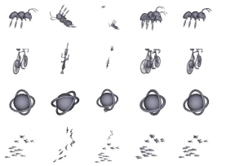
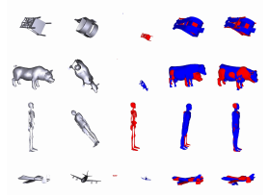
Results
Notes:
Left: Results of experiments by using the same model among different affine transformations.
Right: Results of experiments in aligning model before and after randomly rotating, translating and scaling.

Slide 15
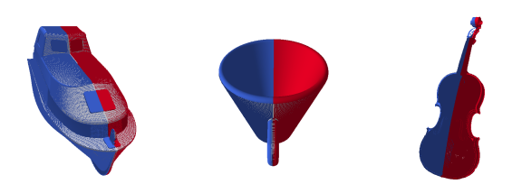
Content-Based Multimedia Indexing (CBMI) 2014
Symmetry-Based Alignment for 3D Model Retrieval
Quoc-Viet Dang | Sandrine Mouysset | Geraldine Morin
University of Toulouse, France

Slide 16
Introduction
Many objects are composed by similar parts up to a rotation, a translation or a symmetry.
Therefore, the canonical frame of a 3D model can be extracted from its partial symmetry information.
This paper present a method for aligning 3D shapes modeled as Non-Uniform Rational B-Spline (NURBS) based Boundary Representations(B-Rep) models, exploiting partial symmetries of the shape.
NURBS is a mathematical model commonly used in computer graphics for generating and representing curves and surfaces.
B-Rep is a method for representing shapes using the limits. A solid is represented as a collection of connected surface elements, the boundary between solid and non-solid.
Notes:
BREP(Boundary Representation): 邊界表示是保存如何根據模型的幾何形狀尤其是歐拉拓撲邊界構建模型所需信息的方法。 http://zh.wikipedia.org/wiki/%E8%BE%B9%E7%95%8C%E8%A1%A8%E7%A4%BA
非均勻有理樣條（Non uniform rational B-spline，NURBS），是在電腦圖形學中常用的數學模型，用於產生和表示曲線及曲面。它為處理解析函式和模型形狀提供了極大的靈活性和精確性。NURBS通常在電腦輔助設計（CAD），製造 （CAM），及工程 （CAE） 中有廣泛應用。在很多不同的3D建模和動畫軟體中也能找到NURBS的工具集。 http://zh.wikipedia.org/wiki/%E9%9D%9E%E5%9D%87%E5%8C%80%E6%9C%89%E7%90%86B%E6%A0%B7%E6%9D%A1

Slide 17
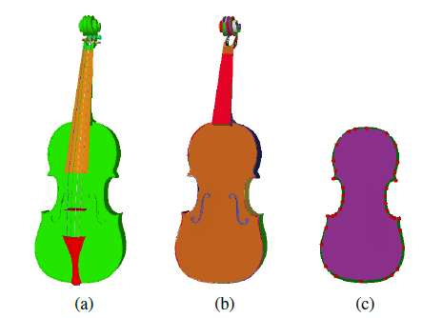
Method Overview
Structure of NURBS based B-Rep Models
  B-Rep object is composed of multiple faces
  and a B-Rep model is composed of multiple B-Rep objects.
Notes:
The violin model is composed of numerous B-Reps objects plotted in different colors (a).
Similarly, the B-Rep object of the violin body (b) contains multiple faces.
A face, as in © is a NURBS surface (violet) bounded by some edges (green) and some vertices (red). In other words, a model contains numerous faces.

Slide 18

Method Overview
Structure of NURBS based B-Rep Models
  B-Rep object is composed of multiple faces
  and a B-Rep model is composed of multiple B-Rep objects.
the NURBS based B-Rep model that composed of nF faces.
$S^{i}$: the NURBS surface used by this face,
is the set of n vertices that bound $F^{i}$.
This paper call the vertices $V^{i}$ the corners of face $F^{i}$
Notes:
The violin model is composed of numerous B-Reps objects plotted in different colors (a).
Similarly, the B-Rep object of the violin body (b) contains multiple faces.
A face, as in © is a NURBS surface (violet) bounded by some edges (green) and some vertices (red). In other words, a model contains numerous faces.

Slide 19
Method Overview
Basic Idea
  Symmetry detection identifies the dominant symmetry plane.
  Axes generation estimates the three canonical axes based on orthographic projection.

Slide 20
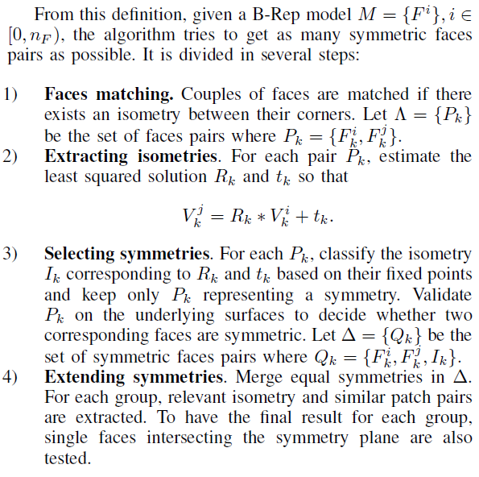

Method Overview
Basic Idea
  Symmetry detection identifies the dominant symmetry plane.
    a definition of similar faces based on their entities objects. Let $F^{i}$= {$S^{i}$; $V^{i}$} and $F^{i}$= {$S^{j}$ ; $V^{j}$} two different faces with the same number of corners.

Slide 21
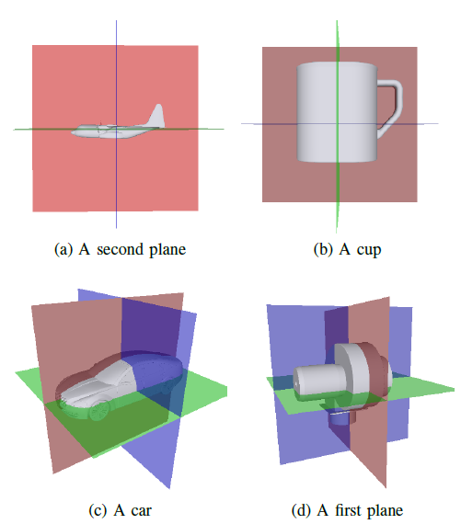
Method Overview
Basic Idea
  Axes generation estimates the three canonical axes based on orthographic projection.
    Their algorithm can extract the two remaining planes, or two remaining axis direction, for aligning our models.
    The first axis is defined as the normal of the dominant partial symmetry and is called the reference axis. (red)
    The second axis is perpendicular to the reference axis and defines a plane orthogonal to the symmetry plane. (blue)
    Third one is then determined as being orthogonal to first and second plane. (green)
Notes:
The normal of the red(symmetry) plane : the reference axis
The normal of the The blue plane : minimizes the orthographic projection areas

Slide 22
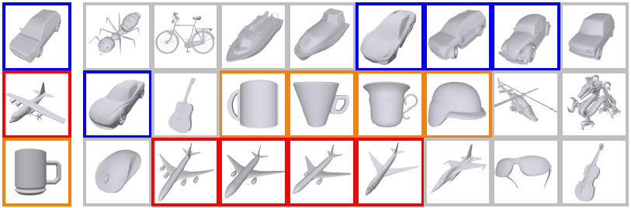
Results
Notes:
Top 4 results of 3 queries for models. The queried models are on the left side, models in the database are on the right side. For each query, the responded models are highlighted the same color as the queried model

Slide 23
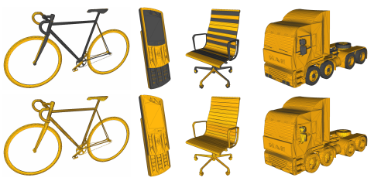
Journal of Computer Graphics Techniques 2014
A Simple Method for Correcting
Facet Orientations in Polygon Meshes
Based on Ray Casting
1Kenshi Takayama | 2Alec Jacobson | 3Ladislav Kavan | 1Olga Sorkine-Hornung
1. Department of Computer Science ETH Zurich
2. Department of Computer Science Columbia University
3. Department of Computer and Information Science University of Pennsylvania

Slide 24
Introduction
The polygon meshes with incorrect facet orientations when working from Internet repositories.
A polygon mesh generally consist of a set of 3D vertex positions and a set of polygon facets each defined by an ordered list of vertex index.
The ordering of vertices determines facet orientation.
The “correctness” of facet orientations is defined as a facet’s orientation is correct if its front side corresponds to the “outside”.
This paper present a method for fixing incorrect orientations of facets in input polygon mesh.
The method is easier than previously methods, only requiring sampling visibilities by shooting many rays.
Notes:
It is still common today to encounter polygon meshes with incorrect facet orientations when working from Internet repositories.
They speculate that one cause is that many popular polygon based 3D modeling tools, such as SketchUp, use double-sided lighting that ignores facet orientations. This allows modelers to create polygon meshes with arbitrary facet orientations and provides no visual feedback on the error in the content creation tool.
So this paper want to find out a method to fixed this problem.
If we see the ordering of vertices as counterclockwise from a viewpoint, we consider the facet is front side.
3D模型常常是由人用3D繪圖軟體畫出來的，所以在繪製的過程中可能會發生facets有正反面錯亂的問題。
一個3D模型(3D model, meshes)由很多點集合構成的，而3個點能組成模型上的一個面(facet)， 面有正面與反面的不同， 正面是可見，有貼圖的; 背面則是相反。我們可以從viewpoint來看組成面的點順序來得知現在是正面或背面。

Slide 25
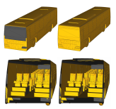
Method
Visibility Sampling
  The method based on “Consistent normal orientation for polygonal meshes” strategy for visibility sampling.
    Shoot two rays in opposite directions to ensure that the same number of rays are shot for both sides of the facet.
    If a ray shot on the facet’s front (resp. back) side does not intersect with any other facets in the mesh, the corresponding counter cfront (resp. cback) is incremented. After shooting all the rays, the facet is flipped if cfront < cback.
    Handling interior facets: If a ray shot on the facet’s front (resp. back) side intersects with some other facet, the distance between the ray origin and the intersecting point is accumulated to the corresponding counter dfront (resp. dback). After shooting all the rays, the facet is flipped if
    (cfront < cback) or ((cfront = cback) and (dfront < dback)).

Slide 26
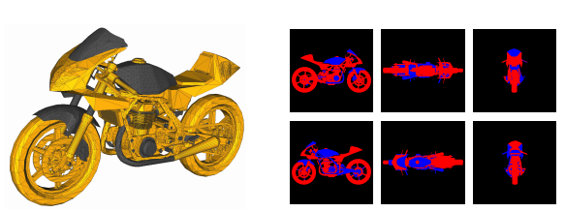
Evaluation
Dataset
  SHREC’10 Generic 3D Warehouse dataset
  It contains 3168 meshes.
Backfacingness measure
  Measure how much of a given mesh's facets are showing their back sides
↑ Backfacingness: 0.2756
Notes:
The dataset often have various types of defects such as disconnected facets with random orientations and self-intersecting/coplanar facets. They believe this dataset to be a fairly good representation of meshes manually created by general users.
Backfacingness measure method:
首先, render模型為兩個顏色, 如上圖,黃色為front side, 灰色為back side
然後從6個不同方向的viewpoints 投影
測量像素比例, ex. 藍色pixel數/(紅+藍pixcel數)

Slide 27
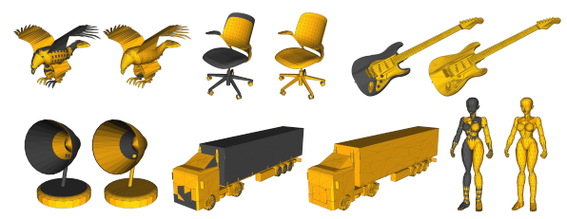
Results
0.5535 → 0.0073
0.6344 → 0.0880
0.5556 → 0.0009
0.5868 → 0.0273
0.5693 → 0.0050
0.5343 → 0.0003
Notes:
Left hand side of each pair is original orientations, and right hand side of each pair is already fixed by their method.

Slide 28
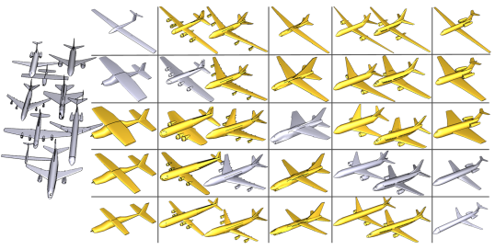
SIGGRAPH Asia 2010
Style-Content Separation
by Anisotropic Part Scales
1,2Kai Xu | 1,2Honghua Li | 1Hao Zhang | 3Daniel Cohen-Or | 2Yueshan Xiong | 2Zhi-Quan Cheng
1. Simon Fraser University
2. National University of Defense Technology
3. Tel-Aviv University

Slide 29
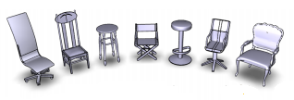
Introduction
The main goal of computer graphics is to provide effective means for artists and non-experts to easily create useful digital 3D models.
This paper develop a method of style-content separation for co-analysis of a set of 3D models.
the chair’s functional parts reflected geometric “content” such as swivel office chairs, armchairs, folding chairs...
and classify the whole set into clusters based on some notion of “style”, e.g., high vs. low back.
Notes:
The set of chairs in clearly contain subclasses such as swivel office chairs, armchairs, folding chairs, and bar stools, as reflected by the geometric “content” of the chairs’ functional parts. At the same time, one can also classify the whole set into clusters based on some notion of “style”, e.g., high vs. low back, long vs. short legs.

Slide 30
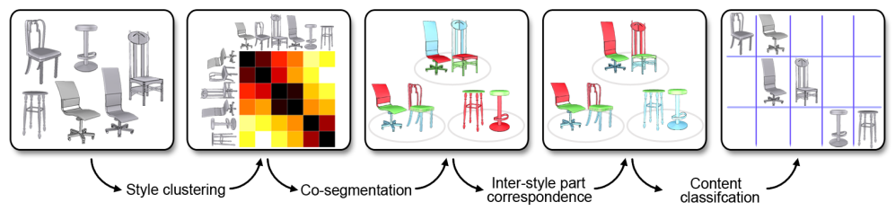
Overview
Style-content separation algorithm
Notes:
???????????

Slide 31
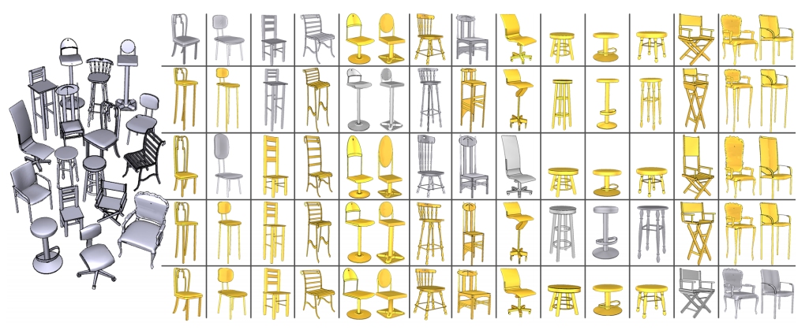
Results
Notes:
Style-content separation for a chair and stool set (row: style; column: content). Newly synthesized models (in gold) fill the table.

Slide 32
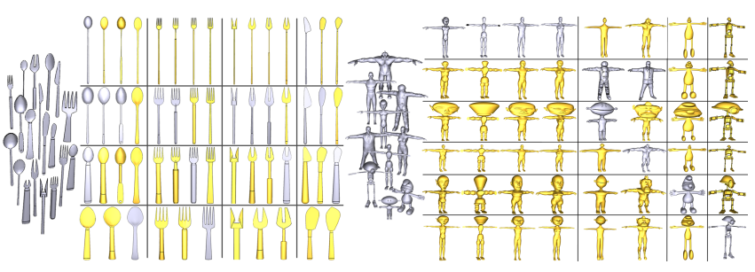
Results
Notes:
Other results.

