Slide 1
Salient Local Visual Features for Shape-Based 3D Model Retrieval
SMI 2008
Ryutarou Ohbuchi | Kunio Osada | Takahiko Furuya | Tomohisa Banno
University of Yamanashi
Notes:
Shape Modeling and Applications, 2008.
SMI 2008: Shape Modeling International (2008)

Slide 2
Introduction
/ Method/ Evaluation/ Results
3D models have become ubiquitous, and have many kind of applications, e.g. 3D games, mechanical or architectural design, etc.
Notes:
So far the 3d models already become ubiquitous, and have many kind of applications, like the 3D games, mechanical or architectural design, and another else. if I want to organize some of 3D models , how can I effective reuse (or find the similar 3D models)? So it prompted research into 3d model retrieval.

Slide 3
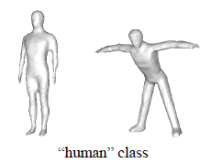
Introduction
/ Method/ Evaluation/ Results
3D models have become ubiquitous, and have many kind of applications, e.g. 3D games, mechanical or architectural design, etc.
Most of 3D model retrieval methods try to satisfy the invariance to a certain class of geometrical transformation.
Notes:
Most of 3D model retrieval methods try to satisfy the invariance to a certain class of geometrical transformation. However, there are some problem in this way, like the picture, this two 3d models from same class but different pose ,so the result of this two models are dissimilar.

Slide 4
Introduction
/ Method/ Evaluation/ Results
3D models have become ubiquitous, and have many kind of applications, e.g. 3D games, mechanical or architectural design, etc.
Most of 3D model retrieval methods try to satisfy the invariance to a certain class of geometrical transformation.
A shape-based 3D model retrieval method based on multi-scale local visual features.
Notes:
And then, this paper want to solve this problem , and they proposed a method for shape-base 3D model retrieval (that performs well for both articulated and rigid models).

Slide 5
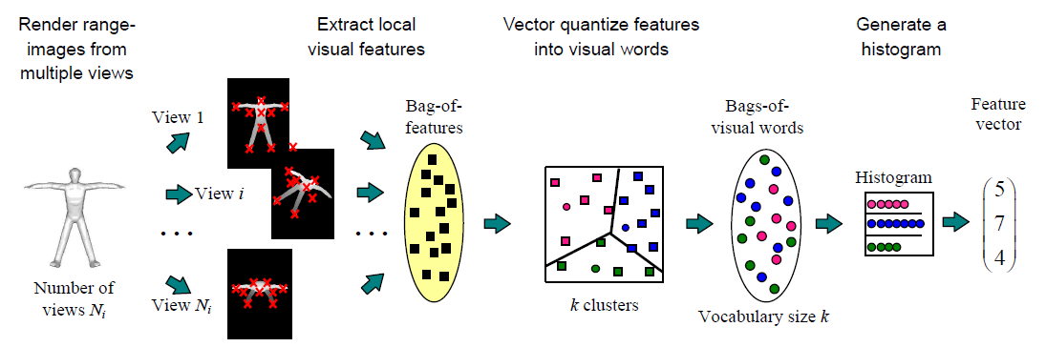
Method
Introduction/
/ Evaluation/ Results
Bag-of-features SIFT algorithm
  Pose normalization
  Multi-view rendering
  Local feature extraction
  Vector quantization and histogram generation
  Histogram generation
  Distance computation
Notes:
So, this paper proposed the method, Bag-of-features SIFT algorithm. It is compares 3D models by following six steps. The picture is all of the algorithm processing step.
And I will keep going to explain each steps.

Slide 6
Method
Introduction/
/ Evaluation/ Results
Bag-of-features SIFT algorithm
  Pose normalization
    it is the preprocessing step for 3d model position and scale, so that the model is rendered with an appropriate size in each of the multiple-view image.
  Multi-view rendering
  Local feature extraction
  Vector quantization and histogram generation
  Histogram generation
  Distance computation
Notes:
First step is Pose normalization, that is the preprocessing for 3d model position and scale, so that the model is rendered with an appropriate size in each of the multiple-view image.

Slide 7

Method
Introduction/
/ Evaluation/ Results
Bag-of-features SIFT algorithm
  Pose normalization
  Multi-view rendering
    it is rendering range images of the model from Ni viewpoints places uniformly on the view sphere surrounding the model.
  Local feature extraction
  Vector quantization and histogram generation
  Histogram generation
  Distance computation
6
12
42
Notes:
Second step is multi-view rendering. It is rendering range images of the model from a few viewpoints.
The viewpoints are spaces uniformly in the solid angle by placing them at vertices of regular polyhedrons enclosing the model.
For example, this picture are 3 different polyhedron, with 6, 12, and 42 vertices, (respectively). So, cameras can be placed at vertices , looking at the center of the polyhedron, for uniformly spaced view directions.

Slide 8
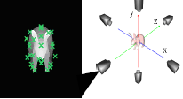
Method
Introduction/
/ evaluation/ results
Bag-of-features SIFT algorithm
  Pose normalization
  Multi-view rendering
  Local feature extraction
    from the range images, extract local, multi-scale, multi-orientation, visual features by using SIFT algorithm.
  Vector quantization and histogram generation
  Histogram generation
  Distance computation
Notes:
Third step is Local feature extraction, that is from the range images to extract local, multi-scale, multi-orientation, visual features by using SIFT algorithm.

Slide 9
Method
Introduction/
/ Evaluation/ Results
Bag-of-features SIFT algorithm
  Pose normalization
  Multi-view rendering
  Local feature extraction
  Vector quantization
    vector quantize a local feature into visual word in a vocabulary of size Nv by using a visual codebook.
  Histogram generation
  Distance computation
Notes:
The fourth step is Vector quantization, Vector quantize a local feature into visual word in a vocabulary of size Nv by using a visual codebook.
The visual codebook is learned, unsupervised, prior to the retrieval by using k-means clustering of features collected from every view of every models stored in the database.
(After the clustering, each cluster is represented by a representative code vector at the braycenter of the cluster.)
(from thousands of features extracted from a set of models, e.g. the model in the database to be retrieval)

Slide 10
Method
Introduction/
/ Evaluation/ Results
Bag-of-features SIFT algorithm
  Pose normalization
  Multi-view rendering
  Local feature extraction
  Vector quantization and histogram generation
  Histogram generation
    quantized local features are accumulated into a histogram having Nv bins, which becomes the feature vector of the corresponding 3d model.
  Distance computation
Notes:
The fifth step is Histogram generation, that Quantized local features are accumulated into a histogram having Nv bins, which becomes the feature vector of the corresponding 3d model.

Slide 11
Method
Introduction/
/ Evaluation/ Results
Bag-of-features SIFT algorithm
  Pose normalization
  Multi-view rendering
  Local feature extraction
  Vector quantization and histogram generation
  Histogram generation
  Distance computation
    dissimilarity among a pair of feature vectors is computed by using Kullback-Leibler divergence (KLD).
Notes:
The final step is Distance computation, that is 3d models dissimilarity.
So, it is using Kullback-Leibler divergence (KLD) to compute dissimilarity among a pair of feature vectors.
Above, is all of the algorithm process. Next, I will show you the evaluation.

Slide 12
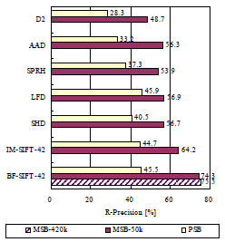
Evaluation
Introduction/ Method/
/ Results
Using McGill 3D Shape Benchmark (MSB) evaluate for articulated models.
Princeton Shape Benchmark (PSB) evaluate for rigid models.
Notes:
It the retrieval performance. In vertical are seven algorithms measured using both MSB and PSB databases. And in horizontal is their R-precision.
The MSB database is McGill 3D shape Benchmark(MSB), that evaluate for articulated models. And another is Princeton Shape Benchmark(PSB) , that evaluate for rigid models.
So in this histogram, there is a better performance, BF-SIFT method.
Recall & precision
http://kevingo75.blogspot.tw/2008/11/precision-and-recall-information.html

Slide 13
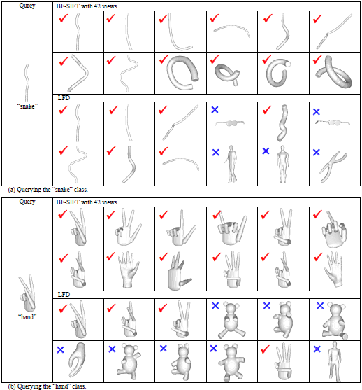
Result
Introduction/ Method/ Evaluation/
Notes:
Finally, it is the retrieval result, the most left is query model, and the result are show in 2 by 6 matrix, in which models are ordered left-to-right, top-to-bottom, by their similarity (to the left).
In these comparison, the BF-SIFT clearly outperforms the Light Field Descriptor(LFD) method.

Slide 14
Consistent Mesh Partitioning and Skeletonisation using the Shape Diameter Function
The Visual Computer: International Journal of Computer Graphics 2008
Lior Shapira (1) | Ariel Shamir (2) | Daniel Cohen-Or (1)
(1) Tel-Aviv University (2) The Interdisciplinary Center
Notes:
The Visual Computer: International Journal of Computer Graphics 2008

Slide 15
Introduction
/ Method/ Results
Mesh partitioning and skeleton are fundamental for many computer graphics and animation techniques.
Notes:
Mesh partitioning and skeleton are fundamental for many computer graphics and animation techniques.
Most previous partitioning and skeletonisation techniques concentrated on one object and rely mostly on surface attributes of the object’s boundary.
Such surface attributes often depend on the pose of the object and on its topology and therefore may change, for instance, if the pose of the object changes.

Slide 16
Introduction
/ Method/ Results
Mesh partitioning and skeleton are fundamental for many computer graphics and animation techniques.
Consider two problems on a wide variety of meshes, and construct across partitioning and skeletons.
Notes:
Partitioning of 3d meshes and extracting a skeleton-like structure for such meshes are two basic and highly important algorithm in computer graphics.
So, in this paper, they consider these two problems (on a wide variety of meshes), and construct across partitioning and skeletons which remain consistent across a family of objects, not single one.

Slide 17
Introduction
/ Method/ Results
Mesh partitioning and skeleton are fundamental for many computer graphics and animation techniques.
Consider two problems on a wide variety of meshes, and construct across partitioning and skeletons.
Propose the algorithm on a volume-based shape-function: shape-diameter-function(SDF).
Notes:
And then, they propose the (simple and fast) algorithm on a volume-based shape-function is called shape-diameter-function(SDF).

Slide 18
Method
Introduction/
/ Results
Shape Diameter Function
  Given a point on surface mesh using a cone centered around its inward-normal direction
  Send several rays inside this cone to the other side of the mesh
  Remove outliers (red lines)
  Repeat the above step until all surfaces are done.
Small
angle
120°
Notes:
there are three steps in the SDF method
First is given a point on surface mesh using a cone centered around its inward-normal direction
And then, send several rays inside this cone to the other side of the mesh
Final step is remove outliers (red lines), and repeat the above step until all surfaces are done.
So, The SDF value at a point is define as the average of all lengths of rays (which fall within one standard deviation from the median of all lengths).
How to know red line? Because red line usually is larger length than normal one.
In this paper, they set the cone angle is 120 degree and send 30 rays each points.
red color is small value, blue color is large value.

Slide 19
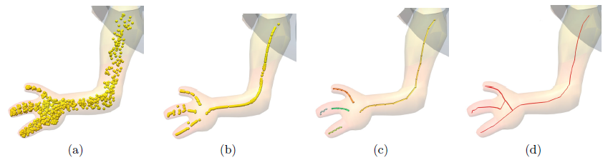
Method
Introduction/
/ Results
Skeleton Extraction
  Selecting a set of N random points on the surface, and project them in an inward normal direction to a distance which is half of their SDF value →P cloud
  Use the moving least squares(MLS) method to fit a single non-intersecting high-degree curve onto the noisy point set → T cloud
  Cluster and order all points in the thinned point cloud T to create skeleton segment →small set S
  Connect the poly-segments together to become a single one-dimensional skeleton
Notes:
This skeleton extraction method guide from SDF.
This skeleton extraction method using SDF.
The SDF method also can do the skeleton extraction. The key idea of this method is to exploit the SDF half distance to the medial axis in most points on the mesh surface.

Slide 20
Results
Introduction/ Method/
Skeleton extraction
Notes:
This picture is the result of skeleton extraction.

Slide 21
Results
Introduction/ Method/
Fitting the histogram of SDF value with k-Gaussians results in finer partitioning of the object to parts.
K = 2
K = 5
Notes:
Each model can get a SDF(SDF value) histogram, and they use a Gaussian Mixture Model (GMM) fitting k-Gaussians to the SDF histogram. Using different values of k results in different hierarchies of parts (see the picture).
they use a Gaussian Mixture Model (GMM) fitting the SDF histogram.
This is achieved using the Expectation-Maximization (EM) algorithm very fast since the histogram is only 1D.
The result of this clustering process for each face is a vector of length k signifying its probability to be assigned to one of the SDF clusters. Note that each SDF cluster may contain multiple mesh parts such as legs or fingers.
Using different values of k results in different hierarchies of parts (picture).
高斯混合模型（Gaussian mixture model，簡稱 GMM）是單一高斯機率密度函數的延伸，由於 GMM 能夠平滑地近似任意形狀的密度分佈，因此近年來常被用在語音與語者辨識，得到不錯的效果。

Slide 22
Results
Introduction/ Method/
Consistent mesh partition
Notes:
The SDF partitioning technique remains consistent, like the picture, the 3d models are different pose, but the partition still consistent.

Slide 23
Results
Introduction/ Method/
The SDF highlights similar parts in similar 3D shapes.
Notes:
The SDF value highlights similar parts in similar 3D shapes. Like the (left) picture, animals body are same color.
red color is small value, blue color is large value.

Slide 24
A Part-aware Surface Metric for Shape Analysis
EUROGRAPHICS 2009
Rong Liu (1) | Hao Zhang (1) | Ariel Shamir (2) | Daniel Cohen-Or (3)
(1) Simon Fraser University (2) The Interdisciplinary Center (2) Tel Aviv University
Notes:
My third paper is …, and this paper is talking about another method of shape description.

Slide 25
Introduction
/ Method/ Results
The fundamental geometric presentation of 3D objects in computer graphics is surface-base.
Notes:
The shape description in computer graphics is the metric based on surface.
So, the solutions of shape description are involving the analysis and understanding of a 3D object utilize metric. Which describes a distance function over the boundary surface of the object. (For example, they using a distance function defined over pairs of points on the surface, to assist shape analysis (and understanding). Like the previous paper SDF method, is a kind of surface metric.)
(the surface metric would play an important role form shape analysis,)So, in this paper, they develop a surface metric that is part-aware. (The metric can be effectively utilized in various applications including mesh segmentation and shape retrieval.)
There is a comparison between some surface metrics and their metric on “T”shape. The red contour is ios-contour, and we can find that, their metric fully senses the boundary of the bottom part of the shape. (形狀開始變化的交接處 I’m not sure, maybe the boundary is mean that the deformation area)

Slide 26
Introduction
/ Method/ Results
The fundamental geometric presentation of 3D objects in computer graphics is surface-base.
Solutions are involving the analysis and understanding of a 3D object.
Notes:
The shape description in computer graphics is the metric based on surface.
So, the solutions of shape description are involving the analysis and understanding of a 3D object utilize metric. Which describes a distance function over the boundary surface of the object. (For example, they using a distance function defined over pairs of points on the surface, to assist shape analysis (and understanding). Like the previous paper SDF method, is a kind of surface metric.)
(the surface metric would play an important role form shape analysis,)So, in this paper, they develop a surface metric that is part-aware. (The metric can be effectively utilized in various applications including mesh segmentation and shape retrieval.)
There is a comparison between some surface metrics and their metric on “T”shape. The red contour is ios-contour, and we can find that, their metric fully senses the boundary of the bottom part of the shape. (形狀開始變化的交接處 I’m not sure, maybe the boundary is mean that the deformation area)

Slide 27
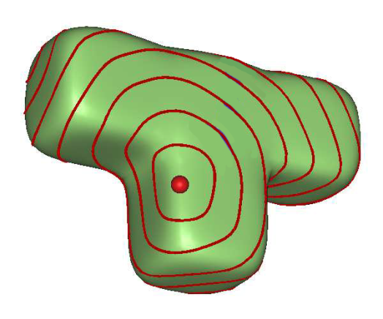
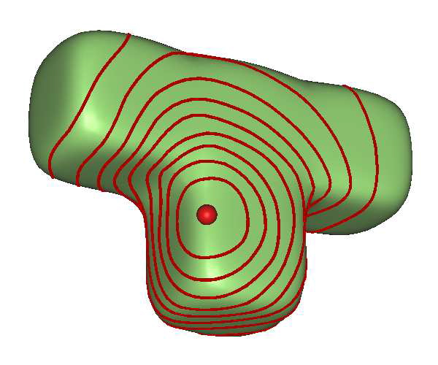
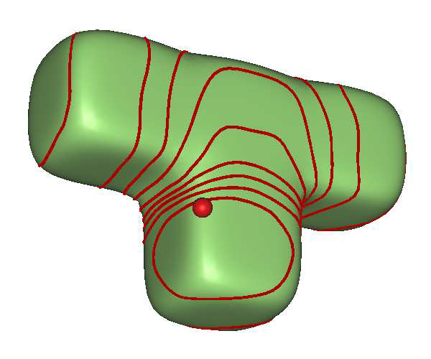
Introduction
/ Method/ Results
The fundamental geometric presentation of 3D objects in computer graphics is surface-base.
Solutions are involving the analysis and understanding of a 3D object.
Develop a surface metric: part-aware metric.
(a) geodesic
(b) diffusion
(c) part-aware metric
Notes:
The shape description in computer graphics is the metric based on surface.
So, the solutions of shape description are involving the analysis and understanding of a 3D object utilize metric. Which describes a distance function over the boundary surface of the object. (For example, they using a distance function defined over pairs of points on the surface, to assist shape analysis (and understanding). Like the previous paper SDF method, is a kind of surface metric.)
(the surface metric would play an important role form shape analysis,)So, in this paper, they develop a surface metric that is part-aware. (The metric can be effectively utilized in various applications including mesh segmentation and shape retrieval.)
There is a comparison between some surface metrics and their metric on “T”shape. The red contour is ios-contour, and we can find that, their metric fully senses the boundary of the bottom part of the shape. (形狀開始變化的交接處 I’m not sure, maybe the boundary is mean that the deformation area)

Slide 28
Method
Introduction/
/ Results
The part-aware metric is combing an appropriate VSI distance with geodesic distance and normal variation.
Notes:
So, The part-aware metric is combing the VSI with geodesic distance and normal variation.

Slide 29
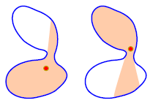
Method
Introduction/
/ Results
The part-aware metric is combing an appropriate VSI distance with geodesic distance and normal variation.
Volumetric shape image (VSI): inside the shape’s enclosed volume, to capture relevant visibility information.
Notes:
Before the method, I want to introduce Volumetric shape image, which is a way to capture relevant visibility information.
And that information collect from inside of a shape. Like the picture, the red point is inside this shape, and the pink area is visible region from the red point, while moving red point, the visible region should be changed. So, the VSI is record these visibility information.
And that is useful ,because visible regions provide the strong hints for part transition.

Slide 30
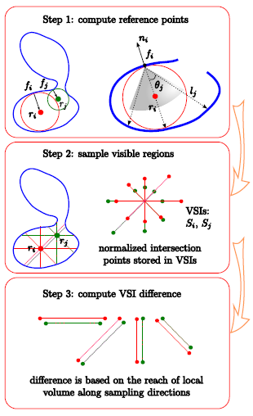
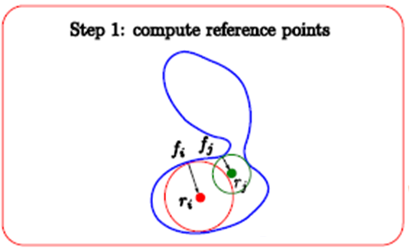
Method
Introduction/
/ Results
Both faces are mapped to their reference points ri and rj.
Notes:
Now, I will talk about how to compute the VSI distance.
the first step is both fi and fj faces are mapped to their reference points ri and rj.
Fi和fj是形狀上的任意兩個面, 然後找出在形狀內最大的球的中心就是參考點ri 和 rj
For example, face i is random faces form this shape, then we need to find the maximal inscribed sphere touching the centroid of face i.

Slide 31
Method
Introduction/
/ Results
the visible regions at ri and rj are sampled into their VSIs, Si and Sj.
Notes:
Second step is that the visible regions at ri and rj are sampled into their VSIs, Si and Sj.
the visible regions as seen from reference points and quantify their differences.
Like the picture, from a reference points ri, send out 4 rays uniformly, that is a VSI(Si). Rj do the same thing is another VSI(Sj). (the ray is touching the boundary)
一般會用100個rays,因為舉例所以用4個rays
And then let these rays to fix in a global coordinate system, so these two VSIs are naturally registered(overlapping). (overlapping these two reference points, so we can get the right picture.)

Slide 32
Method
Introduction/
/ Results
Si and Sj are used to drive the distance between fi and fj in graph.
Notes:
Final step is, compute VSI difference. It is the sum of ray distance different (of these rays).
Through this measurement can help to observe both ri and rj are within the same part or not.
透過測量鄰近的VSI距離差異可以得知fi 和fj 是不是在不同的形狀區域，在區域轉換的地方他們的差別會比較明顯
Si: the VSI from face i
Sj: the VSI from face j
m: number of rays
Si (k) : the k ray from Si
Sj (k) : the k ray from Sj

Slide 33
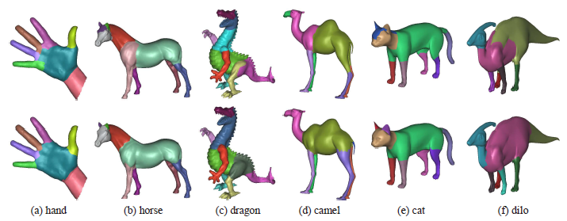
Results
Introduction/ Method/
Segmentation
Notes:
It is segmentation result, the top row is using geodesic and angular distances to segment these 3d models; And the bottom row is using their method(part-aware metric).

Slide 34
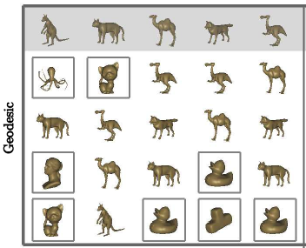
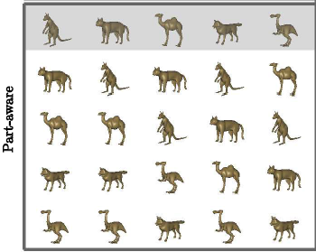
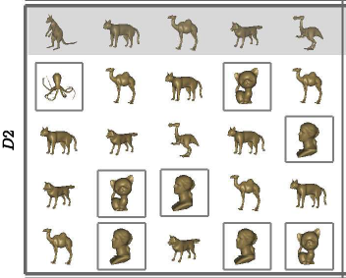
Results
Introduction/ Method/
Shape retrieval
Notes:
It is result of shape retrieval.
They compare with geodesic and D2 distances, in this comparison, their part-aware metric is better one.
In each block, they run 6 queries, and the first (shaded) row is the query shapes.
Each column are the 4 most similar shapes , and squares is mean not similar shape.
So their metric is better than geodesic and D2 distance.

Slide 35
Bag of Words and Local Spectral Descriptor for 3D Partial Shape Retrieval
EUROGRAPHICS WORKSHOP on 3D OBJECT RETRIEVAL 2011
Kai Xuy (1)(2) | Honghua Li (1)(2) | Hao Zhang (1)
Daniel Cohen-Or (3) | Yueshan Xiong (2) | Zhi-Quan Cheng (2)
(1) Simon Fraser University (2) National University of Defense Technology (3) Tel-Aviv University

Slide 36
Introduction
A 3D shape retrieval algorithm based on the Bag of Words.
Notes:
large collections of 3d models are available, thus the need for efficient tools to filter, search, and retrieval this 3d content .
This paper is a 3d shape retrieval based on Bag of Words , but a few different with previous paper.
And their goal of algorithm is efficient for partial shape similarity.

Slide 37
Introduction
A 3D shape retrieval algorithm based on the Bag of Words.
The algorithm is efficient for partial shape similarity.
Notes:
large collections of 3d models are available, thus the need for efficient tools to filter, search, and retrieval this 3d content .
This paper is a 3d shape retrieval based on Bag of Words , but a few different with previous paper.
And their goal of algorithm is efficient for partial shape similarity.

Slide 38
Overview
Building a 3D object database
Notes:
This picture is main step of their algorithm.
Left part is codebook construction from 3d object database,
Codebook construction
The first step is building a 3d object DB
Second step is feature extraction

Slide 39
Overview
Building a 3D object database
Uniform feature extraction and description.
  Random set of vertices + Lloyd’s algorithm
Left: 200 seeds andomly sampled
Right: after 50 Llody’s iterations
Notes:
This picture is main step of their algorithm.
Left part is codebook construction from 3d object database,
Codebook construction
The first step is building a 3d object DB
Second step is uniform feature extraction. So, to create the uniform sampling, they consider a random set of (np) vertices on the mesh as an initial set of seeds, and then apply Lloyd’s iterations.

Slide 40
Overview
Building a 3D object database
Uniform feature extraction and description.
  Random set of vertices + Lloyd’s algorithm
  Laplace-Beltrami operator
r
r: 10% of the bounding box length
Notes:
This picture is main step of their algorithm.
Left part is codebook construction from 3d object database,
Codebook construction
The first step is building a 3d object DB
Second step is uniform feature extraction. So, to create the uniform sampling, they consider a random set of (np) vertices on the mesh as an initial set of seeds, and then apply Lloyd’s iterations.
And , we need to take the red area to compute Description. Every feature point can get a Description, so the black point is feature point, and then given a radius r and feature point is center to circle the red area. Then computed the Description by projecting the geometry of the patch onto the eigenvectors of the Laplace-Beltrami operator.

Slide 41
Overview
Building a 3D object database
Uniform feature extraction and description.
Clustering in the feature space
Notes:
This picture is main step of their algorithm.
Left part is codebook construction from 3d object database,
Codebook construction
The first step is building a 3d object DB
Second step is uniform feature extraction. So, to create the uniform sampling, they consider a random set of (np) vertices on the mesh as an initial set of seeds, and then apply Lloyd’s iterations.
Third step, they apply a simple k-means clustering (nw clusters) on a huge dataset of descriptors.
So, the visual dictionary is built by clustering feature point descriptors computed over a large collection of 3d models. (it means the visual dictionary done.)

Slide 42
Overview
Notes:
So, Bag of words description is do the same thing that I just mentioned.
And final is BoW matching using the formula, bM is bag of words of whole model that can be n dimensional vector
And final they Matching BoW and Visual words to find the anser.

Slide 43
Result
Notes:
It is the result using their algorithm.
Most left, is query models, and right is the top-8 retrieval models.
It can be partial shape similarity. Because the query models look like one models combine with two models.

Slide 44
Topology-Varying 3D Shape Creation via Structural Blending
SIGGRAPH 2014
Ibraheem Alhashim (1) | Honghua Li (1)(2) | Kai Xu (2)
Junjie Cao (3) | Rui Ma (1) | Hao Zhang (1)
(1) Simon Fraser University (2) National University of Defense Technology (3) Dalian University of Technology

Slide 45

Video
/ Introduction/ Overview/ Results
https://www.youtube.com/watch?v=igE3usIHeRU

Slide 46
Introduction
Video/
/ Overview/ Results
The goal is create novel and plausible 3D models using the in-betweens generated by shape blending.
Notes:
這篇paper從3D模型變型這個技術的想法出發，想到在這演變過程中其實可以創造出合成的模型(新模型)
In this paper, they view and adopt shape blending form different angle.
And their goal is create novel and plausible 3D models using the in-betweens generated by shape blending.

Slide 47
Introduction
Video/
/ Overview/ Results
The goal is create novel and plausible 3D models using the in-betweens generated by shape blending.
Consider topology + geometry with a structure-aware representation.
Notes:
這篇paper從3D模型變型這個技術的想法出發，想到在這演變過程中其實可以創造出合成的模型(新模型)
It Consider topology and geometry with a structure-aware representation.
Developed an intuitive tool to help explore continuous space.

Slide 48
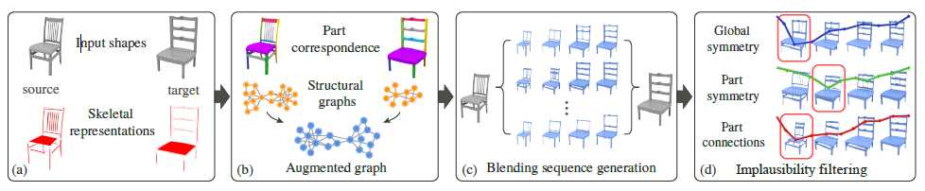
Overview
Video/ Introduction/
/ Results
Notes:
It is overview of the shape blending algorithm.
First, input a source and target shape, then convert each into a skeletal curve-sheet representation.
Second, is augmented graph to accommodate missing part and one-to-many correspondences.
Third, blending generates multiple path of in-betweens.
Final, output the results using amazing filter.
whole the algorithm, I will detail on next week.

Slide 49
Results
Video/ Introduction/ Overview/
Dataset: 110 man-made objects
  furniture, airplanes, robots, etc.
Supplementary material: 896 synthesized shapes

Slide 50
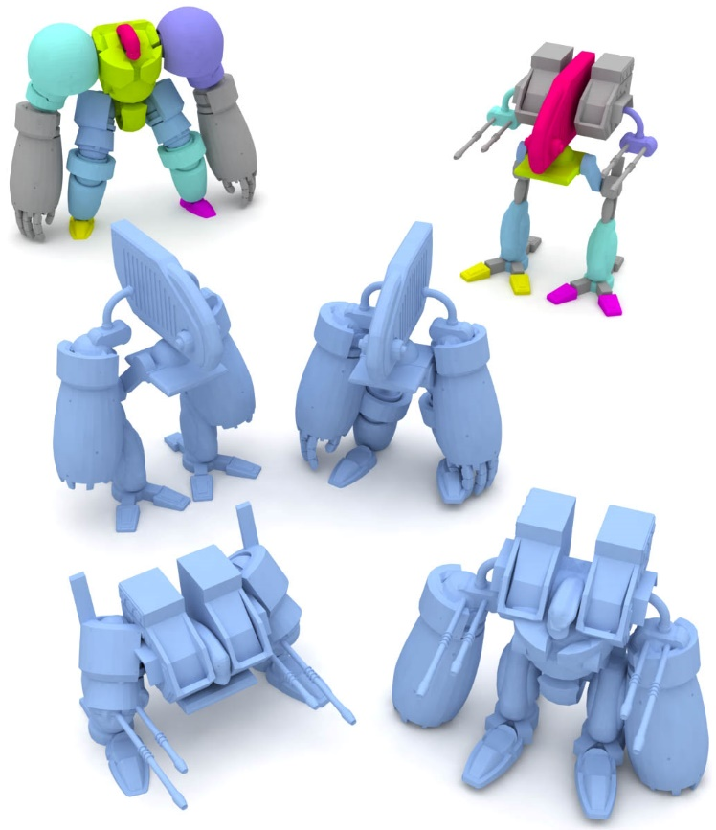
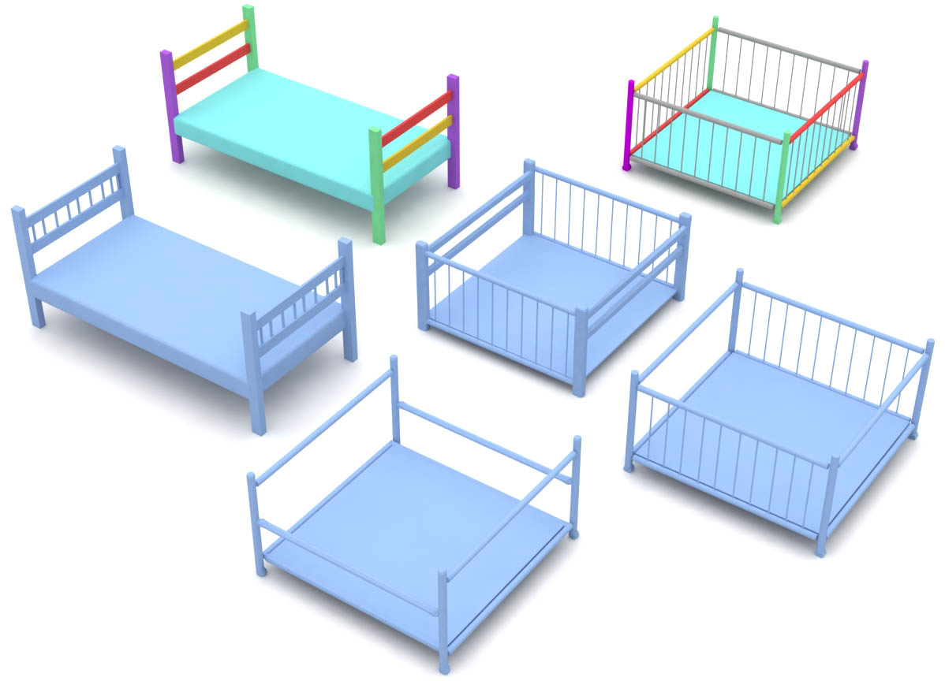
Results
Video/ Introduction/ Overview/
Notes:
here are some results of 3d shape generated by their method.

Slide 51
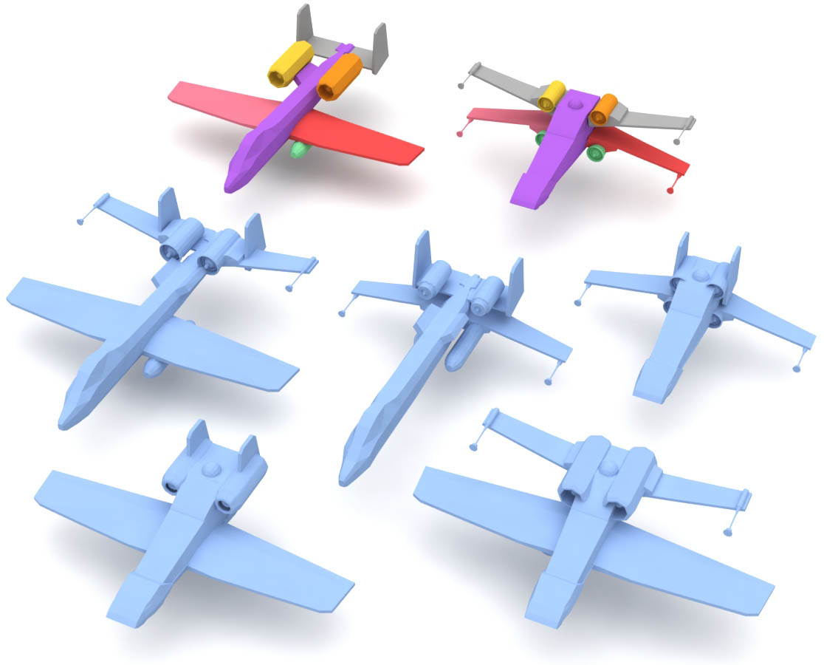
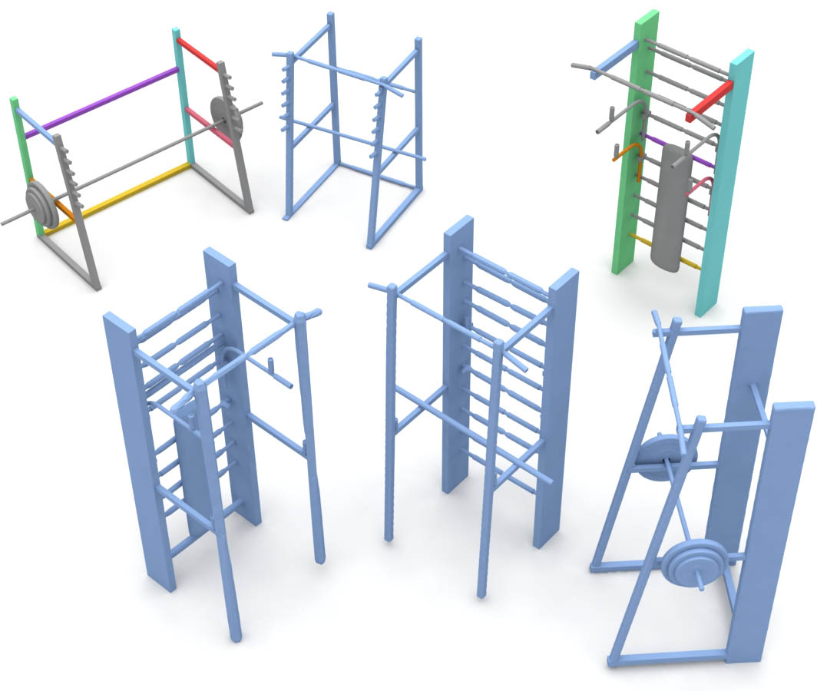
Results
Video/ Introduction/ Overview/

