Slide 1
Viewpoint Selection using Viewpoint Entropy
Pere-Pau V`azquez(1) | Miquel Feixas(1) | Mateu Sbert(1) | Wolfgang Heidrich(2)
(1) Institut d’Inform`atica i Aplicacions, University of Girona (2) University of British Columbia, Vancouver, Canada
Vision, Modeling and Visualization (VMV) 2001

Slide 2
Introduction
A viewpoint to be good if it provides a high amount of information for a scene.
Define a new measure: Viewpoint entropy.
Can be used to select a set of N good views of scene for scene understanding.
(a) (b)
Notes:
Compute good viewing positions automatically.

Slide 3
Viewpoint Entropy
Base on Shannon entropy.
Use as probability distribution the relative area of the projected face over the sphere of directions centered in the viewpoint.
Nf - the number of faces of the scene
Ai - the projected area of face i over the sphere
At - the total area of the sphere
Notes:
Assume the information is visibility.
Incorporates both the projected area and the number of faces.

Slide 4
Implementation
(a) and (b) show two capture paths of a camera around a cube.
(c) and (d) plot the viewpoint entropy and the projected area respectively in the Y axis against the rotation angle.

Slide 5
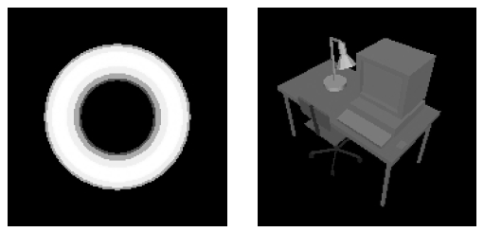
Implementation
The points of maximum viewpoint entropy of a torus and a desk.

Slide 6
Selection of good views
The scene understanding is to select a minimal set of views that gives a good representation of the scene to the user.
Following restrictions on the views:
They should contain a high level of information about the scene.
They should cover all the visible faces.

Slide 7
Selection of good views
Left: The eight view points obtained with the bitmap method for desk.
Right: The four view points of a molecule of isobutanolamine obtained with the bitmap method.

Slide 8
Conclusions
This measure is based on Information Theory and can be interpreted as the amount of information seen from a point.
The best viewpoint has been defined as the one that has maximum entropy.
Furthermore, viewpoint entropy is used to compute the minimal set of N good views which gives a good representation of the scene.

Slide 9
Automatic 2D Shape Orientation by Example
Waqar Saleem | Danyi Wang | Alexander Belyaev | Hans-Peter Seidel
Max Planck Institut Informatik Computer Graphics group
IEEE International Conference on Shape Modeling and Applications 2007
Notes:
The term “shape” refer to a projection of a 3D shape to a 2D image.

Slide 10
Introduction
None of the methods consider shape orientation.
Consider give a view of a 3D shape, automatically find the correct orientation of the shape.
Propose an example based approach to shape orientation.
A shape can be represented by its binary image.
Orientation correction takes place in two steps:
Find for the query shape a candidate class from database.
Align the query shape to target shape from the candidate class.
Notes:
Present a example based method to correct the orientation of a shape in a query image.

Slide 11
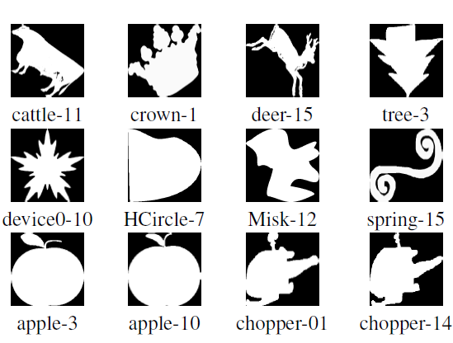
Setting up the Database
Use the MPEG-7 dataset, which contain 1400 binary images organized into 70 classes with 20 members per class, where each image contain a single shape.
Manually remove:
incorrectly oriented images (top row)
images containing non-Orientale shapes (mid row)
Automatically remove:
Redundantly oriented images (bottom row)
After filtering, database contains 237 images in 56 classes, the smallest and largest members are 1 and 4 respectively.

Slide 12
Example based Shape Orientation
Using a shape similarity technique, retrieve a list of database images sorted according to their similarity distance from the query image.
The candidate class is then chosen as the class containing the best match.
Choose the shape most similar to the query shape, that is target shape.
Using PCA to align the query shape to the target shape.

Slide 13
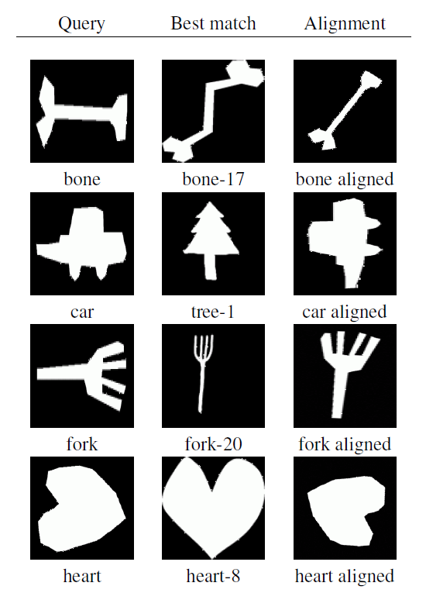
Result
A few result for user-drawn queries.

Slide 14
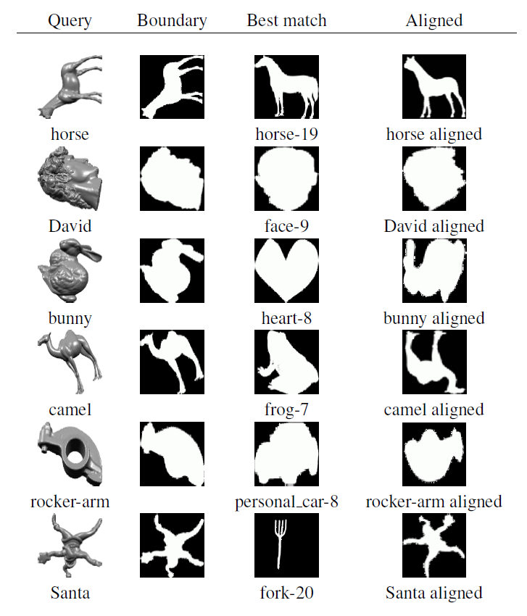
Result
A few result for common Computer Graphics models.

Slide 15
Detector of Image Orientation Based on Borda-Count
Loris Nanni |  | Alessandra Lumini
Università di Bologna
Iberian Conference on Pattern Recognition and Image Analysis (IbPRIA) 2005
Notes:
Iberian Conference on Pattern Recognition and Image Analysis 2005

Slide 16
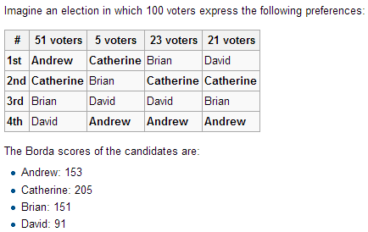
Introduction
Automatic image orientation detection algorithms based on features.
Use Borda Count combination rule for classifiers.
Rule: 4-n (n:rank)
51*3 + 5*0 + 23*0 + 21*0 = 153
51*2 + 5*3 + 23*2 + 21*2 = 205

Slide 17
Introduction
Automatic image orientation detection algorithms based on features.
Use Borda Count combination rule for classifiers.
The orientation detection problem as a four-class classification problem (0 ͦ,90 ͦ,180 ͦ,270 ͦ)
Show combination of different classifiers trained in different feature spaces obtains a higher performance than a stand-alone classifier.

Slide 18
System Overview
Feature extraction
an image divided in blocks (regular subdivision in N*N non overlapping blocks)
Selected features are extracted from each block (the features are extracted from local regions)
Features: Color Moments(COL), Edge direction histogram(EDH), Harris corner histogram(HCH), Phase symmetry(PHS)
Feature transformation: Karhunen-Lòeve transformation (KL) to reduce the feature set to a lower dimensionality.
Classifiers: AdaBoost, P-SVM, R-SVM, Subspace
Multiclassifier system: different approaches are combined to resolve the same problem, used Borda Count to determine the final class from an ensemble of classifier.
Notes:
The above COL, EDH, HCH and PHS vectors are normalized within each block.
Karhunen-Lòeve transformation (KL) to reduce the feature set to a lower dimensionality, maintaining only the most discriminant features.
In this paper the features extracted are reduced by KL to 100-dimensional vector.
Multiclassifier system:

Slide 19
Experimental Comparison
Accuracy rate using different feature spaces and R-SVM as classifier.

Slide 20
Experimental Comparison
Accuracy rate using different classifiers.

Slide 21
Experimental Comparison
Accuracy rate using several classifiers at different level of rejection.

Slide 22
Example-based Synthesis of 3D Object Arrangements
Matthew Fisher(1) | Daniel Ritchie(1) | Manolis Savva(1) |  | Thomas Funkhouser(2) | Pat Hanrahan(1)
(1)Stanford University |  |  | (2)Princeton University
SIGGRAPH Asia 2012

Slide 23
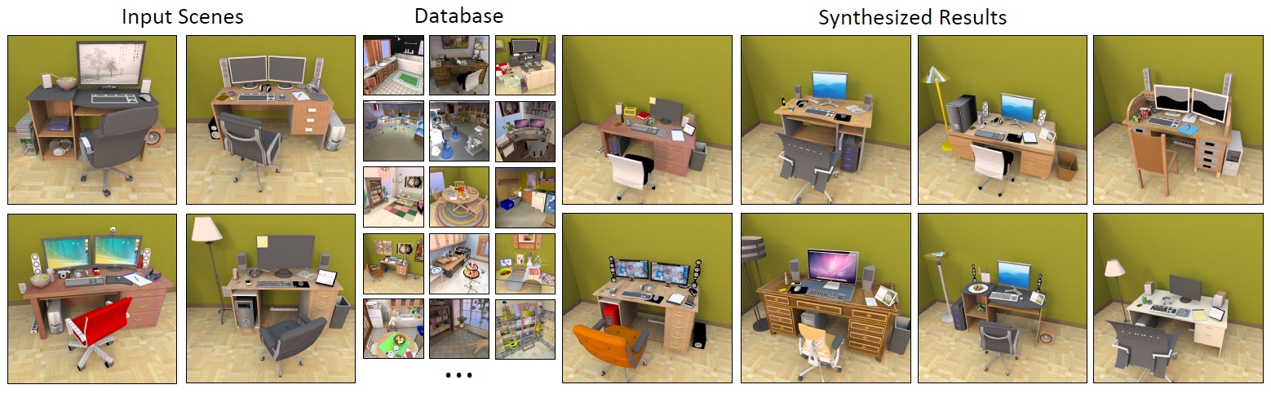
Introduction
Large-scale games and virtual worlds demand detail 3D environments.
Using example-based synthesis to generate new scenes similar to a set of input examples.

Slide 24
Introduction
Large-scale games and virtual worlds demand detail 3D environments.
Using example-based synthesis to generate new scenes similar to a set of input examples.
Three main contributions:
Probabilistic model – consists of an occurrence model and arrangement model
Clustering algorithm – contextual categories
Train the probabilistic model on a mix of user-provided examples and relevant scenes retrieved from database.
Notes:
User 的input和資料庫的相關場景混合訓練機率模型

Slide 25
Probabilistic model
Occurrence model
Use a Bayesian network to model the distribution over the set of objects that occur in a scene.
Use a simple parent probability table to define a function that gives the probability of the parent-child connections between objects in a scene.
Notes:
使用貝式網路B(S)來組成物件的分佈模型 we use a Bayesian network B(S) to model the distribution over the set of objects that occur in a scene.
定義一個靜態連結的parent-child機率模型 Define a probabilistic model over possible parent-child static support connections. The probability of the parent-child support hierarchy given the set of objects in the scene.

Slide 26
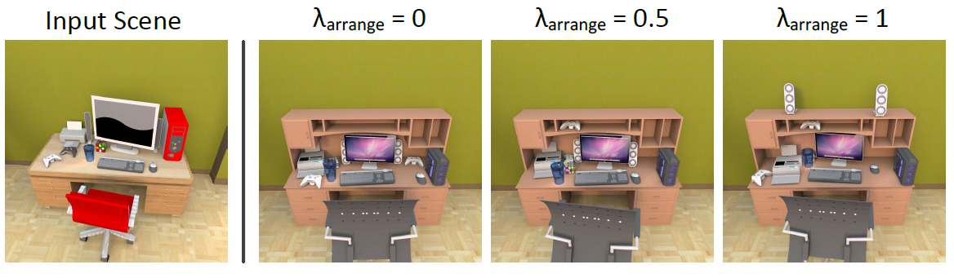
Probabilistic model
Arrangement model
Position and orientation relationships between all pairs of object categories using Gaussian mixture models.
Placement surfaces for objects using a simple Gaussian kernel density estimation approach.
Notes:
使用貝式網路B(S)來組成物件的分佈模型 we use a Bayesian network B(S) to model the distribution over the set of objects that occur in a scene.
定義一個靜態連結的parent-child機率模型 Define a probabilistic model over possible parent-child static support connections. The probability of the parent-child support hierarchy given the set of objects in the scene.

Slide 27
Contextual categories
Notes:
Compare the results of synthesizing using basic and contextual categories.

Slide 28
Human Evaluation
Online judgment study on three types of scenes: gamer desks, study desks, dining tables.
Recruited 30 participants via Amazon Mechanical Turk.
5-point liker scale (1=completely random, 5=very plausible)
About 80% of systh scenes are not distinguishable from hand-created scenes by a casual observer.
Notes:
Each participant was shown 51 scene images.

Slide 29
Upright Orientation of Man-Made Objects
Hongbo Fu(1) Daniel Cohen-Or(2) Gideon Dror(3) Alla Sheffer(1)
(1)University of British Columbia (2)Tel Aviv University (3)The Academic College of Tel-Aviv-Yaffo
SIGGRAPH 2008

Slide 30
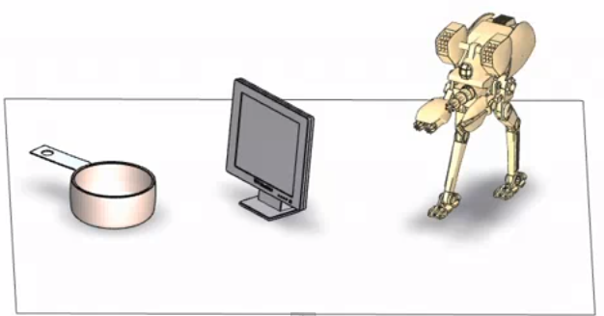
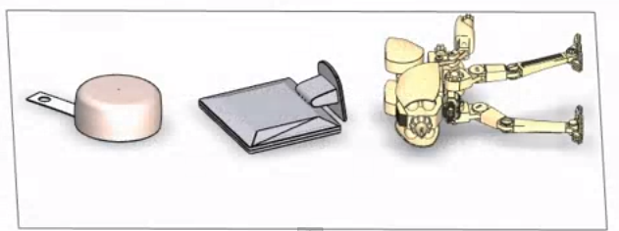
Introduction
Infer objects upright orientation by analyzing geometry.

Slide 31
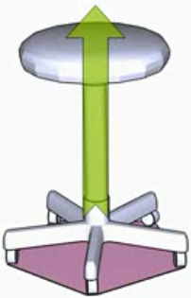
System Overview
The objects are stand on a flat surface, each of them has a natural base.

Slide 32
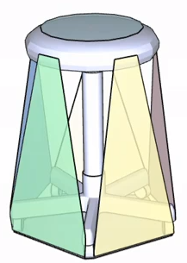
System Overview
Extract a set of candidate bases by analyzing the object’s convex hull.
7 candidate bases

Slide 33
System Overview
Per-Candidate Features
Function-related geometric attributes
Four categories:
Stability
Symmetry
Parallelism
Visibility
Notes:
Tailored for orientation discrimination

Slide 34
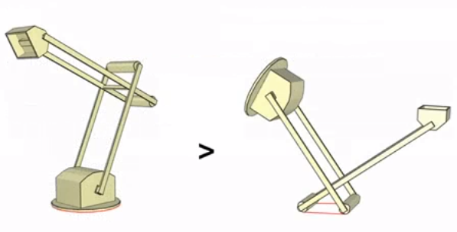
System Overview
Per-Candidate Features
Function-related geometric attributes
Four categories:
Stability
Symmetry
Parallelism
Visibility

Slide 35
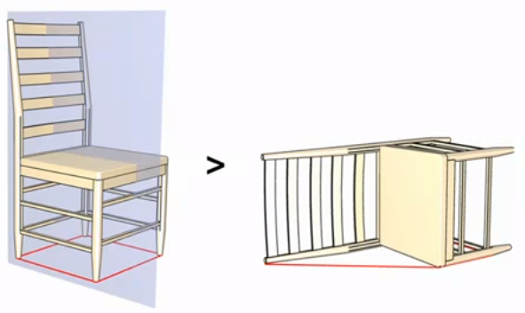
System Overview
Per-Candidate Features
Function-related geometric attributes
Four categories:
Stability
Symmetry
Parallelism
Visibility

Slide 36
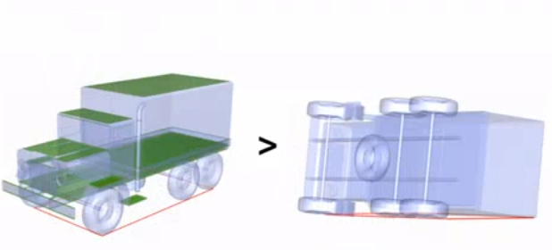
System Overview
Per-Candidate Features
Function-related geometric attributes
Four categories:
Stability
Symmetry
Parallelism
Visibility

Slide 37
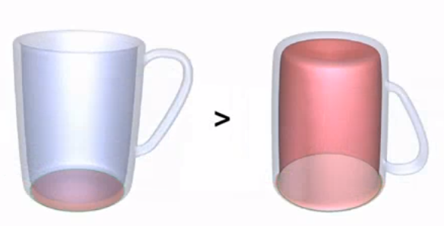
System Overview
Per-Candidate Features
Function-related geometric attributes
Four categories:
Stability
Symmetry
Parallelism
Visibility

Slide 38
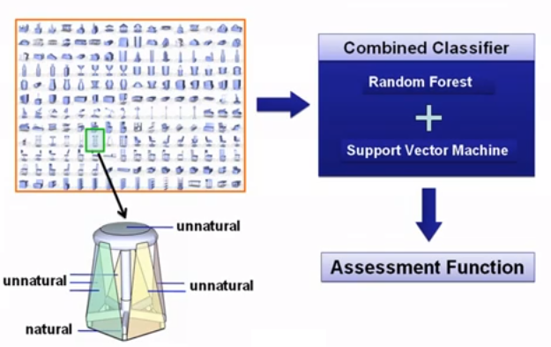
System Overview
Assessment function learning

Slide 39
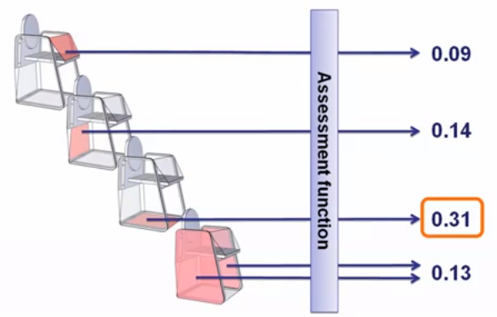
System Overview
Predicting

Slide 40
Validation Results

