Slide 1
Inferring User Interest Familiarity and Topic Similarity with Social Neighbors in Facebook
Department of Computer Science, KAIST
Dabi Ahn, Taehun Kim,
Soon J. Hyun, Dongman Lee
IEEE 2012 Web Intelligence and Intelligent Agent Technology

Slide 2
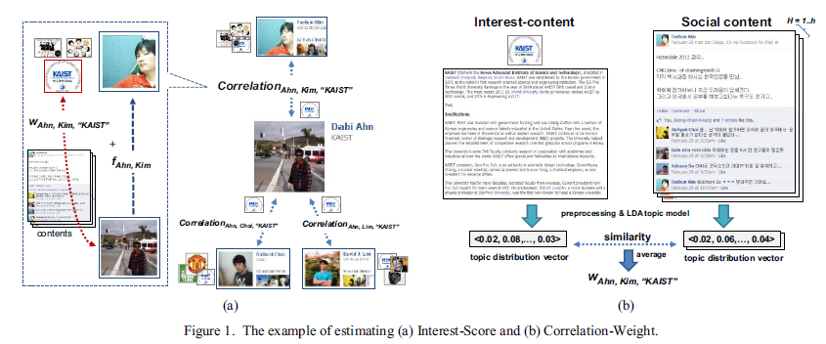
System Workflow

Slide 3
Inferring User Interest Using Topic Structure
We formally define Interest-Score for interest i_{k} of user u_{i} as:
Correlation_{i,j,k}，the strength of correlation between u_{i} and u_{j} for i_{k}, is defined as:
Notes:
W = Correlation-Weight
F = Online Familiarity

Slide 4
Correlation-Weight
We compute Correlation-Weight w_{i,j,k} by estimating similarity between the two topic distribution vectors and averaging them
h = 1 to H(the number of total social activities between u_{i} and u_{j})
= a topic distribution vector of each social content
= a topic distribution vector of each interest content

Slide 5
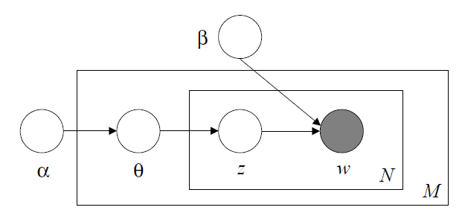
Latent Dirichlet Allocation(LDA)
The parameters and are corpus-level parameters.
The variables are document-level variables
The variables z_{dn} and w_{dn} are word-level variables and are sampled once for each word
in each document

Slide 6
Online Familiarity
We formulate Online Familiarity f_{i,j} as:
Freq(i,j) is defined as:
P_{i,j} = u_{i} writes a posting into u_{j}’s wall
C_{i,j} = u_{i} writes comment(s) in u_{j}’s posting
L_{i,j} = u_{i} likes u_{j}’s posting.
Notes:
N(Social Activity) = is the number of social activity

Slide 7
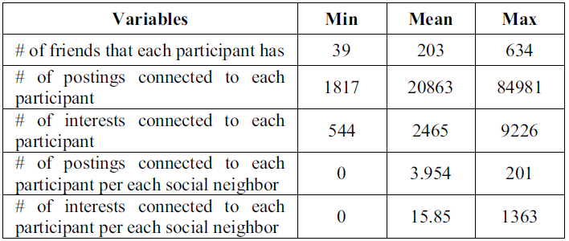
Dataset
A user writes a posting on his social neighbor’s wall or a posting is written in his wall by the social neighbor.
A user writes comment(s) in his social neighbor’s posting or comment(s) is written in his posting by the social neighbor.
A user likes his social neighbor’s posting or his posting is liked by the social neighbor.(In Facebook, a user expresses his/her preference about a post by pressing the “Like” button.)
Notes:
50 participants(35 males and 15 females)

Slide 8
Evaluation
Based on User Explicit Interest
EXP is set of the user’s explicit interests
INF_{N} is a set of top-N inferred interests ordered by Interest-Score
Based on Questionnaire

Slide 9
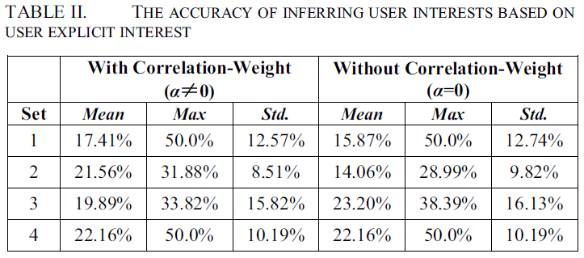
Result
Notes:
Set 1 the average precision(recall) from all participants
Set 2 from 12 participants
Set 3 from 4 participants
Set 4 from 24 participants
#for the remaining 10 participants, they have not specified any their interests in Facebook.

Slide 10
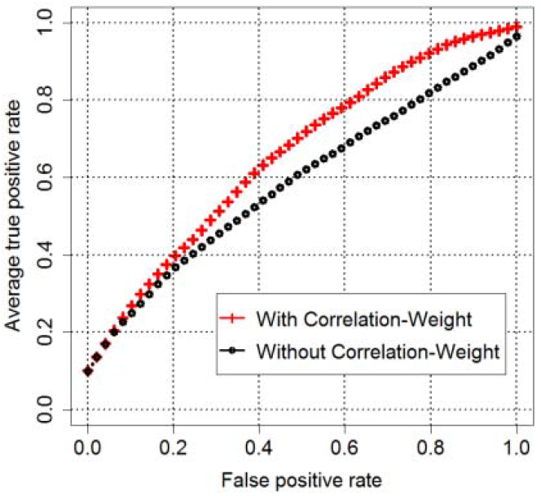
Result

Slide 11
Conclusion
We consider topic similarity between communication contents and interest descriptions as well as the degree of familiarity
We plan to extend the proposed scheme by using not only spatial aspects such as a user’s location, trace history or characteristics of a place, but also temporal context like time slots

