Slide 1
An Online News Recommender System for Social Networks
Department of Computer Science University of Illinois at Urbana-Champaign
Manish Agrawal, Maryam Karimzadehgan, ChengXiang Zhai
SIGIR Search in Social Media 2009

Slide 2
Facebook
In general, two users may be connected in three different ways：
User a is a friend of User b
User a and User b belong to the same network
User a and User b belong to the same group
Connection 1 and 2 are strong connections, in the sense, that a user can see the profiles of all his friends and also the profiles of all the people in his network(s)

Slide 3
Content-based recommendation
As an example, the following shows the set of Indri queries used in our system for the “University of Illinois” community：
#syn = are used as synonyms.
#2(a b) matches “a * b”(where * is any word or null).
#1(U of I) exactly matches “U of I”.
Notes:
#syn 同義詞
#2 matches 2 trem * is the 萬用字元
#1 準確的matches
#uw 無限無序的只要有matches就極可

Slide 4
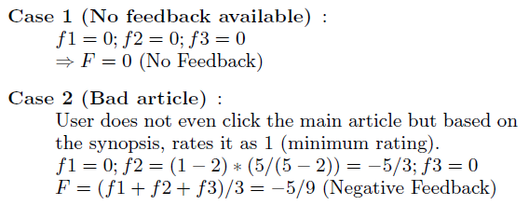
Collaborative User Feedback
The user feedback is captured in three different ways:
Clickthroughs of articles
Ratings of articles
Recommendation of an article by a user to another user

Slide 5
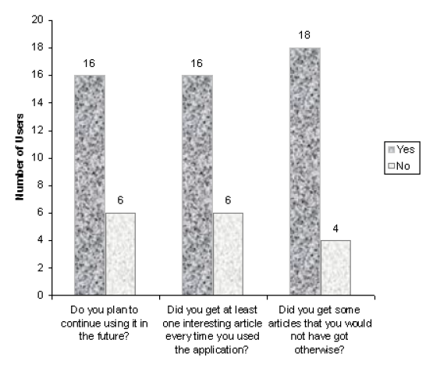
Pilot Study

Slide 6
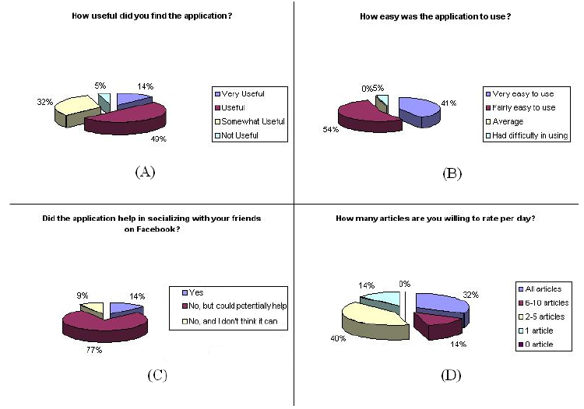
Pilot Study

Slide 7
Group Recommendation System for Facebook
Department of Computer Science and Engineering University of North Texas
Enkh-Amgalan Baatarjav, Stanti Phithakkitnukoon, Ram Dantu
OTM 2008 Workshops
Notes:
http://www.onthemove-conferences.org/

Slide 8
Basic Architecture
Group recommendation system(GRS)
Profile feature extraction
Classification engine
Final recommendation

Slide 9
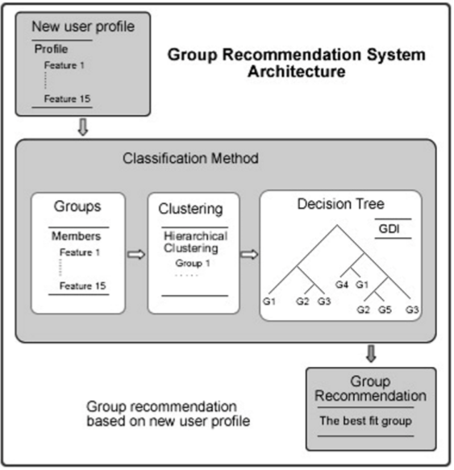
Basic Architecture

Slide 10
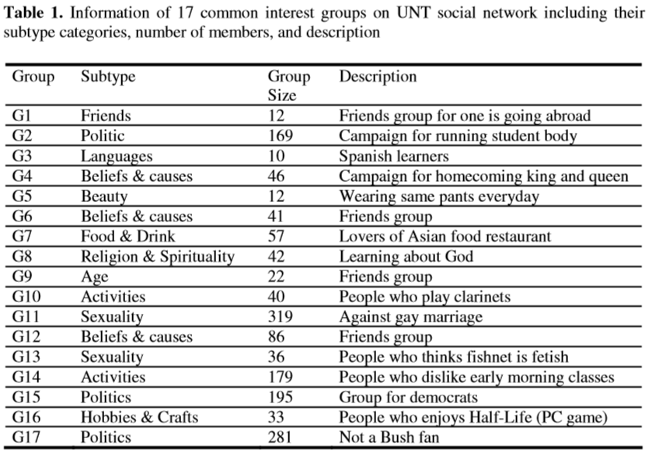
Profile Features
Notes:
University of North Texas(UNT)

Slide 11
Similarity Inference
Clustering takes place in the following steps for each group：
Normalizing data
Computing a distance matrix to calculate similarities among all pairs of members
using unweighted pair-group method using arithmetic averages (UPGMA) on distance matrix to generate hierarchical cluster tree
Notes:
Distance = Euclidian distance
不加權平均重法為使用樣本距離矩陣和原始資料為依據進行分析。此方法屬於層次具類方法(hierarchical clustering)之一，為一種常用的群集方法。此方法是由一系列的梯次分析為多步驟完成的分群分類法。此方法梯次分析分群方法是不可逆的，也就是說，當通過此方法將兩群分群組合合併後，無法通過再將其分離到合併的狀態。

Slide 12
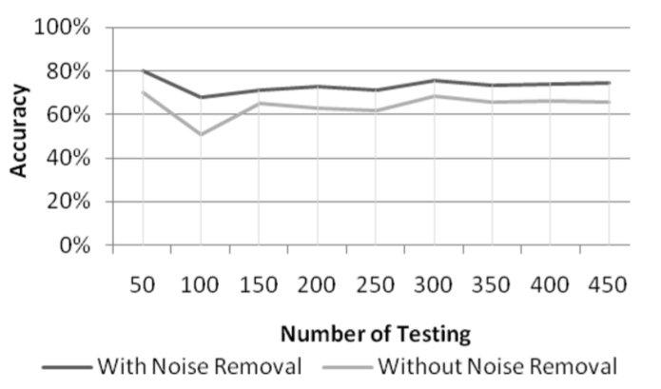
Result
We used 50% of data for training and other 50% for testing.
Notes:
Average accuracy without clus- tering was 64%. Meanwhile, after removing noise from each group using clustering coefficient method, average accuracy improved to 73%. In other words, average accu- racy improved by 9%

Slide 13
On the Evolution of User Interaction in Facebook
Max Planck Institute for Software Systems
Kaiserslautern/Saarbrucken, Germany
Bimal Viswanath, Alan Mislove, Meeyoung Cha,
Krishna P. Gummadi
ACM Workshop on Online social networks 2009
Notes:
Alan Mislove
Rice University
Houston, Texas

Slide 14
Data Set
Data: Facebook New Orleans Network
Users: 90,269 users
Friendship links: 3,646,662 links
Limitations
Users can interact in many ways
Users privacy setting
Users who were not connected to the networks
Our data set is based on a single network

Slide 15
Cumulative distribution function
Notes:
累積分配函數 (Cumulative distribution function)
設X為一隨機變數，x為一實數，且設 F(x) = P(X≦x)，
則稱F為隨機變數X的累積分配函數，以C.D.F表示。
定義：累積分配函數係用以求算特定變量之以下累加機率之函數。
http://en.wikipedia.org/wiki/Cumulative_distribution_function

Slide 16
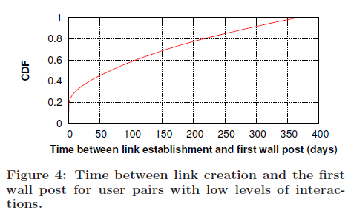
Patterns of infrequent interactions
We are interested in understanding the reasons for the low level of interaction
Notes:
CDF => Cumulative distribution function
定義：累積分配函數係用以求算特定變量之以下累加機率之函數。

Slide 17
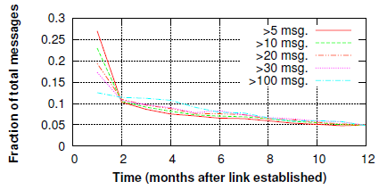
Patterns of frequent interactions
We are particularly interested in knowing whether wall posts are spread out evenly in time
Notes:
Msg = wall posts.

Slide 18
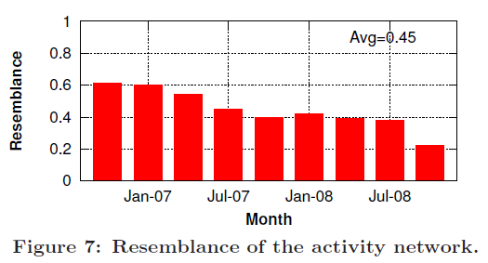
Refresh rate of the activity network
We use the notion of resemblance. Resemblance is used to measure the quantitative overlap between two sets.
P_{t} is the set of links that are active at time t.
Notes:
測量使用者保持活躍度
0.45 => 說明使用者保持活躍的數量

Slide 19
Conclusion
Our analysis demonstrate that there is a significant skew in the distribution of activity across links：
A minority of the user pairs generate a majority of the activity.
A general decay in the amount of interaction between pairs of users, suggesting that the activity network is rapidly changing over time.
Notes:
我們的分析表明，有一個顯著歪斜的活動分佈在整個鏈接：
少數用戶對生成的大部分活動。
我們觀察到一般對用戶之間的相互作用的量衰減，這表明活性的網絡迅速地隨時間而改變。

Slide 20
The Impact of YouTube Recommendation System on Video Views
College of Computer Science and Technology Harbin Engineering University, Harbin, China
Renjie Zhou
Department of Electrical and Computer Engineering University of Massachusetts, Amherst, USA
Samamon Khemmarat, Lixin Gao
ACM SIGCOMM Internet measurement 2010

Slide 21
Data Source
On YouTube, a video is viewed on a page named watch page, We focus on three elements of the data.
Video metadata
Related video list
View statistics & data

Slide 22
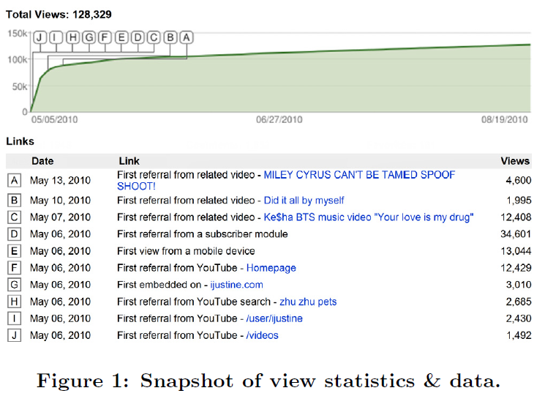
Data Source

Slide 23
Data Collection
We describe how we collected the two data sets in this study.
D1：
the videos by capturing and parsing YouTube video requests at a university network gateway.
D2：
We retrieved 400 featured videos via API as the initial set, crawled their associated data.
Notes:
https://developers.google.com/youtube/?hl=zh-tw

Slide 24
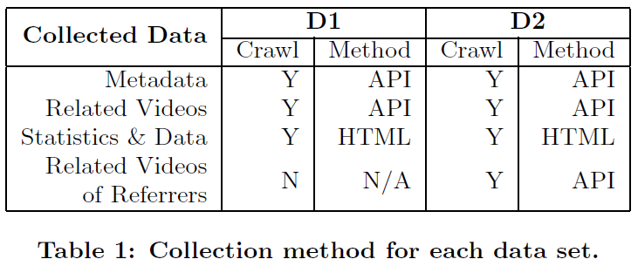
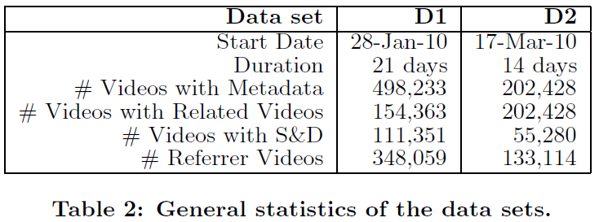
Data Collection

Slide 25
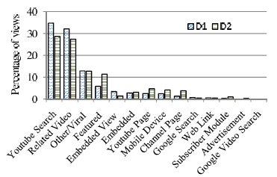
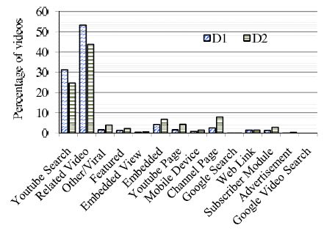
Sources of Video Views
Percentage of tracked views from each category
Percentage of videos dominated by each category

Slide 26
Gini Coefficient
堅尼指數（Gini index）是指堅尼係數乘100倍作百分比表示。在民眾收入中，如堅尼係數最大為「1」，最小等於「0」。即人與人之間收入絕對平等，但這兩種情況只出現在理論上；堅尼係數越小收入分配越平均，吉尼係數越大收入分配越不平均。
n is the number of total videos
X_{k} is the percentage of the first k videos
Y_{k} is the percentage of the views from the first k videos
Notes:
沒有顯示出來在哪裡存在分配不公。
國際間並無制定堅尼係數的準則，一些問題（如應否除稅項，應否剔除公共援助受益者，應否剔除非本地居民，或應否加入政府的福利）並沒有一致性，以至缺乏比較的準則。

Slide 27
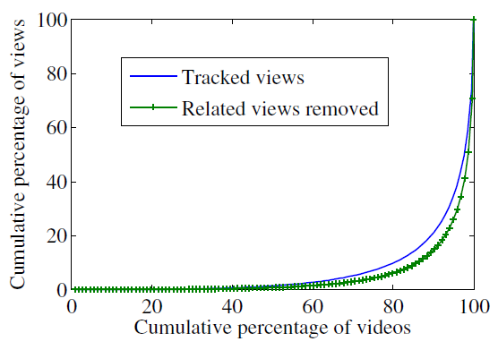
Result
Notes:
從上表中​​，我們發現，基尼係數為每個之間的間隙的情況是相當高的，這意味著熱門影片欣賞和特殊視頻是巨大的。這是證實由洛倫茲曲線，它顯示了在90％以上的意見是從20％的影片。此外，當我們刪除的意見，從推薦系統，基尼係數變得更高。這表明推薦系統的存在有助於減少基尼係數，換句話說，增加的觀點多樣性。

Slide 28
Inferring User Interest Familiarity and Topic Similarity with Social Neighbors in Facebook
Department of Computer Science, KAIST
Dabi Ahn, Taehun Kim,
Soon J. Hyun, Dongman Lee
IEEE 2012 Web Intelligence and Intelligent Agent Technology

Slide 29
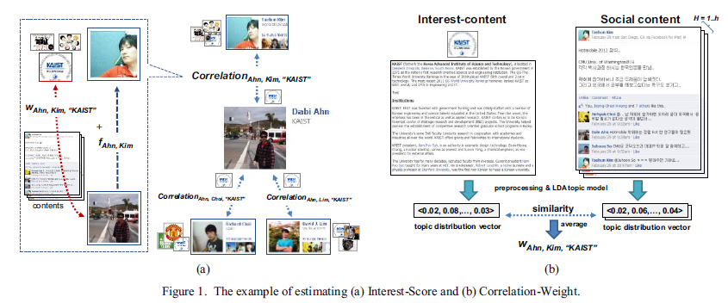
System Workflow

Slide 30
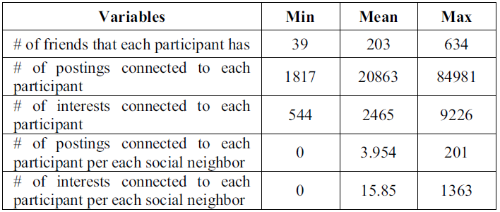
Dataset
A user writes a posting on his social neighbor’s wall or a posting is written in his wall by the social neighbor.
A user writes comment(s) in his social neighbor’s posting or comment(s) is written in his posting by the social neighbor.
A user likes his social neighbor’s posting or his posting is liked by the social neighbor.(In Facebook, a user expresses his/her preference about a post by pressing the “Like” button.)
Notes:
50 participants(35 males and 15 females)

Slide 31
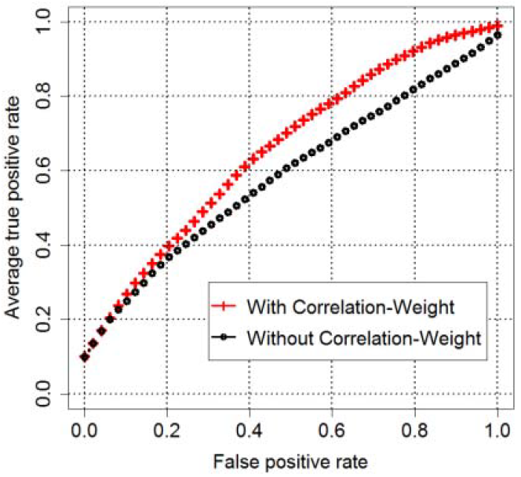
Result

