Slide 1
Social Media Recommendation based on People and Tags(SIGIR2010)
IBM Research Lab
Ido Guy,Naama Zwerdling
Inbal Ronen,David Carmel,Erel Uziel

Slide 2
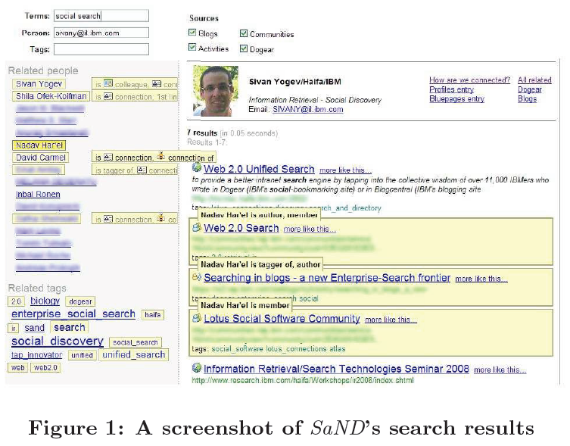
Social Networks and Discovery(SaND)
Notes:
文件、人物和標記使用一種統一的方法在社交數據搜索和檢索

Slide 3
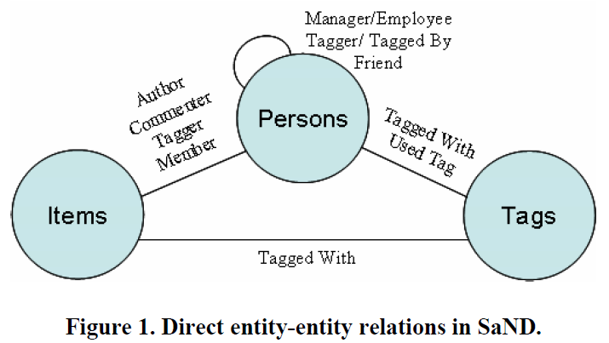
Direct entity-entity relations
Notes:
SaND => Social Networks and Discovery

Slide 4
Recommendation Algorithm
is a decay factor(set in our experiments to 0.025)
is a parameter that controls the relative weight
and are the relationship strengths of u to user v and tag t
Notes:
RS = Recommendation score

Slide 5
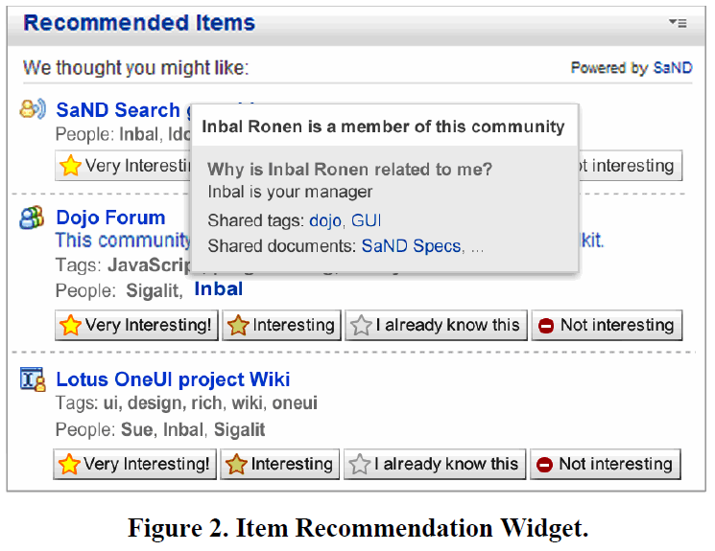
Item Recommendation Widget
Notes:
Item Recommendation Widget =>
The First is a blog entry
The Second is a community
The Third is a wiki

Slide 6
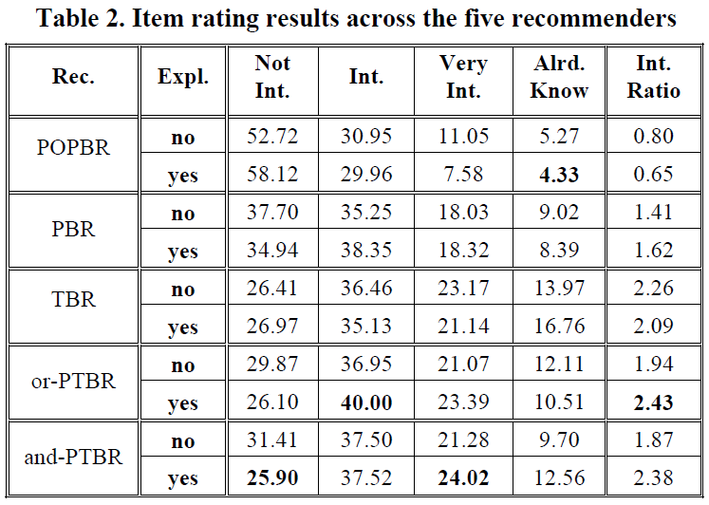
Result
Notes:
POPBR => popularity-based recommender
PBR => people-based recommender
TBR => tags-based recommender
or-PTBR => people or tags based recommender
and-PTBR => people and tags based recommender

Slide 7
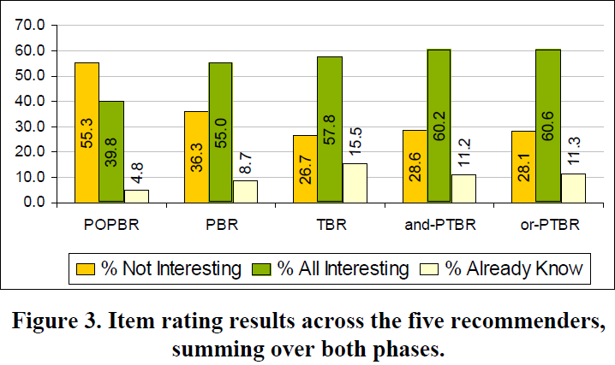
Result
Notes:
POPBR => popularity-based recommender
PBR => people-based recommender
TBR => tags-based recommender
or-PTBR => people or tags based recommender
and-PTBR => people and tags based recommender

Slide 8
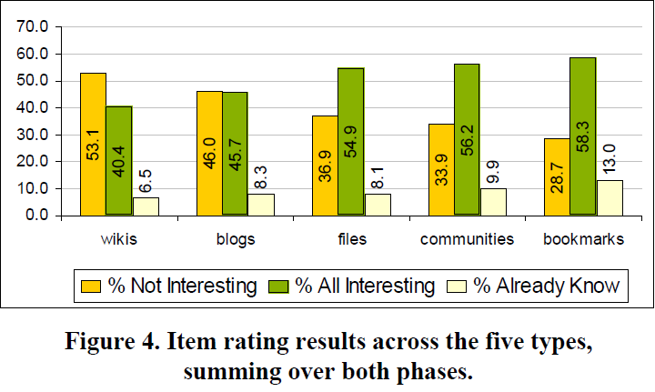
Result

Slide 9
On Social Networks and Collaborative Recommendation(SIGIR2009)
Dept. of Computing Science University of Glasgow United Kingdom
Loannis Konstas, Joemon M Jose
Vassilios Stathopoulos
Notes:
2010 12th International Asia-Pacific Web Conference

Slide 10
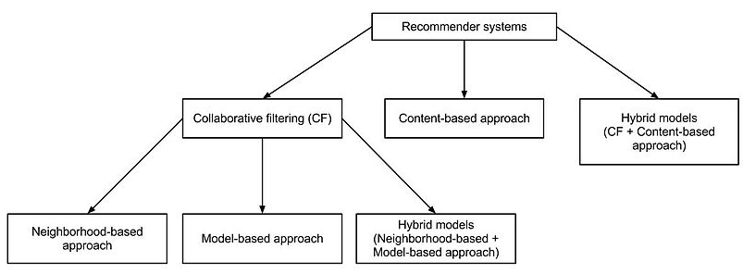
Collaborative Filtering

Slide 11
Random Walk with Restarts
How closely related are two nodes in a graph？
a = in every step there is a probability
q = is a column vector of zeros with the element corresponding to the starting node set to 1
P^{(t)} = denotes the probability that the random walk at step t
Notes:
a = 每一步的機率
q = 跟各個點相對應的向量
http://malt.ml.cmu.edu/mw/index.php/Random_walk_with_restart

Slide 12
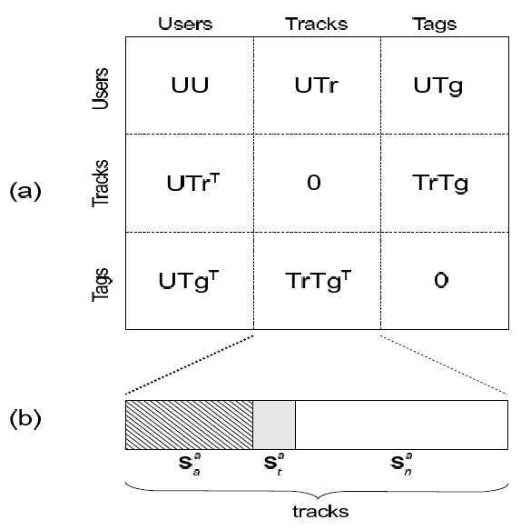
Social Graph and the Sub-matrices
Notes:
UU = User-User
UTr = User-Track
UTg = User-Tag
TrTg = Track-Tag
S = full social graph

Slide 13
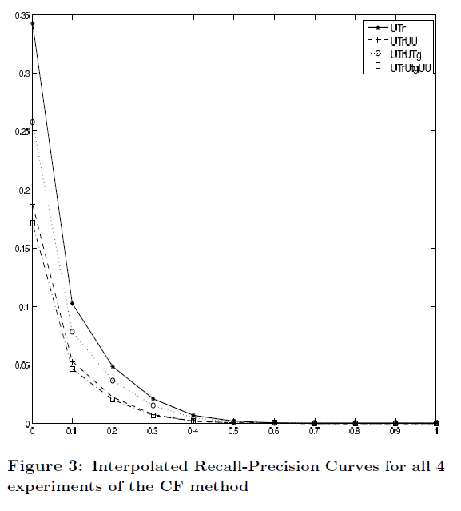
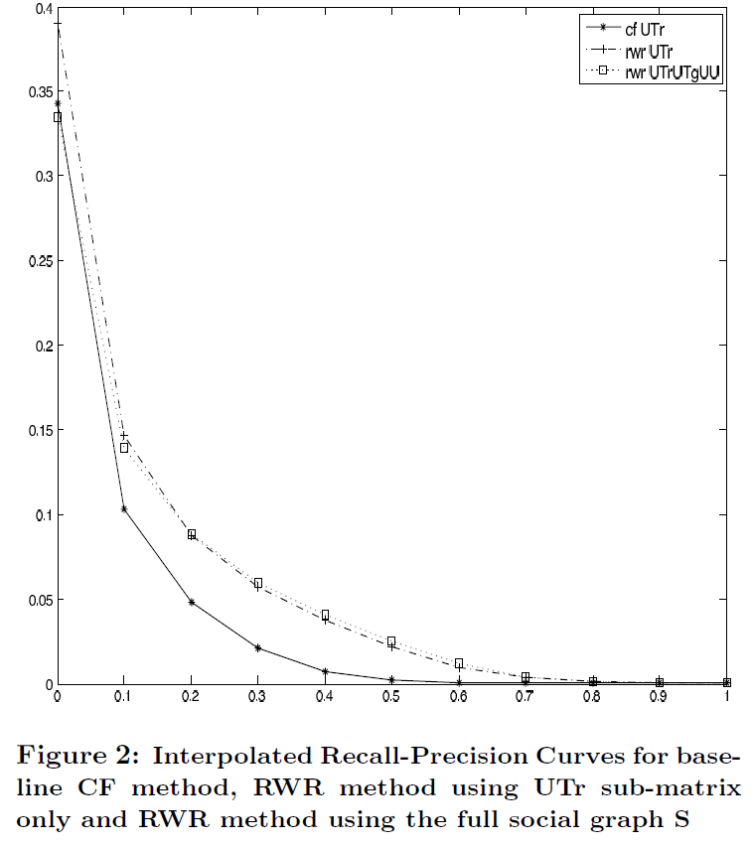
Result
Notes:
UU = User-User
UTr = User-Track
UTg = User-Tag
TrTg = Track-Tag
S = full social graph
橫軸 => Precision
縱軸 => Recall

Slide 14
Result
* = indicates statistical significane at p < 0.05 between consecutive experiments of RWR models
Notes:
UU = User-User
UTr = User-Track
UTg = User-Tag
TrTg = Track-Tag

Slide 15
Graph-based Recommendation on Social Networks(IEEE2010)
School of Electronics Engineering and Computer Science Peking University
Beijing, P.R. China
Ziqi Wang, Yuwei Tan, Ming Zhang
Notes:
2010 12th International Asia-Pacific Web Conference

Slide 16
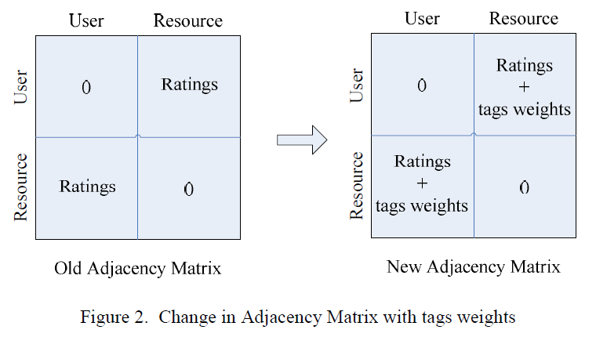
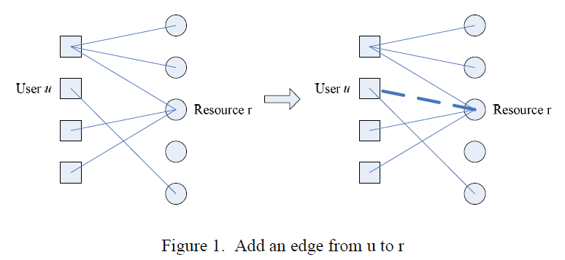
Tag-based Promotion Algorithms
Notes:
雙方User的對於Tag的權重

Slide 17
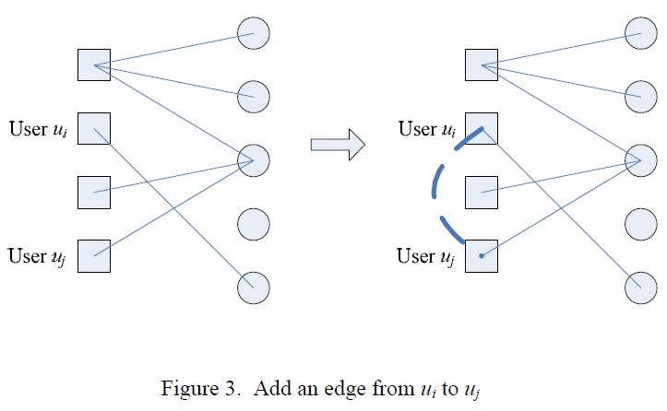
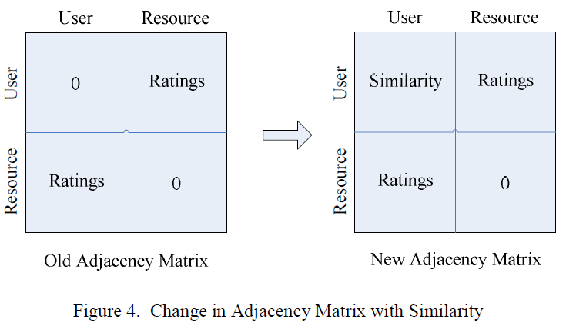
User’s similarity based on their tagging information
Notes:
使用者之間的相似程度是只說他們擁有相同的Tag在同一個Resource上的數值來算他們的相似程度

Slide 18
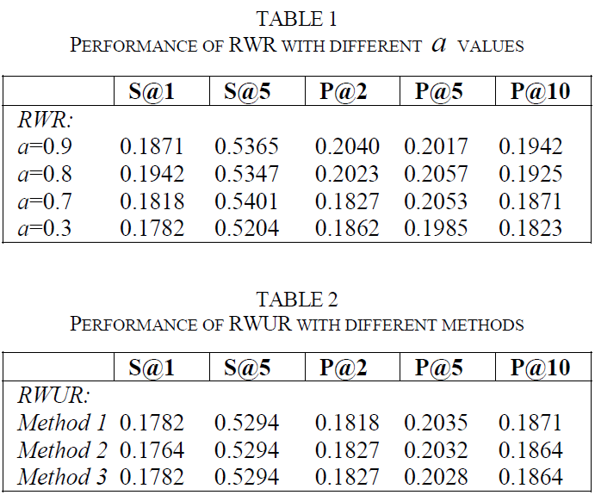
Result
Notes:
Java language 1.66GHz Intel Core 2 Duo CPU with 2GBmemory Windows Vista
RWR = Random Walk with Restart
a = is the probability of re-start (0.8 and 0.9 are better then others)
RWUR = User-Resource Tag-based Algorithm
RWUU => User-User Tag-based Algorithm
P@k => reports the proportion of resources ranked in the top K results that is relevant
S@k => This metrics reports the probability of finding a good resource among the top K results

Slide 19
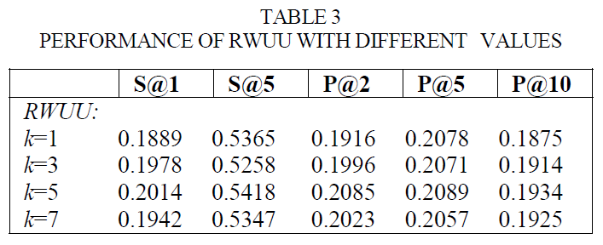
Result
RWR = Random Walk with Restart
RWUR = User-Resource Tag-based Algorithm
RWUU = User-User Tag-based Algorithm
P@k = Precision at rank K
S@k = Success at rank K
Notes:
RWUU => User-User Tag-based Algorithm
P@k => reports the proportion of resources ranked in the top K results that is relevant
S@k => This metrics reports the probability of finding a good resource among the top K results

Slide 20
Learning Optimal Ranking with Tensor Factorization for Tag Recommendation(KDD2009)
University of Hildesheim
Steffen Rendle, Leandro Balby Marinho
Alexandros Nanopoulos, Lars Schmidt-Thieme
Notes:
Germany
Institute for Computer Science
Information Systems and Machine Learning Lab(ISML)

Slide 21
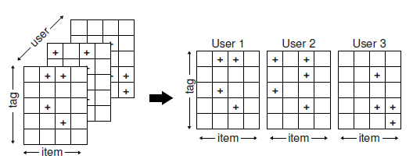
Ternary Relationship

Slide 22
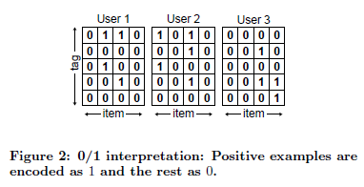
0/1 Interpretation Scheme
The semantics are obviously incorrect
Also from a sparsity point of view the 0/1 scheme leads to a problem
Notes:
缺點 => 如有未知的狀態時，會無法使用
S = Ternary relation 三元關係
問題：
有明顯的語意不正確
0/1 scheme會有很稀疏的矩陣

Slide 23
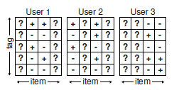
Post-based Ranking Interpretation Scheme

Slide 24
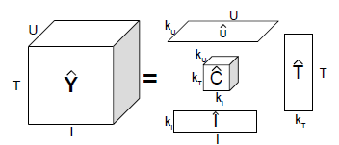
Tensor Factorization Model
U = Users
T = Tags
I = Items
C = Small core tensor
k = are the dimensions of the low-rank approximation
Notes:
Small core tensor = C
k are the dimensions of the low-rank approximation
The feature matrices = U,I,T

Slide 25
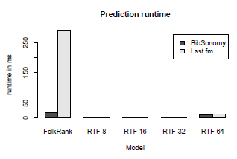
Datasets
Notes:
S
Ps
Last.fm
http://cn.last.fm/music/Bigbang/Alive/Intro+(Alive)

Slide 26
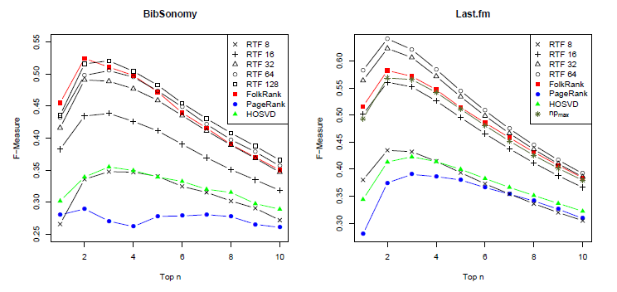
Result

Slide 27
Result
Notes:
AUC = Area Under Curve 數值越大越好

Slide 28
Predicting Tie Strength With Social Media(SIGCHI2009)
University of Illinois at Urbana-Champaign
Eric Gillbert, Karrie Karahalios

Slide 29
Strong Ties and Weak Ties
Strong ties are the people you really trust, people whose social circles tightly overlap with your own.
Weak ties, conversely, are merely acquaintances
Notes:
Weak Ties => 只是相識的人，沒有非常的熟。

Slide 30
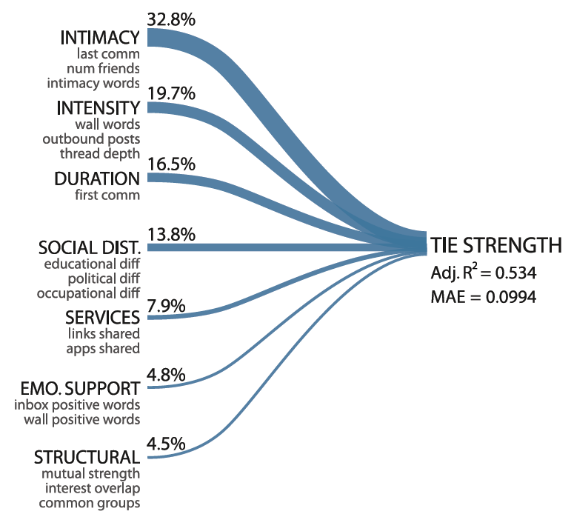
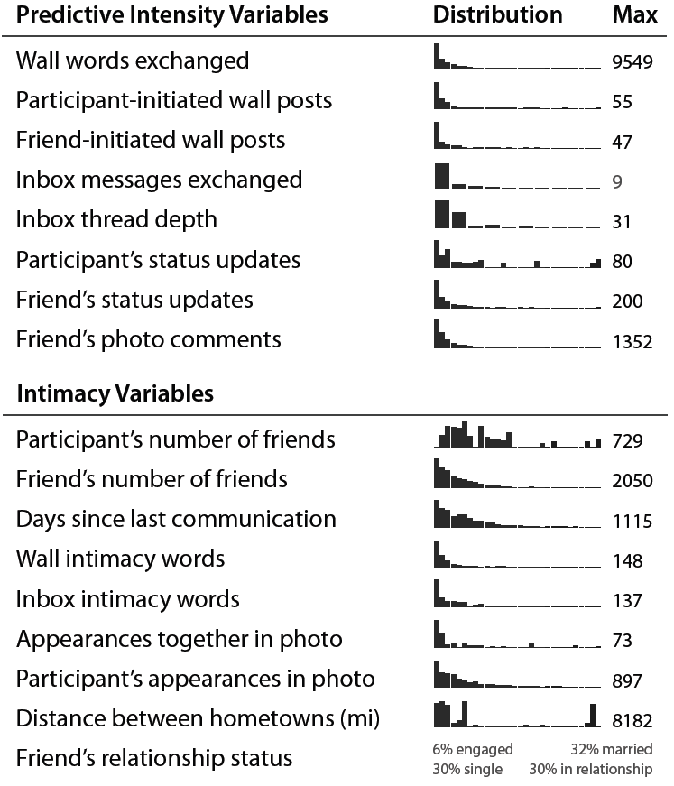
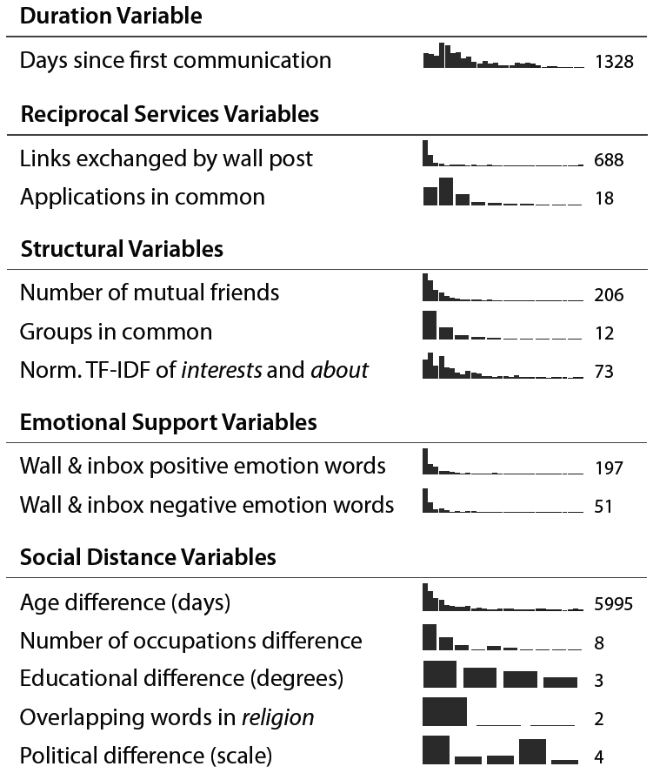
Seven Dimensions On FaceBook
Notes:
Predictive Intensity預測強度
Intimacy親密程度
Duration期間長短
Reciprocal Services互動程度
Structural結構
Emotional Support情緒化
Social Distance社群距離

Slide 31
Error Analysis Interviews
Asymmetric Friendships
Educational Difference
Confounding the Medium
Notes:
因為之前在一起研究的教授，所以在FB上稱為朋友，但其實也沒有算是真的朋友
因為七年前我們還有互動，但是現在在FB上稱為朋友 但是卻不一定是
假設有很好的朋友，可是他們不只會用FB也會使用email、phones、IM等等的溝通工具，所以也無法很完整的呈現

Slide 32
Limitations
Limitations
We purposely worked from theory to extend this research beyond just Facebook.
The specific predictive variable coefficients may not move beyond Facebook.
Conclusion
We have revealed a specific mechanism by which tie strength manifests itself in social media.

