Slide 1
Mobile recommendation systems for decision making ‘on the go’
University of Surrey,UK
Han van der Heijden
Johannes Kepler University Linz,Austria
Gabriele Kotsis, Reinhard Kronsteiner
Notes:
IEEE ICMB 2005 的Paper
物品的比較

Slide 2
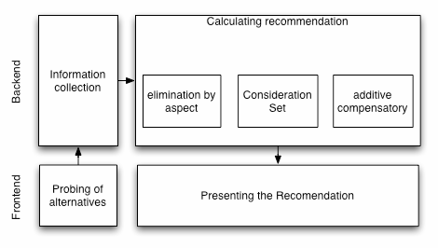
Prototype

Slide 3
Elimination by aspect
Support for the EBA strategy varies with the scale of the attribute in question.
EBA support for attributes of every scale could be in the form of a dichotomous recommendation
One solution is to treat the lowest or highest value of the alternatives available in the room as anchor points.
Notes:
EBA 是因為物品的屬性有很多，但不盡然都有統一的單位或是格式
所以在此步驟會將資料進行 dichotomous recommendation(二分推薦)

Slide 4
Additive compensatory
The essential part of a compensatory strategy is comparison between one product and one or more others.
The system calculates the index using the attribute values and the weights, and standardises the final index on a range of 1 to 100.
Notes:
因為比較物品的一些屬性會差距很大，像是手機跟書籍的價格
所以在AC部分將最後的分數讓他分布在1~100之間

Slide 5
Conclusion
Throughout this paper, we have been focusing on multi-attribute
Clearly this is but one way of making decisions.
In an impulse and emotionally charged
The time when environments start emitting data signals is not far away, and the usefulness of these systems.

Slide 6
A Mobile Product Recommendation System Interacting with Tagged Products
Auto-ID Labs ETH Zurich and SAP Research CEC Zurich Switzerland
Felix von Reischach, Dominique Guinard
Auto-ID Labs ETH Zurich Switzerland
Florian Michahelles, Elgar Fleisch
Notes:
IEEE 2009的Paper
看到一個物品但是太貴或是其他原因讓自己沒有辦法買

Slide 7
Abstract
Mobile devices are evolving into permanent companions of consumers. In many developed countries the mobile phone penetration is well above 90%
Consumers spend considerable time on comparing products before taking a buying decision.

Slide 8
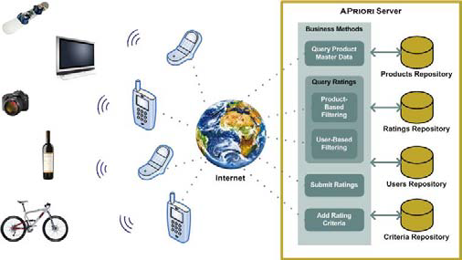
Prototype
Products and Tags
Mobile Phone and Mobile Application
Apriori Server Application
Notes:
NFC的技術來當作物品的Tags
手機部分是使用Nokia 6131 NFC的手機來測試

Slide 9
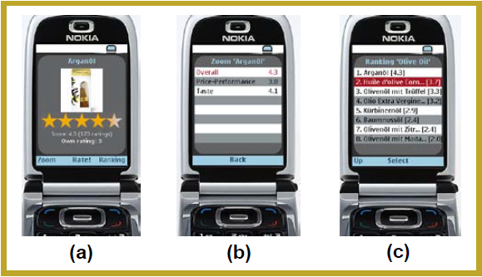
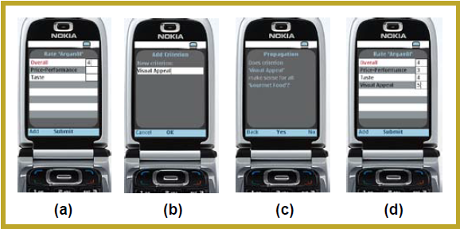
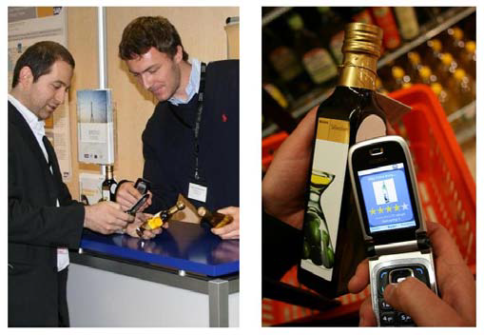
Result

Slide 10
Conclusions
Based on the implementation of Apriori and first user feedback we discuss real-world challenges of pervasive product recommendation

Slide 11
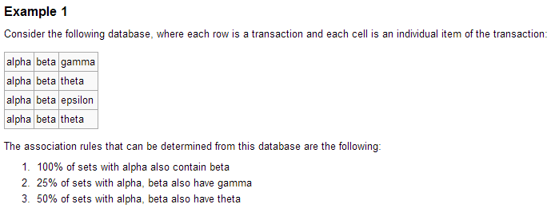
Apriori algorithm

Slide 12
Foafing The Music:A Music Recommendation System Based on RSS feeds and User Preferences
Music Technology Group Universitat Pompeu Fabra
Oscar Celma , Miquel Ramirez , Perfecto Herrera
Notes:
WWW2008的Paper

Slide 13
System Overview
Music Recommendations
Music Related News Filtering

Slide 14
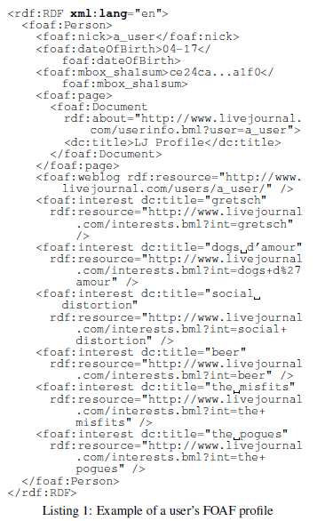
Music Recommendations
Get interests from user’s FOAF profile
Detect artists and bands
Select related artists, from artists encountered in the user’s FOAF profile
Rate results by relevance

Slide 15
Music Related News Filtering
PubSub is a matching service instantly notifies a user whenever new content matching user’s subscription is created
Jabber is an open secure protocol, an ad-free alternative to consumer instant messaging services.

Slide 16
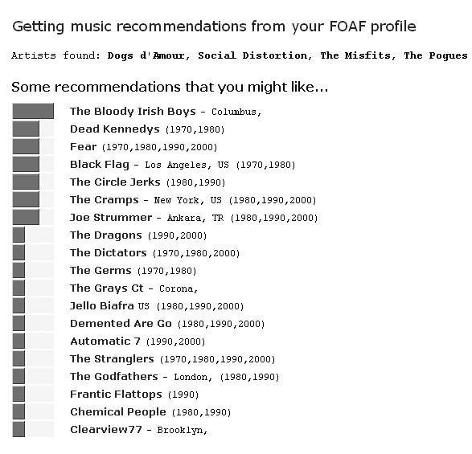
Result

Slide 17
Conclusions
This system is able to filter and to contextualize users’ queries.
Past music recommender based on collaborative system
Notes:
系統有情境化使用者的要求
Collaborative system後面會說明

Slide 18
PubSub
WebSite：http://www.pubsub.com
PubSub reads over 13 million weblogs and more than 50,000 internet newsgroups.

Slide 19
Incorporating Multi-Criteria Ratings in Recommendation Systems
Department of Engineering Science National Cheng Kung University
Hsin-Hsien, Wei-Guang Teng
Notes:
IEEE 2005的PAPER
有時候我們在買東西時，會覺得很多東西都很符合我們的需求
沒有一個是全部都最好的可以壓倒性贏的物品

Slide 20
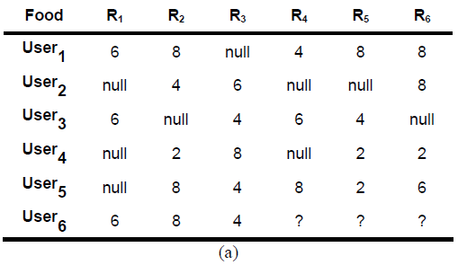
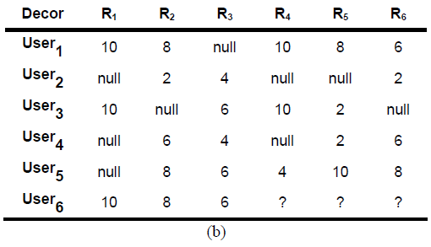
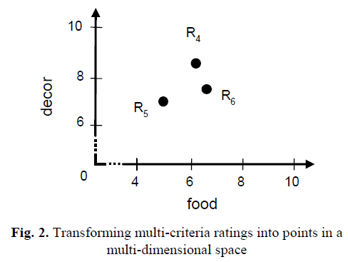
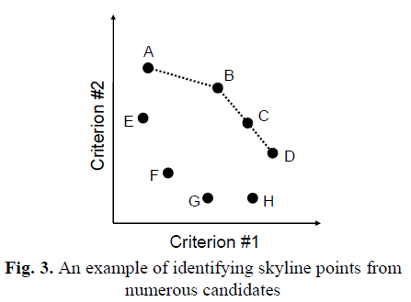
Prototype
From single criterion to multi-criteria ratings
Extending CF(Collaborative Filtering) Techniques for Multi-Criteria Recommendations
Utilizing Skyline Queries

Slide 21
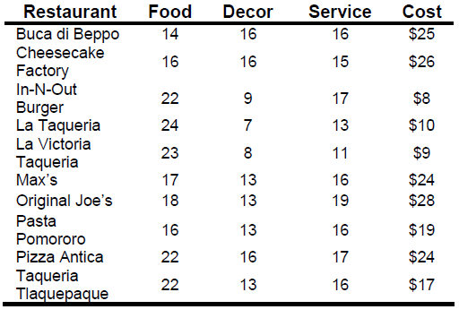
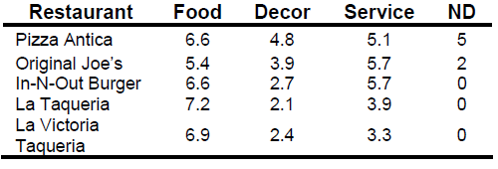
Result

Slide 22
Conclusions
We have extended the concept of single criterion ratings to multi-criteria ones.
We have considered the multi-criteria recommendation problem as a data query problem.

Slide 23
Adderssing Cold-Start Problem in Recommendation Systems
Vietnam National University of Ho Chi Minh City
Xuan Nhat Lam、Anh Duc Duong
Sungkyunkwan University Suwon
Trong Duc Le
Stanford University
Thuc Vu

Slide 24
Prototype
The User-Info Aspect Model
Parameter Estimation
Expectation Maximization(EM)
Prediction
Notes:
EM簡單教程
EM是一個在已知部分相關變數的情況下，估計未知變數的迭代技術。EM的演算法流程如下：
初始化分布參數
重複直到收斂：
E步驟：估計未知參數的期望值，給出當前的參數估計。
M步驟：重新估計分布參數，以使得數據的似然性最大，給出未知變數的期望估計。
應用於缺失值。

Slide 25
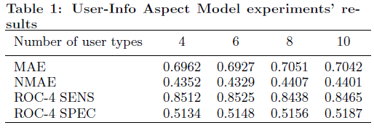
Result

Slide 26
Conclusions
More critical attributes of users should be selected to improve the performance.
This model may be applied to solved item-side cold-start.

