Slide 1
Capacitive Fingerprinting: Exploring User Differentiation by Sensing Electrical Properties of the Human Body
Chris Harrison
Munehiko Sato
Ivan Poupyrev
Disney Research Pittsburgh
Carnegie Mellon University
University of Tokyo
UIST’2012

Slide 2
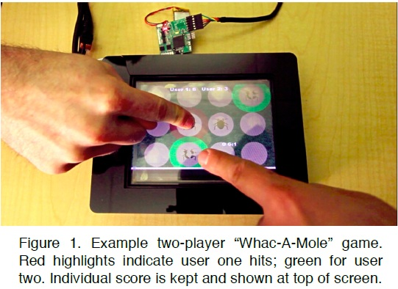
ABSTRACT
Touchscreens can differentiate multiple points of contact, but not who is touching the device.
Electrical properties of humans and their attire can be used to support user differentiation on touchscreens.

Slide 3
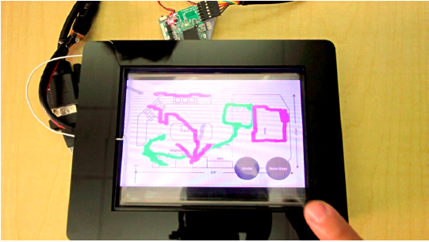
Title
Electrical properties of users’ bodies can be used for differentiation – the ability to tell users apart, but not necessarily uniquely identify them.
Not only report finger touch locations, but
also identify to which user that finger belongs.

Slide 4
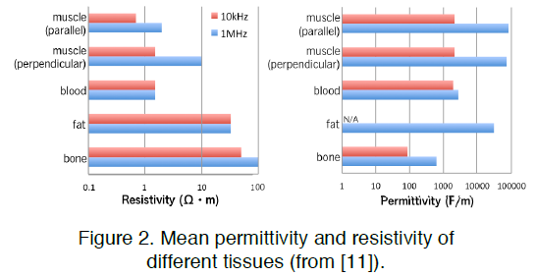
Title
We estimate impedance profiles of users at different frequencies.
The fundamental physical principle behind Capacitive Fingerprinting is that the path of alternating current (AC) in a human body depends on the signal frequency.

Slide 5
PROTOTYPE

Slide 6
APPLICATIONS
There are many games, especially for tablets,that allow two users to play simultaneously.
Using Capacitive Fingerprinting, it is possible for two players to interact in a common game space.

Slide 7
FUTURE WORK
We are also curious as to how our approach could be applied to differentiating between humans and non-humans (e.g., bags, drinks) in ride systems and other applications.

Slide 8
WorldKit: Rapid and Easy Creation of Ad-hoc Interactive Applications on Everyday Surfaces
Chris Harrison
Robert Xiao
Scott E. Hudson
Carnegie Mellon University
Human-Computer Interaction Institute
CHI 2013

Slide 9
ABSTRACT
WorldKit system, which makes use of a paired depth camera and projector to make ordinary surfaces instantly interactive.
Using this system, touch-based interactivity can
without prior calibration, be placed on nearly any unmodified surface literally with a wave of the hand, as can other new forms of sensed interaction.

Slide 10
Title
The system automatically selects an orientation for the interactor, which can optionally be adjusted by dragging a hand around the periphery of the selected area.
Once all elements have been instantiated, the interface
starts and can be used immediately

Slide 11
One-Time Projector / Depth Camera Calibration
The calibration above only needs to be performed once .The setup can then be transported and installed anywhere.
Depth sensor is used to automatically learn about new environments without requiring explicit steps to measure or (re-)calibrate in a new space.
environment changes temporarily or permanently after
interfaces have been defined by a user (e.g., a surface being projected on is moved), it may be necessary to re-define affected interfaces.

Slide 12
Title
When the system starts up, we capture 50 consecutive depth frames and average them to produce a background profile.
Within the background image, the standard deviation at each pixel location across the frames is used as a noise profile.

Slide 13
APPLICATION

Slide 14
LIMITATIONS
The system has two notable drawbacks: the resolution of sensing and graphics can be
lower than optimal, and the user may occlude the depth sensor and/or projector in certain configurations.

Slide 15
GaussBits: Magnetic Tangible Bits for Portable and Occlusion-Free Near-Surface Interactions
Rong-Hao Liang
Kai-Yin Cheng
Liwei Chan
Chuan-Xhyuan Peng
Mike Y. Chen
Rung-Huei Liang
De-Nian Yang
Bing-Yu Chen
National Taiwan University
National Taiwan University of Science and Technology
CHI 2013

Slide 16
ABSTRACT
Since non-ferrous materials, such as the user’s
hand, do not occlude the magnetic field.
Such on-surface approaches allow users only to perform 2D tangible interactions but not 3D interactions, such as grasping.

Slide 17
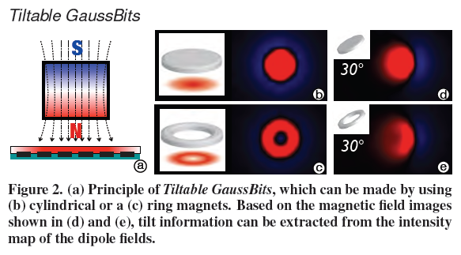
Types of GaussBits
The basic operations that can be performed with the Gauss-Bits are 3D translation, tilt, roll, and flip.

Slide 18
Title

Slide 19
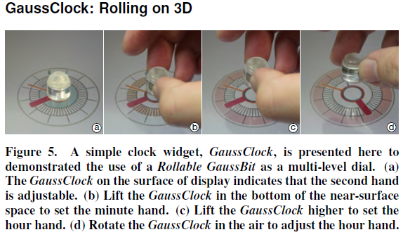
APPLICATIONS

Slide 20
Title

Slide 21
Combination with Other ID Techniques

Slide 22
Results and Discussion

Slide 23
SideBySide: Ad-hoc Multi-user Interaction with Handheld Projectors
Karl D.D. Willis
Ivan Poupyrev
Moshe Mahler
Scott E. Hudson
Disney Research
Carnegie Mellon University
Computational Design Lab
UIST’11

Slide 24
Abstract

Slide 25
On-device Sensing

Slide 26
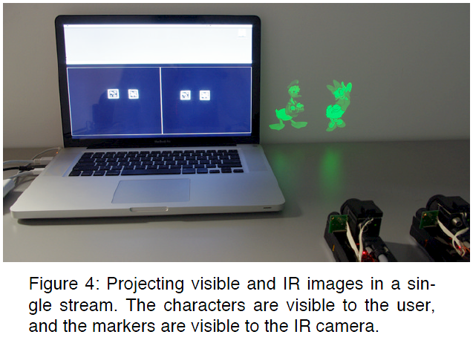
Title
Tracking visible projected images restricts the type of content that can be projected, we track invisible fiducial markers projected from the handheld projection device.

Slide 27
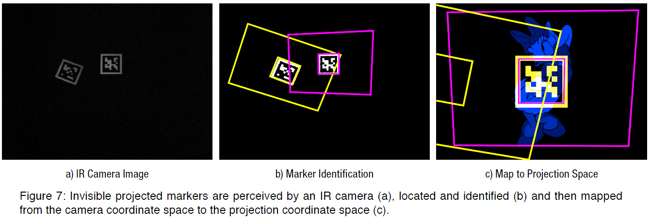
Combining Visible and Infrared Imagery
loading a monotone image into the red and green channels of an OpenGL frame buffer. The visible image is loaded from a separate monotone image into the blue channel using OpenGL’s additive blending mode.

Slide 28
Overlapping Markers

Slide 29
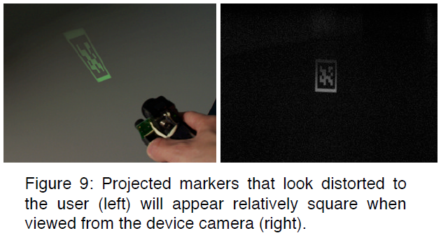
Title
Our marker recovery procedure continuously adapts to the changing environmental conditions by refreshing the stored image of the reference marker when there is no overlap,resulting in more robust performance.

Slide 30
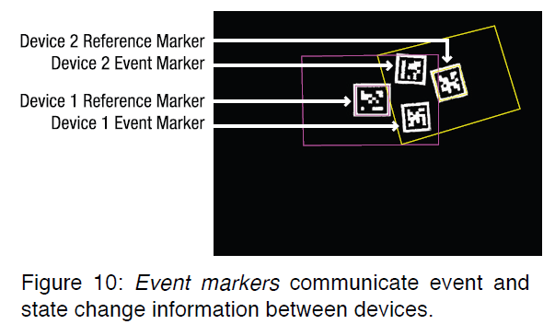
Optical Communication
To project dynamic event markers, the sender device firstly identifies an empty region in the projection frame.

Slide 31
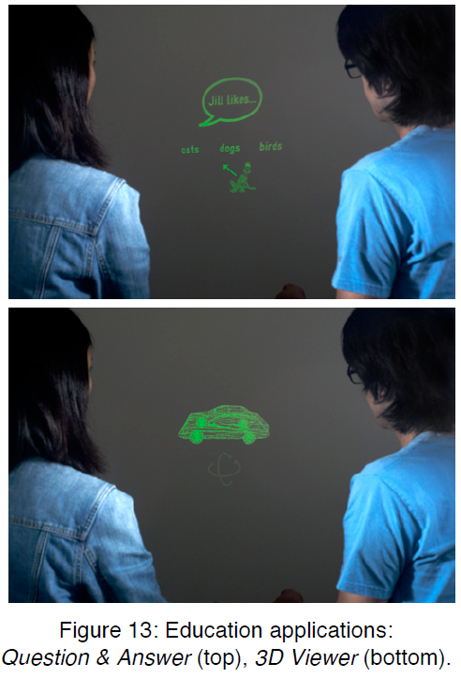
APPLICATIONS

Slide 32
APPLICATIONS

Slide 33
3D Puppetry: A Kinect-based Interface for 3D Animation
Robert T. Held
Ankit Gupta
Brian Curless
Maneesh Agrawala
University of California, Berkeley
University of Washington
UIST’12

Slide 34
ABSTRACT

Slide 35
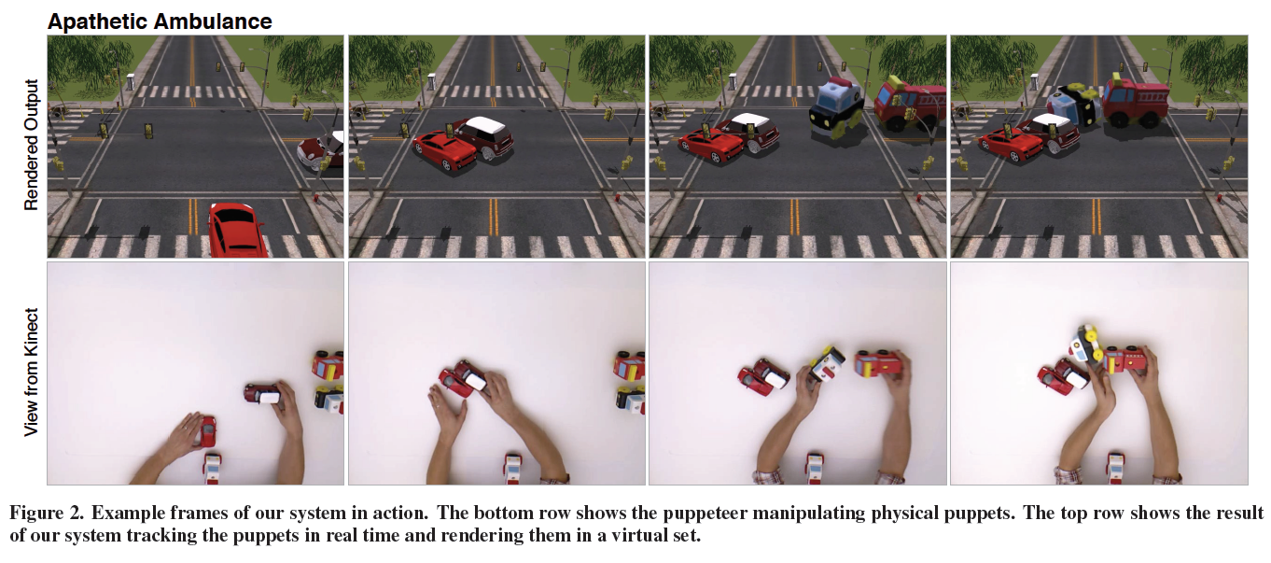
INTRODUCTION
We use the Kinect along with the ReconstructMe 3D scanning software to build virtual 3D models of each puppet as a pre-process.

Slide 36
恭賀老師
榮升正教授

Slide 37
Title
With tangible 3D puppets, the physics of the real world can help to produce natural-looking motions.
Our puppet-tracking algorithm does impose a few restrictions on puppeteers. It assumes that puppets are rigid objects it cannot track articulated joints or easily deformable materials such as cloth.
In addition, if puppeteers move the puppets very quickly over long distances our system can lose track of them.

Slide 38
SYSTEM OVERVIEW

Slide 39
Title
With tangible 3D puppets, the physics of the real world can help to produce natural-looking motions.
Our puppet-tracking algorithm does impose a few restrictions on puppeteers. It assumes that puppets are rigid objects it cannot track articulated joints or easily deformable materials such as cloth.
In addition, if puppeteers move the puppets very quickly over long distances our system can lose track of them.

Slide 40
Title
With tangible 3D puppets, the physics of the real world can help to produce natural-looking motions.
Our puppet-tracking algorithm does impose a few restrictions on puppeteers. It assumes that puppets are rigid objects it cannot track articulated joints or easily deformable materials such as cloth.
In addition, if puppeteers move the puppets very quickly over long distances our system can lose track of them.

