Slide 1
Multiscale Vector Volumes SIGGRAPH Asia 2012
Lvdi Wang, Yizhou Yu, Kun Zhou, Baining Guo
Tsinghua University, The University of Hong Kong, Zhejiang University, Microsoft Research Asia,
Tsinghua University

Slide 2
Overview
A compact vector representation for volumetric objects with
complex internal structures spanning a wide range of scales.

Slide 3
Key idea
Decompose a complex object into individual
volumetric components with respect to its multi-scale structure,
and preserve the boundary shape of each component in
a resolution-independent way.
This is achieved by hierarchically
dividing an entire volumetric object into multiple non-overlapping
regions using multiple continuous signed distance
functions (SDFs).

Slide 4
Challenge
Constructing high-quality digital models with complex volumetric property, we have to face 2 task.
-- how can we compactly represent volumetric structures and patterns spanning a wide range of scales
--how can we represent high-frequency features in a resolution-independent way

Slide 5
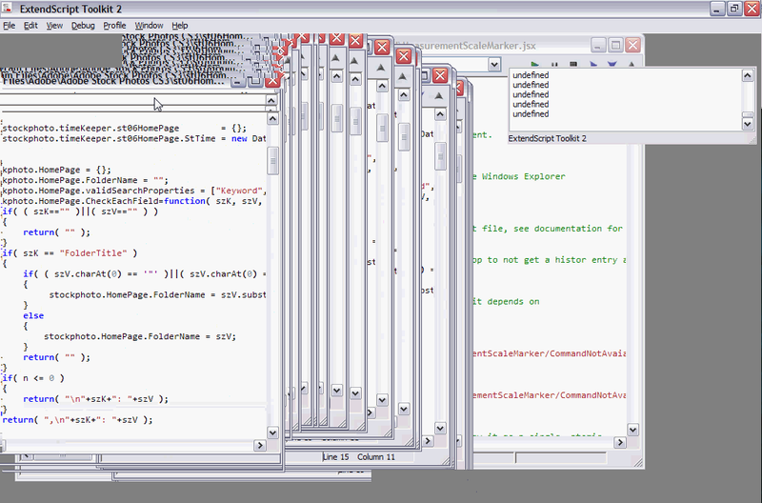
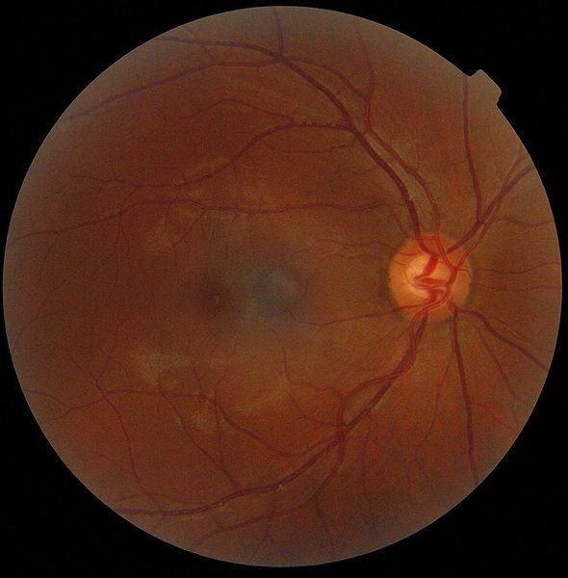
Challenge
Visual artifacts: Anomalies during visual representation of e.g. digital
graphics and imagery.

Slide 6
Volumetric object should be
Expressiveness:
It should be able to represent volumetric
objects with spatial structures spanning a wide range of
scales and including complex non-manifold features.
High frequency features should remain sharp during
magnification.
Ease of editing:
It should be easy and intuitive to
create novel objects and edit existing ones using this
representation.

Slide 7
Volumetric object should be
Random access:
To be able to provide a timely response to user
interactions, fast visualization is required, which further
demands efficient random access to the volumetric
content.
Compactness:
Given the limited memory on current graphics
cards, the representation should be as compact
as possible.

Slide 8
Comparison

Slide 9
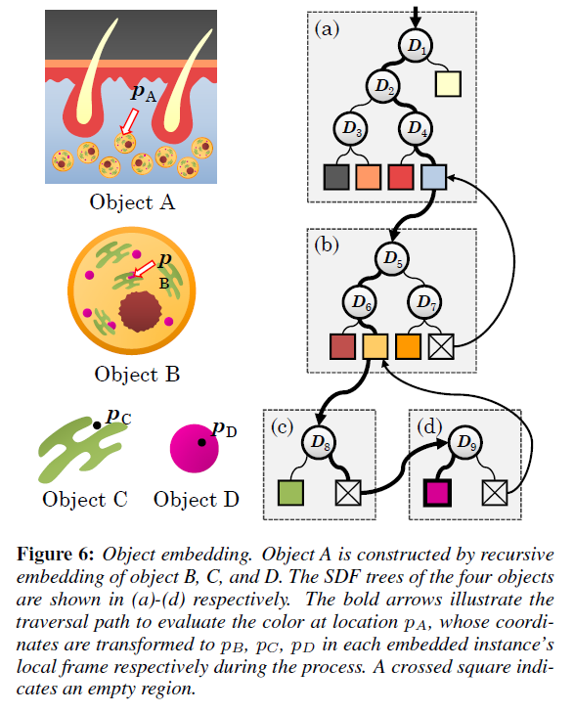
SDF tree
Limitation:
It can only divide a volume into two-colorable regions
The bold arrows illustrate the traversal
Path to evaluate the color at location Pa

Slide 10
Content creation
Planning stage
--rely on user’s knowledge to conceptually decompose the object in a hierarchical way
Creation stage
--User need to create the object and assemble them together into linked SDF tree

Slide 11
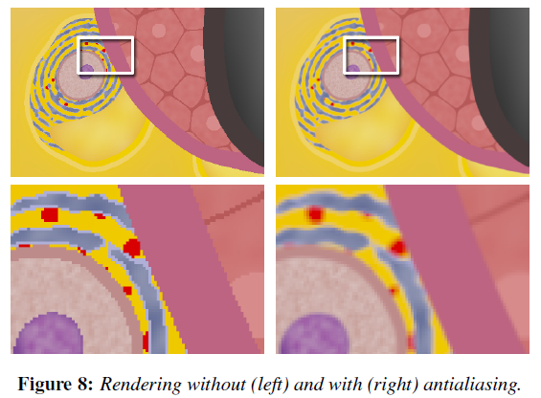
Rendering
Traverse the SDF tree to decide which region a location p belong.
Antialiasing

