Slide 1
Printing Reflectance Functions

Slide 2
Author
TOM MALZBENDER & RAMIN SAMADANI—
Hewlett-Packard Laboratories
STEVEN SCHER and ADAM CRUME--
University of California Santa Cruz
DOUGLAS DUNN--
3M
JAMES DAVIS--
University of California Santa Cruz

Slide 3
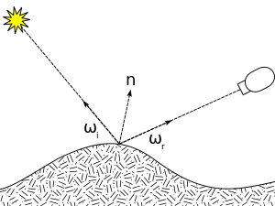
A real scene’s appearance at each point depends upon the incident
illumination, the surface Bi-directional Reflectance Distribution
Function (BRDF) [Nicodemus et al. 1977], and the local
surface orientation.
BRDF:
a four-dimensional function that defines how light is reflected at an opaque surface.

Slide 4
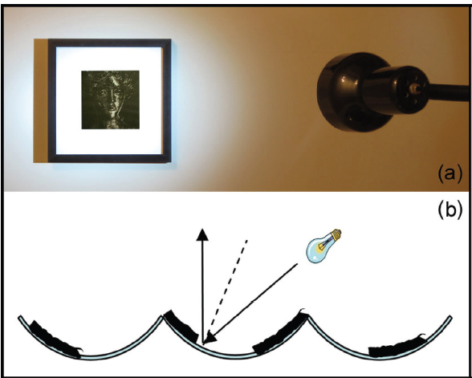
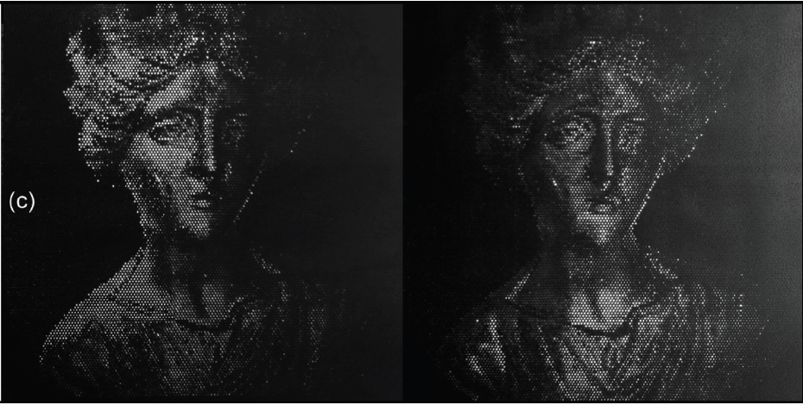
The paper consists of a hexagonal array of spherical depressions that have a specularly reflective surface.
By selectively printing opaque or partially opaque ink on portions
of that surface, we can control whether a specific incident
lighting direction returns a specular highlight, and to what
degree.

Slide 5
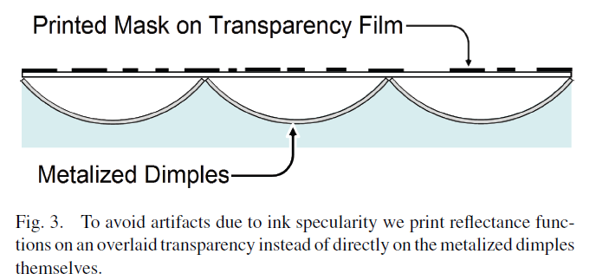
Mask
In this approach, specular highlights off the inks on the transparency film are in the reflection direction given by
the normal of the film, not the normals associated with the shape
of the metalized dimple.

Slide 6
Result

Slide 7
Video

