Slide 1
Manuel Lang Oliver Wang Tunc Aydin Aljoscha Smolic Markus Gross Disney Research Zurich ETH Zurich
Practical Temporal Consistency for Image-Based Graphics Applications
M10009113 張冠中

Slide 2
Abstract
An efficient and simple method for introducing temporal
consistency to a large class of optimization driven image-based
computer graphics problems.

Slide 3
Contribution
A simple novel approach for approximating a class of energy
minimization problems in image-based graphics using edge aware filtering.
An efficient implementation of this concept, extending existing work to enable temporal filtering that follows motion
paths, confidence values, and occlusion estimates.

Slide 4
Method(1/2)
The main idea of our method is in order to avoid costly global optimization,
we split up the data and smoothness terms and solve
them each in series.
unknowns J(x, y) are motion vectors, expressed as w(x, y) =
(u, v) corresponding to the motion between two images It and It +1
at pixel (x,y).

Slide 5
Method(2/2)
First initializing J with application specific initial conditions that
minimize Edata locally

Slide 6
Temporal Filtering(1/2)
We adding an additional pass of the separable box filter
that filters the temporal (T) dimension.
(T) filtering should follow the motion of points between
frames.
At any given frame, every output pixel belongs to exactly one path.

Slide 7
Temporal Filtering(2/2)
1) A path can leave the image boundary
--the path is ended and the sliding box filter stopped.
2) Multiple paths can converge on the same pixel
--when multiple paths collide, we randomly keep one while cutting the other off at the previous frame.
3) A pixel can have no paths in the previous frame that map to it.

Slide 8
Result
Confidence: For optical flow and disparity estimation, we use the feature
matching vector difference as a confidence weight.
Occlusions: We estimate both forward and backwards flows at each frame,
and apply a confidence penalty for each pixel I based on how well
the vectors match.

Slide 9
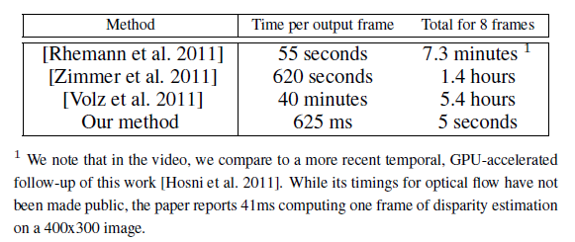
Performance
Times reported are for the task of computing eight frames of optical flow on a Middlebury sequence (640x480 resolution).

Slide 10
More

Slide 11
Video

