Slide 1
Application-oriented License plate recognition
Gee-Sern Hsu, , Jiun-Chang Chen, Yu-Zu Chung,
Department of Mechanical Engineering,NTUST

Slide 2
Abstract
Split the applications of vehicle license plate recognition(LPR) into 3 categories.
--Access Control
--Law Enforcement
--Road Patrol

Slide 3
Overview
Plate Detection → Character Segmentation → Character Recognition

Slide 4
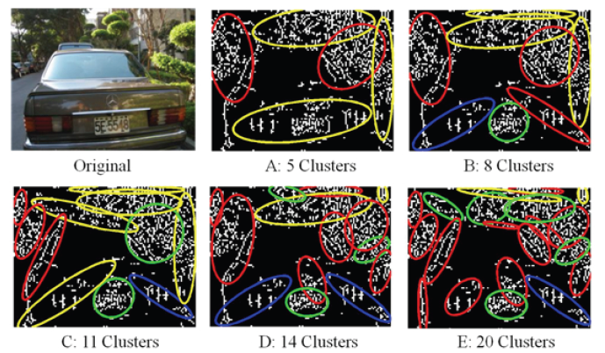
Plate detection
Yellow: Reject by size
Red: Rejected by shape
Blue: Rejected by density

Slide 5
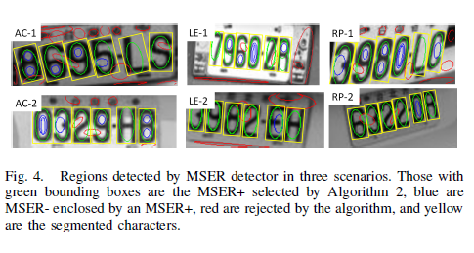
Character Segmentation
Maximally Stable Extreme Region(MSER)
{B,R,6,8} {C,G} {D,0} {E,F} {I,1} {U,V} {Z,2,7}

Slide 6
Result
Comparison of Plate Detection Rates
Method | AC | LE | RP
Proposed | 93% | 93% | 94%
Statistical Ranking | 81% | 70% | 72%
Edge-morph. + SCW | 87% | 81% | 77%
Comparison of Character Segmentation Rates
Method | AC | LE | RP
Proposed | 98% | 96% | 97%
Vec. quantization | 88% | 72% | 74%
Adap. morphology | 93% | 85% | 82%

Slide 7
Result
Comparison of Character Recognition Rates
Method | AC | LE | RP
Proposed | 95% | 93% | 94%
PNN | 92% | 88% | 91%
ANN | 90% | 86% | 90%
Tesseract | 96% | 83% | 83%

