Slide 1
Social behavior recognition in continuous video
Xavier P. Burgos-Artizzu, Piotr Doll´ar, Dayu Lin, David J. Anderson, Pietro Perona
California Institute of Technology,
Microsoft Research, Redmond,
NYU Medical Center

Slide 2
Abstract
Use continuous vedio to analyzing social behavior.
Use mice to build a database
-- Easier to study than human behavior
-- Easier to detect and track in a limited
space
-- more practical and ethical to set up experiments and collect abundant video of animals, rather than humans

Slide 3
Overview
Take 237 videos
Use 104 videos for training
Model
Use 133 videos for testing

Slide 4
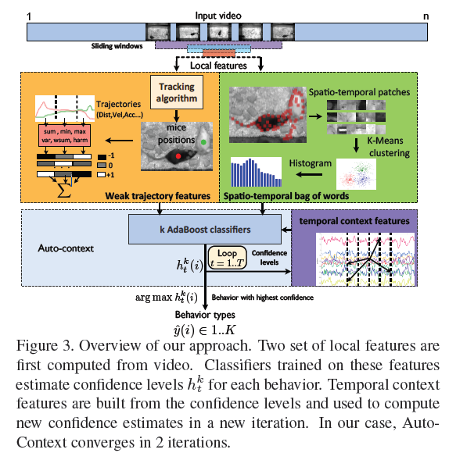
Overview

Slide 5
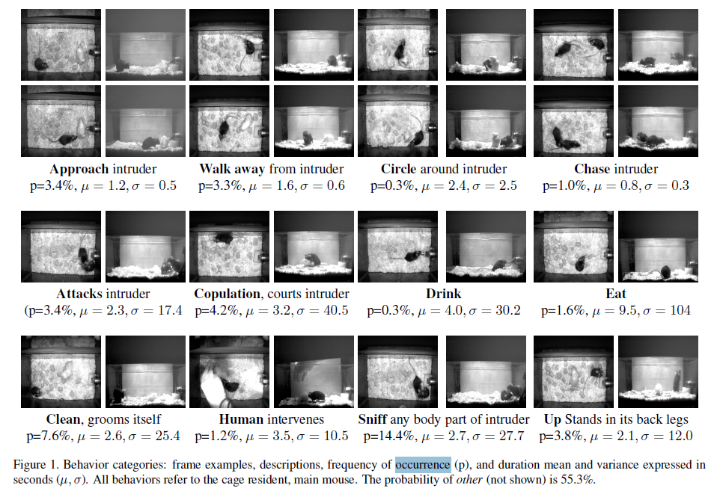

Slide 6
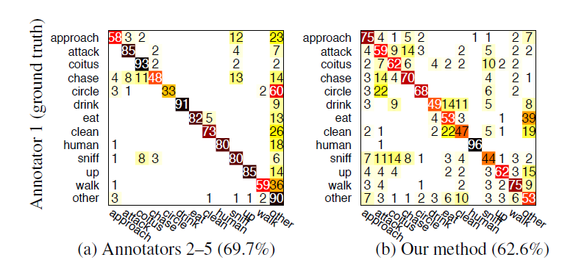

Slide 7
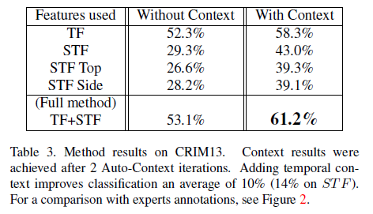
Result

