Slide 1
Development of Three Dimensional Digital Tourism Presentation System Based on Google Earth API
ICSDM 2011
Haifeng Huang, Wei Liu
China Three Gorges University

Slide 2
Motivation
With the development and maturity of digital earth technologies, digital tourism has become the inevitable trend of tourist industry.
Ecological-cultural tourism circle in western Hubei Province” is a regional development policy and planning, and was put forward by Hubei Province, central of China.

Slide 3
System Construction
KML:
Keyhole Markup Language，是基於語法標準的一種標記語言，採用標記結構，由Google旗下的Keyhole公司發展並維護，用來表達地理標記。根據KML語言編寫的文件則為KML文件，格式同樣採用的XML文件格式，應用於Google地球相關軟體中(Google Earth，Google Map, Google Maps for mobile...)，用於顯示地理數據(包括點、線、面、多邊形,多面體以及模型...)。而現在很多GIS相關企業也追隨Google開始採用此種格式進行地理數據的交換。

Slide 4
System Construction

Slide 5
System Construction
HD remote sensing images:
-- In China, GE only provides low resolution remote sensing data of 3-5 years ago, so it’s necessary to overlay HD remote sensing images of recent times.
Thematic vector data:
--exporting professional GIS vector data to KML files by using some specialized software, e.g. ArcGIS.

Slide 6
System Construction
3D modeling and overlays:
-- We use Google SketchUp to create 3D models.
Scene tours overlay:
-- All virtual scene roaming dynamic process according to customize travel route can also be saved as KML files.

Slide 7
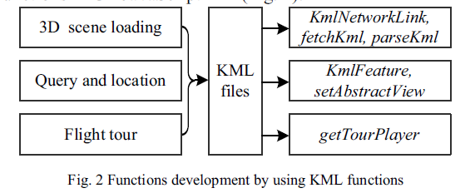
Functions Development
3D scene loading:
--GE Plug-in can import KML files which include all 3D scene data using three methods
KmlNetworkLink, fetchKml and parseKml.

Slide 8
Functions Development
Query and location:
--In GE API, all feature types include placemarks, overlays, tours, layers can be obtained by
KmlFeature interface functions such as getName. And system also supports flying to scenic spots by using setAbstractView function.
Flight tour:
-- We can easily create a tour easily by the function provided by GE Plug-in API.

Slide 9
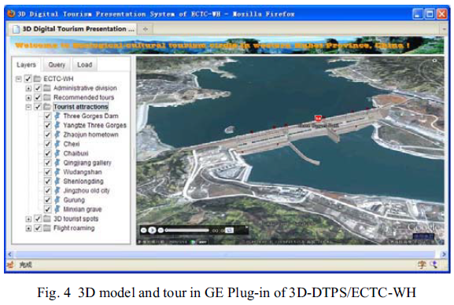
Result

Slide 10
Conclusion
As a relatively mature digital earth software and platform, GE has been widely used in various fields, and with the release of GE Plug-in and API, 3D web map applications which is just like 3D digital tourism presentation system
can be built easily and effectively.

