Slide 1
Integrated Videos and Maps for Driving Direction UIST 2009
Billy Chen, Boris Neubert, Eyal Ofek,Oliver Deussen, Michael F.Cohen
Microsoft Research , University of Konstanz

Slide 2
Overview
To make the first time navigating a route feel more familiar, they present a system that integrates a map with a video automatically
constructed from panoramic imagery captured at close intervals along the route.

Slide 3
Related work
To See But Not to See: A Case Study of Visual Agnosia 1987
Glyn W. Humphreys and M. Jane Riddoch
A paper discuss a patient who, because of an inability to form visual memories, has great difficulty finding his way along routes he commonly takes, even though he can draw a fairly accurate map of the route.

Slide 4
Related work
Differences in cue use and spatial memory in men and women.
C. Jones and S. Healy.
This paper show that women orient themselves more by remembering landmarks while man use more abstract features such as maps.

Slide 5
Related work
Movie-maps: An application of the optical videodisc to computer graphics.
SIGGRAPH 1980
Andrew Lippman
A seminal work in creating flexible video views of routes.

Slide 6
System Design(1/2)
Input: Driving Route & Landmark.
Landmarks along the routes are chosen, by hand, by indicating points on the map.
A typical landmark is a building corner near a turn.
In the future we expect that landmarks will be automatically chosen, based on proximity to important turns, known sites of importance, visual importance.

Slide 7
System Design(2/2)

Slide 8
Modulate speed
long straight sections of the route have the highest apparent speed.
Shorter segments are traversed slower and sections related to turns and landmarks are the slowest. (10 m/s)
Dj : The path length between landmarks j and j+1
Vj : velocity for the segment j to j+1
a : 200
b : 20
c : 500

Slide 9
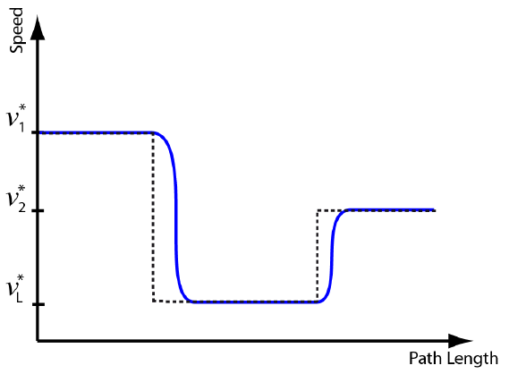
Modulate speed
We now have discontinuous target velocity, v*(s) defined at
All point along the path. The actual velocity is computed
iteratively starting from V0 = 0 and S0 = 0 and proceeding
At each frame f.
: Frame time
: 0.25
Sf : Path length.

Slide 10
Field of view
At each frame in the video we have full 360 degree panorama.
We have found from informal experimentation that a 90 degree FOV achieves a good balance between providing a wide enough FOV to provide side to side context while exhibiting only mild wide angle distortion.

Slide 11
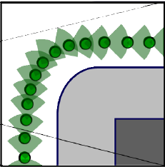
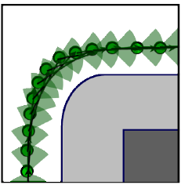
Orient Video
The intuitive choice is to center the 90 degree window on the direction of travel. However, this produces rapid, disconcerting swings in orientation at turns.
We do this by always orienting the view towards a point on the path 25 meters ahead.

Slide 12
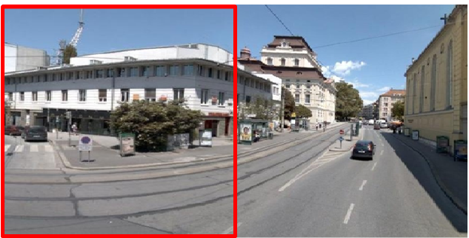
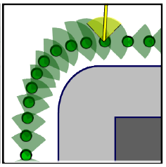
Widen FOV
We widening the view and freezing the landmark thumbnail.

Slide 13
User Interface
Scenarios:
1.Play the route video.
-- User receives a quick summary of the entire route.
2.Interactively select and play the route video.
-- User drives into more detail about individual route segments.

Slide 14
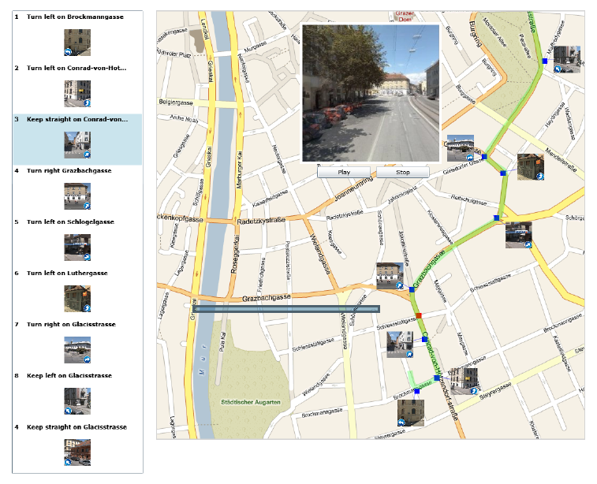
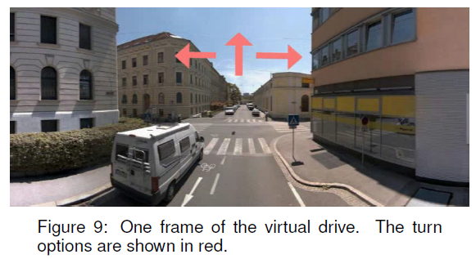
User study

Slide 15
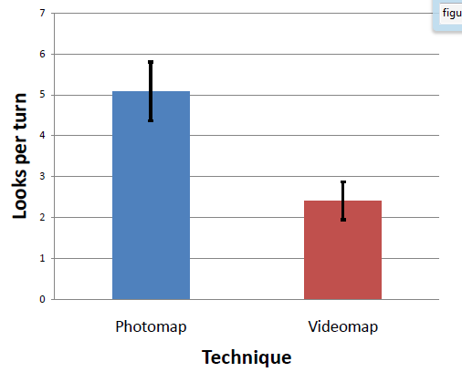
User study

Slide 16
User study
1.
When driving video simulation, I needed the printed map
and directions to navigate the turns.
2.
When driving the video simulation, I needed more time
To decide each turn.

Slide 17
Video

Slide 18
Conclusion
We have demonstrated a prototype that combines maps with imagery assembled into a video to depict driving a route to help a user in wayfinding along the route.
How long does the visual memory from the application
last?
How will lighting differences effect the outcome?
How will the differing modalities between viewing a video
and actually driving in a car effect the usefulness of the
video?
How long a route can one retain in memory?

