Slide 1
Integrated Google Maps and smooth street view videos for Route Planning
ICS 2010
Chi Peng, Bing-Yu Chen, Chi-Hung Tsai
National Taiwan University, Institute for Information Industry

Slide 2
Motivation
It is inconvenient to use Google Maps with Street View to watch a route, because the users need to keep pressing the “forward” button to jump from one panorama image to the next one step by step.

Slide 3
System Overview

Slide 4
Collecting Data
Calculate Route:
-- Connect to Google Maps to calculate the route of the trip.
Tracing along the route:
-- Use Google street view to trace all the way from the starting point to the destination.
Get street view panorama:
--Download all panorama images and their information according to the panorama ID.

Slide 5
Preparing Data
Decide facing direction in each panorama:
--we use Direct3D to draw a sphere around the camera and apply the spherical panoramas as a texture image on it. Notice that the camera needs to be adjusted by the three values of <pano_yaw_deg>, <tilt_yaw_deg>, and <tilt_pitch_deg> we recorded before to make it correct and coincidence with the <heading> value.

Slide 6
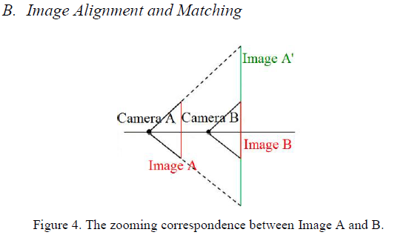
Preparing Data
Align every image with each other:
→We assume moving forward is like ”zoom in”
--To align Image A and Image B, SIFT is used. Then, we use RANSAC to find the transform function to match the Image B into the middle of Image A.

Slide 7
Preparing Data
Blend every aligned image together:
--In order to paste one image to another in a seamless way. To further reduce the seam between the images, the minimum error boundary cut is used. By this algorithm, we can find the best crop line between the images to make the artifact of blending even less obvious.

Slide 8
Preparing Data

Slide 9
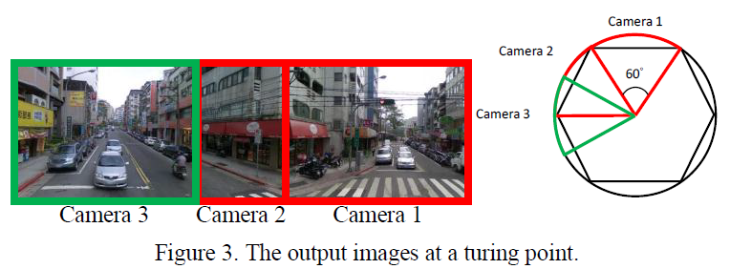
Preparing Data
Handle turning:
1. we take the image with the heading direction opposite to where we came from as the starting image.
2. We take the next image after turning 60 degree and stitch it with the initial one.
3. we continue turning the camera until just one final turn of the camera before we are facing the direction of the next panorama.

Slide 10
Output
Generate output video:
-- Zoom in from the first image toward the second one which stitched in it while alpha blending the two images at the same time. After we zoom in to the second image, do the same thing with the third image, etc. Some special cases are also needed to be handled like turning at this time. After this step, the route guiding video is generated.

Slide 11
System interface

Slide 12
Result

Slide 13
Result:Failure case

