Slide 1
Automatic Street View Walk-through System Using Characteristics of Modified Maps
W2GIS 2011
Kaori Kobayashi, Daisuke Kitayama, and Kazutoshi Sumiya
University of Hyogo, Japan

Slide 2
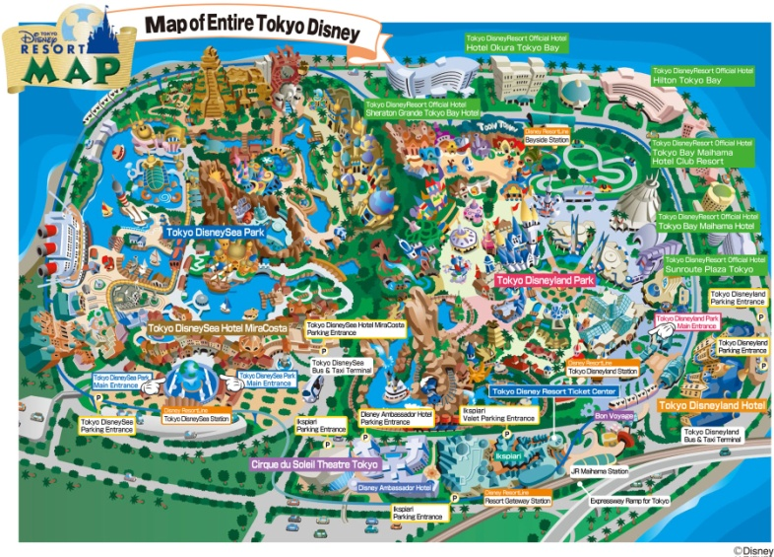
Motivation
Modified maps are simplified to suit a specific purpose.
However, people cannot visualize the appearance of the station exit and the surrounding buildings. Therefore, we propose a system for transforming modified maps into streaming video based on the features of modified maps.

Slide 3
System overview

Slide 4
Analysis of Modified Maps

Slide 5
Analysis of Modified Maps

Slide 6
Analysis of Modified Maps
Determination of types of modified maps
Route Maps:
-- Maps that show some paths between 2 nodes.(Paths are important for route maps)
Object Maps:
-- Maps that show various maps.(Nodes are important for object maps)
Mixed-feature Maps:
-- Maps that show nodes existing in the vicinity of paths.(Paths and Nodes are both important.)

Slide 7
Analysis of Modified Maps

Slide 8
Transforming Modified Maps into Streaming Video

Slide 9
Transforming Modified Maps into Streaming Video

Slide 10
Transforming Modified Maps into Streaming Video

Slide 11
Conclusion
We proposed a concept of a system for transforming a modified map into a streaming video based on the features of the modified map.
In the future, we intend to develop the system and examine the effectiveness of the styles for showing street view based on the type of each modified map. In addition,
we are going to discuss other relations among geographical objects, such as those among landmarks and inclusive relations.

