Slide 1
An Evaluation of Multiobjective Urban Tourist Route
UCAml 2012
Inmaculada ayala
Lawrence mandow
Mercedes amor
Lidia fuentes
Dpto. Lenguajes y ciencias de la computación
Universidad de málaga

Slide 2
Overview
This paper evaluates the performance of a multiobjective interactive
urban route planner that calculates walking routes for tourists in urban
areas.
The system allows tourists to choose a walking route between two locations that is short, but at the same time traverses interesting tourist areas.

Slide 3
Multi-criteria decision making
Multiattribute Utility Theory
--Combine all available attributes ai(x) in a weighted linear function
U(x) = w1a1(x)+w2a2(x)+…+wnan(x)
Contextual information
-- All areas are tagged with a set of keywords(shopping, history…)

Slide 4
Multi-objective route planner
U(x) = w1*f1(x) + w2*f2(x)
Minimize the physical distance to be walked f1(x)
Minimize the portion of this distance through uninteresting urban areas f2(x)
Wi are actually reached interactively for each user and problem instance after a simple process of binary refinement decisions.

Slide 5
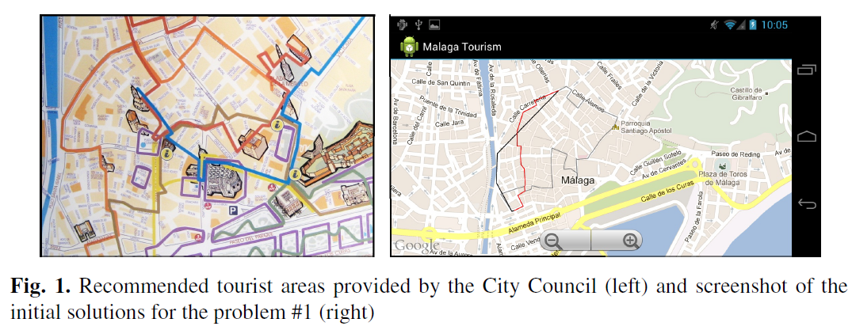
Result
20 route planning problems was generated choosing random origin and destination
Points in the recommended tourist areas.

Slide 6
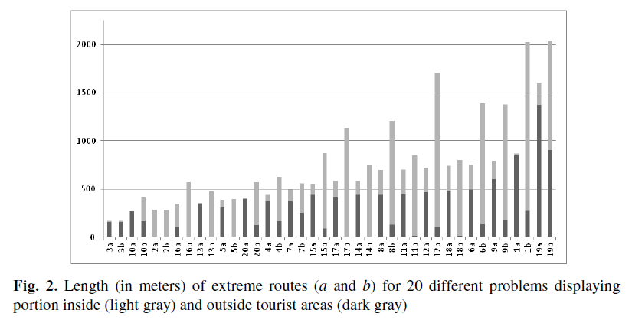
Result
A : Minimizes distance
B : Minimizes walking distance outside recommend area
Light gray(inside tourist area) Dark gray(outside tourist area)

