Slide 1
Which cities produce more excellent papers than can be expected?
JASIST 2011
Lutz bornmann
loet leydesdorff
max planck society, hofgartenstr munich,
Germany
Amsterdam school of communications research,
university of Amsterdam

Slide 2
Overview
We explore new methods to analyze the geographic distribution of highly-cited papers.
This method is relatively straightforward identification of cities and regions with high output.

Slide 3
Method
Focus on Top 10 in 2008 (Chemistry)
Document type: Article
Time span: All year
CHEMISTRY, ANALYTICAL (1,227 articles)
CHEMISTRY, APPLIED (870 articles)
CHEMISTRY, INORGANIC & NUCLEAR (670 articles)
CHEMISTRY, MEDICINAL (560 articles)
CHEMISTRY, MULTIDISCIPLINARY (4,513 articles)
CHEMISTRY, ORGANIC (1,349 articles)
CHEMISTRY, PHYSICAL (2,418 articles)

Slide 4
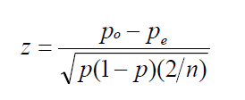
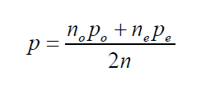
Method
Z test
Pe = 0.1
P0 = n0/0 (n0= number of observed paper of this category)
ne = n/10

Slide 5
Method
z is positively :the observed number of top papers is larger than the expected number .
Z is negatively: the observed number of top papers is smaller than the expected number .

Slide 6
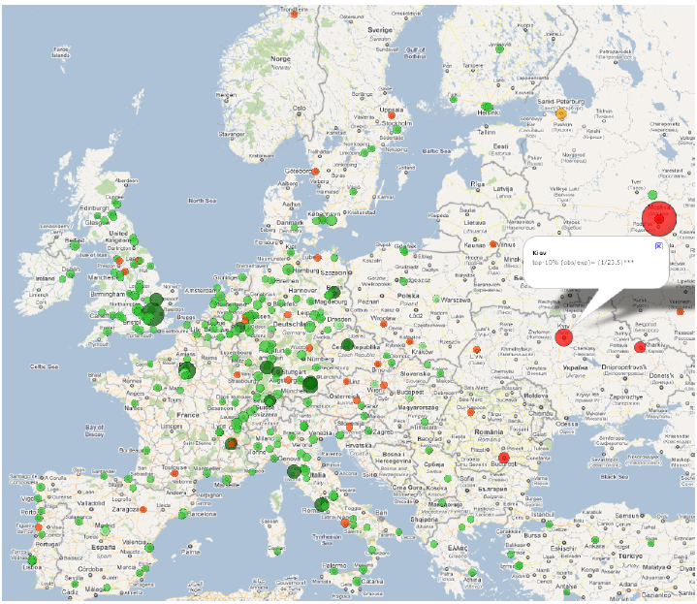
Result
Green : observed values are larger than the expected value.
Red: observed values are smaller than the expected value.
Radii: |observed value – expected value|(e.g., Costas, Bordons, van Leeuwen,
& van Raan, 2009; Seglen & Aksnes, 2000 )

Slide 7
Result
http://www.leydesdorff.net/topcity/figure2.htm

