Slide 1
Using Weather Information to Improve Route
AGILE conf. 2012
Paul litzinger
Gerhard navratil
Åke sivertun
Daniela knorr
University of applied sciences technikum wien
Vienna university of technology
Swedish national defence college
UBIMET gmbh

Slide 2
Overview
The traditional approach considers legal speed restrictions only.
The approach using static weather information determines
realistic driving speed based on the actual weather conditions

Slide 3
Weather and it’s influence on traveling
Influence of weather events on the roadway and traffic operations

Slide 4
List of speed and capacity reduction

Slide 5
Ubimet provided Real weather data.
Ubimet: Ubimet not only uses public weather data but also
accesses the data of the largest private weather observation
network in Central Europe
Data formats:
Gridded Binary – 6hr update (10km)
Network common data format – 1 hr update (4km)

Slide 6
Route planning using weather information
Uwind = |U| + |V| + |UST|
DegreeCelisus = Kelvin – 273.5
The values for wind speed, temperature, and precipitation were then reclassified
to match the categories in Table 2 and provide values for speed
reduction.

Slide 7
Route planning using weather forecast data
While the static weather routing uses
only one weather situation, the dynamic approach includes the hourly updated
weather forecasts.

Slide 8
Route planning(Assumption)
Drivers move with an average speed equalling the speed limit.
The interval of the weather forecast data is 1 hour.
The road network consists of highways with a speed limit of 130 km/h.
Service areas: black rings
Start position: black dot
Different weather condition: grey area
Road network : black lines

Slide 9
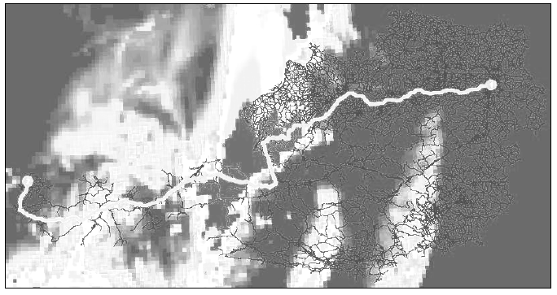
Result
Old route
New route

Slide 10
Result

Slide 11
Result

