Slide 1
Google Map Based User Interface for Network Resource Planning in Post Disaster Management
ACM DEV 2013
Sujoy saha
Nitin agarwal
Priyam dhanuka
Subrata nandi
National institute of Technology durgapur, india
Institute of engineering & Management kolkata, india
National institute of Technology durgapur, india

Slide 2
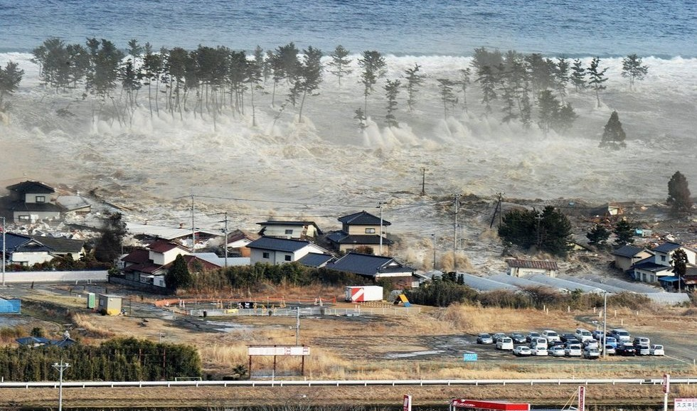
Overview
Disaster strikes will jeopardized existing network infrastructure.
Ensuring higher packet delivery ratio along with optimal utilization of resources are prime objectives of such planning.

Slide 3
Four tier hybrid architecture
SP: Shelter Points
WT: Wi-Fi tower
DM: Data Mules
DB: Drop Box
DTN: Data transaction node

Slide 8
Four tier hybrid architecture
1. Finding the optimal number of groups along with the placement of Wi-Fi tower on each Group Center.
2. Finding the minimum number of DMs required for each group to traverse those within Latency & finding the pathways of each DM.

Slide 9
Google map API

Slide 10
Conclusion
Rescue team can rapidly determine the optimal resources required for setting up communication system ensuring higher packet delivery ratio within acceptable latency.

